Slide 1


About the Team Development Program

Slide 2

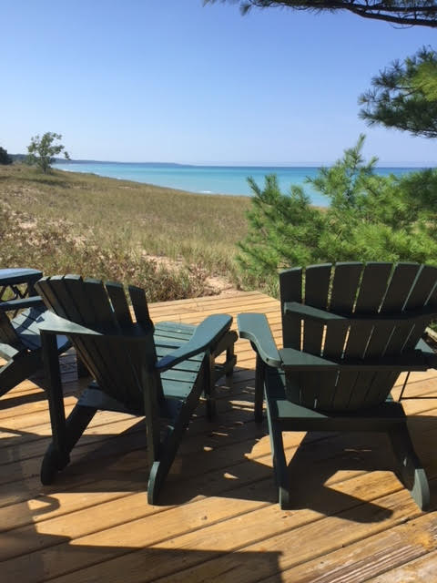



One Minute
Introductions
Upload profile picture
Upload a picture about your life outside of work
About You
Sue Cain
Pentwater!
One comment about your picture: I have 4 kids; one grandchild. And spend time in Chicago and Pentwater, Michigan. I am on faculty at Benedictine University and maintain a limited private practice. I love kids, dogs, chocolate and any museum. A strength team members can count on you for: I am a process consultant and love to facilitate rather than teach.
Share one recommendation: Visit your learning site and read the updates at https://www.corplearning.com/pk-client-services-team/

Slide 3
Team Development - Purpose
Main purpose is to get better team results
Bonus if your team can find out how each member can feel more connected, engaged, and useful to the team
Even better if you can learn to support each other’s strengths and challenges, engage in healthy conflict and embrace a common purpose and set of clear guidelines
To do that we have organized a series of short sessions to help you do your best thinking…

Slide 4
Program Overview
1. Tue. 19 July 2022, 1:00- PM – 3:00 PM
1. Getting started: Find out about team member’s DISC styles, strengths and challenges and how to best support each member.
2. Tue. 16 Aug. 2022, 1:00 PM -3:00 PM
Who are we? Building clarity around team mission and direction, shared values, and operating norms.
3. Tue. 13 Sep. 2022, 1:00 PM –3:00 PM
How can we work together most effectively? Building collaboration skills to give and get information and support (inside and outside the team).
4. Tue. 11 Oct. 2022, 1:00 PM-3:00 PM
How can we resolve conflicts? Building clear communication and resolving conflicts (inside and outside of the team).
5. Tue. 15 Nov. 2022, 1:00 PM –3:00 PM
Where do we go from here? Building an action plan to ensure commitment to high quality standards and results.

Slide 5

Questions?

