Slide 1
DISC Professional Styles Understanding DISC: A self-help guide

Slide 2
Cornerstone Principles of DISC Theory
All styles are equally valuable and can be equally effective.
Understanding yourself better is the first step to managing your intentions and making the impact you want.
DISC is a learning assessment, measuring preferences, not abilities.
You can and have learned to flex your style to accommodate changes in your environment.

Slide 3
Let’s Take a Closer Look at the Styles
Guide P. 6

Slide 4
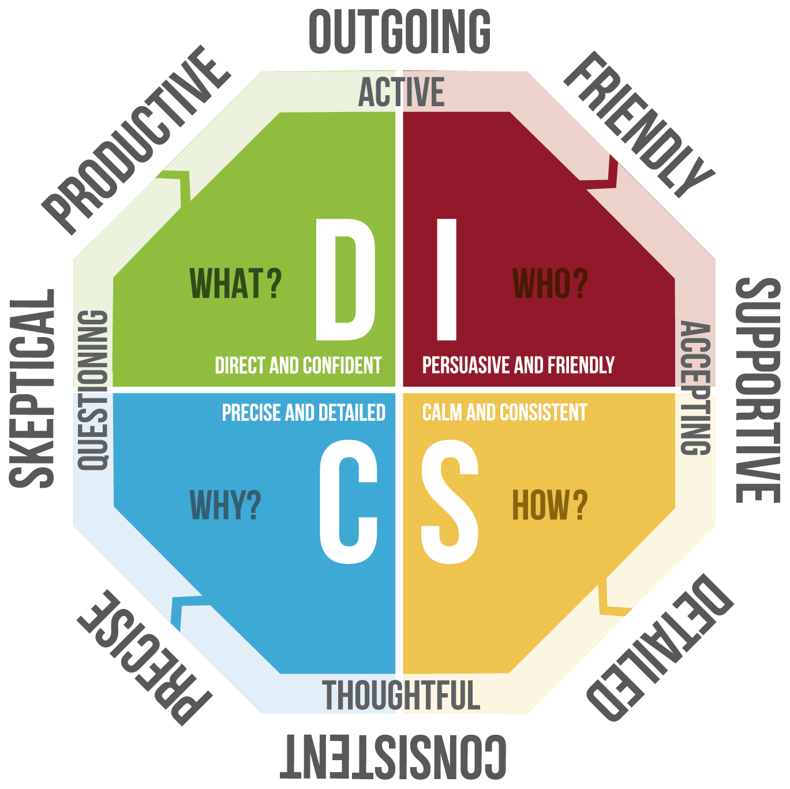
The D, Direct and Confident Style focuses on what needs to be done.
This style is characterized by being:
Productive
Outgoing
The D style takes risks and initiate's action.

Slide 5
The I, influential, Persuasive and Friendly Style focuses on who needs support.
This style is characterized by being:
Outgoing
Friendly
Supportive
The I style is enthusiastic and collaborative.

Slide 6
The Steady, Calm and Consistent Style focuses on how things needs to be done. The style characterized by being:
Supportive
Detailed
The Steady Style likes to
focus on understanding how to proceed to ensure
stability and reduce risk.

Slide 7
The C, Conscientious, Precise and Detailed Style and Confident Style focuses on why things need doing.
This style is characterized by being:
Precise
Skeptical
The C style works to ensure accuracy and ensures that
they know why to proceed before acting.

Slide 8
Benefits
C: Precise
C: Overly critical
S: Overly cautious
I: Too giving
Challenges
S: Dependable
I: Supportive
D: Productive
D: Too urgent
DISC Style Benefits &
Challenges

Slide 9
Learn to Flex your Style
If you are a: | Reduce your overemphasis on: | And be more:
High “D” | Controlling people and conditions in your environment | Patient; accepting; open to others; listening in your approach.
High “I” | Approval from others your primary source of direction | Task-focused; open to facts and data; prepared; organized.
High “S” | Resistance to new ideas and opportunities and “risk-free” choices | Direct with your opinion; negotiable; open to change; quicker to adapt.
High “C” | Perfectionism; the weaknesses of others and yourself. | Flexible in problem-solving; open to views of others; empathic.

Slide 10
Review What steps can you take to optimize your impact?

