Slide 1
Manager Training Session

Slide 2
Welcome
The Compassion in Action Program was designed to help partners live the Moorings Park Mission and Values, learn essential skills for managing healthy aging, optimize their delivery approach and feel empowered to deliver “WOW.”
To empower partners to provide Simply the Best services to create the joy, satisfaction, and happiness vital to everyone in the Moorings Park communities.

Slide 3
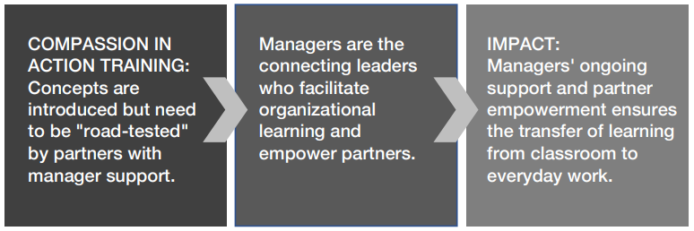
Your Role

Slide 4
Icebreaker: Mingle, Mingle
Mingle, mingle is an activity to share and communicate perspectives.
Please find 2 or 3 others to stand with.
You will be asked question to answer.
After you answer, you will break and find a new team.

Slide 5
Question 1
According to Harvard Business Review, managers are the engine of a business, making things work, the glue that keeps organizations together. Weigh in. Is that true here at Moorings Park for you?

Slide 6
Question 2
HBR also found that the most effective managers mediate and find common grounds between actors at different levels in the organization. The term they use is that you are “connecting leaders” of the organization. What can you do as a “Connecting Leader” to ensure the success of the Compassion in Action program for everyone in the Mooring Park communities?

Slide 7
Question 3
When you consider that the goal of the Compassion in Action program is “to empower partners to provide Simply the Best services,” what can you do to empower the partners you lead?

Slide 8
Question 4
How is empowering others different than delegating?

Slide 9
Question 5
How good are you at empowering
others on a 1-10 scale (with 10 high)?

Slide 10
Question 6
Will you need to adapt your management approach or develop any new skills to ensure that you empower partners?

Slide 11
Question 7
If you can imagine that it is a year from now, and everyone in the Moorings Park communities has really benefitted from Compassion in Action training, what would you see, feel, and hear that is different from today?

Slide 12
Group Discussion
What would you see, feel, and hear a year from now if the Compassion in Action Program is very successful?

Slide 13
Your Important Role as a Connecting Leader (Manager)
1. Help yourself and others find ways to buy-in and support the Compassion in
Action program guidelines.
2. Help partners apply skills through discussions, manager huddles and coaching.
3. Provide ongoing support to partners to ensure successful application of skills.
4. Trouble-shoot and circle back on problems and challenges partners have to
ensure that the program goals are achieved.

Slide 14
Understanding the Compassion in Action Program and Impact on Partners
Topic
Our Shared Mission and Values
Our Best Friends Culture
An Insider’s Guide to Supporting the Aging Process
You are Empowered to Deliver WOW
Turning Problems into Solutions
Module
1
2
3
4
5
Table Discussion: Your role is to reinforce the program content.

Slide 15
The Importance of Autonomy, Mastery, and Purpose
Watch the video:
https://www.youtube.com/watch?v=u6XAPnuFjJc
Group Discussion:
Times are changing. What can you do as a connecting leader to ensure that you provide autonomy, mastery and purpose for the partners you lead?

Slide 16
What You can do to Support the Information in Each Training Section
Here are 6 actions you can take to support the learning content from the Compassion in Action Program.

Slide 17
Our Shared Mission and Values
Repeat the mission often and ask partners to offer an example of how they can “live” or “apply” both the mission and vision.
Coach them on examples if needed.

Slide 18
Our Best Friends Culture
Share the bullet points in the Best Friends training section, and in team meetings ask for examples of how the team can apply the concepts to teamwork.

Slide 19
An Insider’s Guide to
Supporting the Ageing Process
Ask partners how they have directly supported residents who have vision, hearing, balance, dexterity, dementia, or depression challenges.

Slide 20
You are Empowered to Deliver WOW
Work at asking partners how they would like to approach tasks.
Provide a clear goal, then give some latitude in the way the partner approaches the task.
Discuss the outcome and help them apply learning for the next opportunity. This promotes autonomy and mastery.
Seek ways to reinforce WOW actions. This promotes purpose.

Slide 21
Turning Problems into Solutions
Reinforce LASSIE by reviewing the LASSIE steps to
service recovery and offering examples of how to use it in
your department.

Slide 22
Learn to Differentiate
Between Delegating and Empowering
The most important function managers can perform is to increase partner’s ability to engage in active delegation and empowerment.
Partners who are ready for delegation are much more productive, accountable, and engaged.
In short, they feel empowered to do the right things. How can you help partners develop from unready to ready to be empowered?

Slide 23
Exercise: Delegation Poker
Consider the seven levels of delegation using the cards on your table.
Review the following case studies and decide which delegation style matches the case study.
Keep track of your individual points to see who wins at the end of the match.

Slide 24
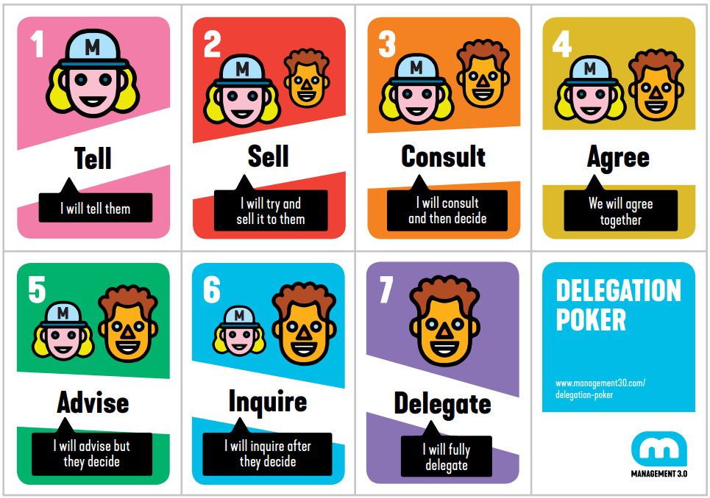
The Seven Levels of Delegation
The following are seven levels of delegation:
1. Tell: I will tell them
2. Sell: I will try and sell it to them
3. Consult: I will consult and then decide
4. Agree: We will agree together
5. Advise: I will advise but they decide
6. Inquire: I will inquire after they decide
7. Delegate: I will fully delegate

Slide 25
Directions
1. A case study will be displayed on the screen.
2. Each player responds to the case study by choosing one of the seven delegation cards privately, reflecting on how he/she would delegate the decision in that situation.
3. Once all players have decided, they can then reveal their selected cards.
4. Everyone earns points according to the value of their card.
5. The partners with the highest and the lowest cards explain the reasoning behind their choices.
6. Keep track of your points.
7. There will be 5 rounds of case studies.

Slide 26
Delegation Poker Case Study 1
Johnny has been working for your department for 20 years. He has been a star player in the past but has periods of low motivation. Recently he seems to be unmotivated again. What style do you use?

Slide 27
Delegation Poker Case Study 2
You have a new employee who can’t seem to understand how to perform the requirements of her job. She seemed very eager when she was first hired.

Slide 28
Delegation Poker Case Study 3
Mario has surprised you. He has been with your department for five years. He is always coming up with great solutions to problems and is truly committed to his job. But sometimes he goes too far with a risky innovation, and it backfires.

Slide 29
Delegation Poker Case Study 4
Maria is a great, consistent employee. She really blends in well and is always there when you need her. However, she backs down when a challenge presents itself. Maria does not like change, and you have several planned changes coming up that will affect her.

Slide 30
Delegation Poker Case Study 5
You don’t really trust David. He is smart, assertive and fast. He accomplishes things that normally require two employees. But he can rub you the wrong way. Sometimes you think he wants your job.

Slide 31
Tally your Points!
The object of the game is to become more aware of your delegation style, and how to best delegate and empower others.
Knowing your preferences is the first step to becoming more effective at delegation.

Slide 32
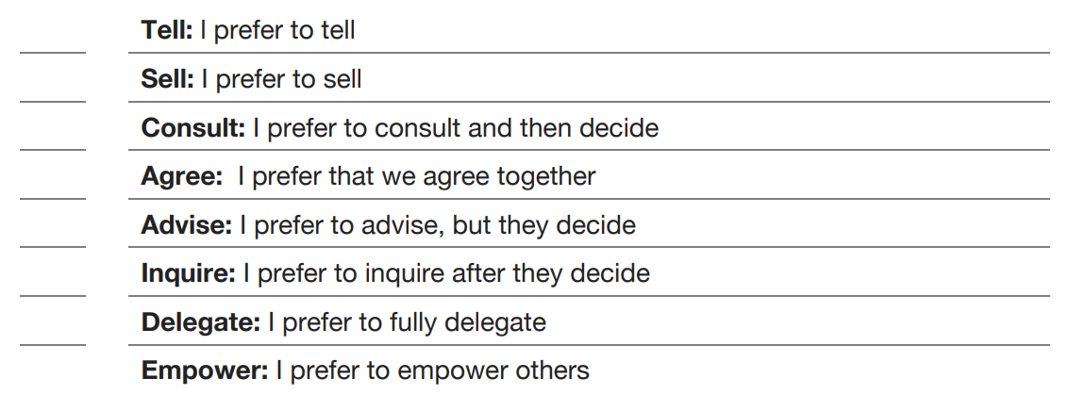
Self-Assessment:
Assess your Preferred Delegation Approach
Number your
most-least preferred
approach from 1-8
____

Slide 33

Table Discussion
The Compassion in Action program supports the notion of partner empowerment.
This in turn creates a sense of autonomy, mastery and purpose for partners.
Share your preferred approach.
What are your strengths as you think about your preferred approach?
What are your challenges as you think about your preferred approach?
Regardless of your preference, how can you improve your empowering skills?

Slide 34
Key Differences Between Delegating and Empowering
Delegation is often task-based, giving employees the opportunity to act on your behalf as their manager.
Empowerment allows partners to act on their own behalf so that they can take initiative and make decisions. Navigating between delegation and empowerment can be tricky.

Slide 35
Delegating Skills
Delegation is--:
Useful for assigning short-term tasks, tasks of high importance (where employee skill is low), technical or low-human touch tasks.
Useful for distributing work across a team.
Useful for maintaining control over an outcome with no or little authority granted .
Useful when partner development is secondary.
Useful when there is little time for the task to be completed.
Useful when there are very tight parameters for success.
Useful when someone must represent you.
Use These
Delegating Words:
Plan to…
The project requires you to…
Start…and complete…due by…
Your job is to…
To be successful, do this…

Slide 36
Table Discussion
How are you doing on a 1-10 (10 high) with the idea of supporting the Compassion in Action program as a manager?
Can you share an example of a time you recently delegated a task?

Slide 37
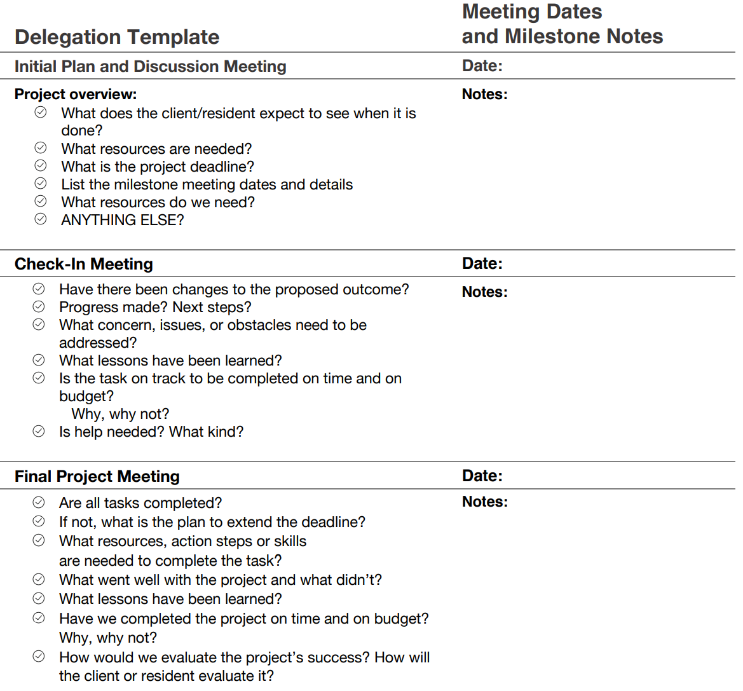
Delegating Template

Slide 38
Table Discussion
If you are having a difficult time delegating, consider using a template like this.
How can a more structured approach help you delegate and empower effectively?

Slide 39
Empowerment Skills
Empowerment IS:
Useful for developing skills in partners and teams
Useful for building confidence
Useful for building long-term skills and capabilities
Useful for letting go of control over an outcome with increased authority granted
Useful when partner development is critical
Useful when there is more time for the task to be completed
Useful when there are broader parameters for success
Useful when you want the partner to feel ownership and responsible
Use These Empowering Words:
Let me describe what the goal and what success looks like here…
What do you think is important to do to make sure
that this task is completed?
If the project must start now, what do you need to do, and when?
Here is the task, what is your role?
And how will you approach this task?
To be successful, what can you do to ensure this is done well? How would you like to approach this task?

Slide 40
Table Discussion
Can you share an example when you recently empowered a partner?
Which approach are you better at, delegating or empowering?
Which do you need to improve at?

Slide 41
Empowering Others: Key Indicators
Grow your Empowerment Capabilities:
Key indicators that you're off target (and wearing a manager’s hat and using delegating instead of empowering!)
You are assigning work tasks to the team. You focus more on your to-do lists — the completion of the tasks — and less on the person.
You are allowing someone to represent you by acting on your behalf without truly granting them authority.
You are issuing direct assignments that offer little opportunity to grow. Hence, development is secondary.
You are likely still focused, at some level, on control, especially if you're setting upfront protocols for what/how to do tasks and checking up on how the work is getting done.
Through these actions, you're only empowering yourself — getting things done which you otherwise would have not been able to do alone. While this means less work for you in the short run, it can also turn into more work for you in the long run.
It also ensures that you are your own leadership legacy — for good or ill. It holds you at the center of leadership activity and allows you to raise more followers, but not to cultivate leaders within your organization.

Slide 42
10 Tips for Empowering Others
1. Give your followers enough space to represent themselves and take initiative.
2. Give decision-making responsibility and ownership to them.
3. The development of your followers and their growth should become one of your primary focuses.
4. Have a support-learn-apply mindset in place to ensure the team’s success.
5. Work to gain a comfort level with your followers’ capability, and in turn, empower them more.
6. Establish a regular back-and-forth question and answer dialogue with your followers and watch your focus on guidance take the place of your need to control.
7. Empowering your followers is time-consuming and complicated work in the beginning, especially when you must give problems back to followers to solve themselves.

Slide 43
10 Tips for Empowering Others
8. When you do this, you have to be sure that they have both the desire and the ability to find a solid solution. However, investing the initial time and resources to develop your followers creates less work for you in the long run.
9. Making followers feel responsible for meaningful tasks and making them believe that they are competent creates a healthier working relationship and fosters mutual trust.
10.You are giving others more authority and power to achieve objectives with the aim of developing follower commitment, enthusiasm and expertise while simultaneously encouraging innovative initiatives that benefit the organization over time.

Slide 44
Table Discussion
Find your favorite tip and share
it, and explain why you chose it.

Slide 45
This Just In!
Research Bulletin from Harvard Business Review
At work, we show kindness by doing things like paying someone a compliment with no ulterior motive or holding the door open for a colleague. Now think about the rare occasions when we’re feeling stressed and snap at a coworker or criticize their ideas. Are we still kind?
It turns out we may not be nearly as kind as we think we are. A study shows that the brain responds more strongly to bad experiences than good ones and that it retains the memory of bad experiences longer. In fact, about five positive experiences are equal to one negative experience.

Slide 46
Switch From Blame to a Teaching Approach
Our brains interpret blame the same way they interpret a physical attack. When we’re blamed, our prefrontal cortices effectively shut down and direct all our energy to defending ourselves, which, ironically, sabotages our ability to solve the problem for which we are being blamed.
Switch your mindset to “We’re all still learning,” and share your mistakes. Use problems and mistakes as teaching moments, not shaming moments. As a manager, discuss your own mistakes and the lessons learned from them. When a problem surfaces, partners will be more likely to acknowledge their part in creating them and stop passing the buck. Ask “where did the process break down?,” instead of “Who is to blame?”

Slide 47
Empathy: A Key Leadership Skill
Great leadership requires a fine mix of all kinds of skills to create the conditions for engagement, happiness and performance.
Empathy contributes to positive outcomes.
Can be a powerful antidote to struggle and burnout.
Innovation. When people reported their leaders were empathetic, they were more likely to report they were able to be innovative—61% of employees compared to only 13% of employees with less empathetic leaders.
Engagement. 76% of people who experienced empathy from their leaders reported they were engaged compared with only 32% who experienced less empathy

Slide 48
Table Discussion
Is innovation important in your department?
Is engagement important in your department?

Slide 49
Steps For Preparing Your Followers
Get your followers ready for delegation and
empowerment with these three steps:
1. Start conducting check-ins to listen and understand your followers’ needs.
2. Start holding regular huddles to share information.
3. Use the SBI Model to ensure adequate feedback and build skills.

Slide 50
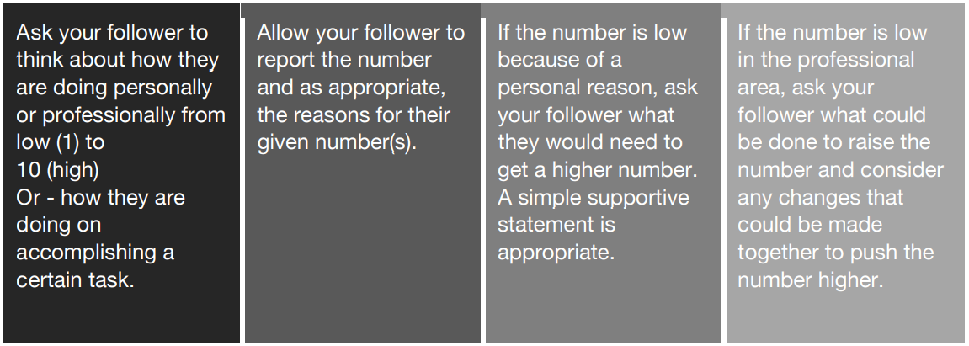
Steps For Preparing Your Followers
1
The 1-10 Check-In Hold regular information team or individual
check-ins with followers to “take the pulse” of everyone.
Here is how to conduct a 1-10 Check In:
Empathy and understanding an employees’ struggles and offering to be present, if possible, helps build mutual trust.
Role Play: Work with a partner you are leading who is struggling with a difficult task. They are feeling unsuccessful. Work in pairs with one of you playing the role of the manager and one the role of the partner. Decide which department and task before starting, then work through the conversation.

Slide 51
Use Team Huddles to Communicate
2
HOW TO USE HUDDLES EFFECTIVELY:
A huddle is an opportunity to meet with your team to share information and reinforce learning concepts. Huddles let your people explore information together and allow them to learn from each other.
Keep your huddles interesting, short and sweet!
A good huddle:
Is interesting to the listener Supports recent learning content
Allows team members to answer questions

Slide 52
Practice a Huddle
At your table, read through the following huddle and share tips to personalize it for your team.

Slide 53
March 16-31
Each of us, whatever our talents, has compassion service to give - and to do it well always involves continuous learning.
1. Why do you need to be open to newer education in the workplace?
• It opens your world to higher learning to improve your work skills.
• When you learn something new you are exercising your brain, which can help improve cognitive functions such as concentration, attention to detail, memory recall and problem solving, and reduce the chance of developing dementia.
• Education has the power to change people's lives. The knowledge that is gained can be used to shape your future and educate generations to come.
2. What type of compassionate action can you show another partner?
• Be that lending ear – actively listen without judgement
• Praise the Partner in front of other Partners
• Take notice of a Partner’s mental well-being – show them you care
3. How can you make a difference in a Resident’s life with compassionate service?
• Ask about their life story and remember key points for your next conversation with them
• Showing the Resident respect and empathy when they are not in the best mood
• Anticipate their needs and assist when you can

Slide 54
Table Discussion
Review the Huddle on the screen and try to determine five ways that it benefits everyone at Moorings Park.
Benefits of Huddles
1.
2.
3.
4.
5.

Slide 55
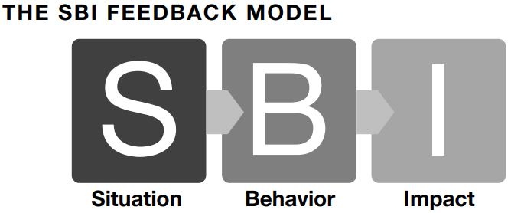
3
Rapidly Develop Follower Skills
1. Situation: Specifically describe the situation and be specific about when and where it occurred.
2. Behavior: Describe the behavior you observed directly. Be objective. And consider asking about your follower’s intent. This opens up a 2-way dialogue about what the follower is trying to achieve and how s/he can do it better.
3. Impact: Using empathy, describe the impact, positive or constructive, that the behavior had on you, others or the organization.

Slide 56
Partner Exercise
Read the case study on the PowerPoint slide and decide who will be the manager and who will be the partner. Use the SBI feedback approach to hold a feedback session together.

Slide 57
Case Study
Michael is a great employee. He has been in your department for 6 years. He consistently shows up on time, is neat, clean and respectful, and has a ”can-do” attitude. However, he seems to be unaware of some issues that others have brought to your attention. Michael jokes a lot and has a habit of telling off-color jokes that get around. You have talked to home about this before, and he said he would work on it. Now, with a more diverse employee pool, you worry about the impact of his jokes. Hold an SBI session to discuss this.

Slide 58
Create A Personal Action Plan
What can you start doing to ensure your best approach as a manager in support of the Compassion in Action Program?
What can you stop doing to ensure your best approach as a manager in support of the Compassion in Action Program?
What can you continue doing to ensure your best approach as a manager in support of the Compassion in Action Program?

