Slide 1
Welcome to Compassion in Action
Notes:
Welcome to Compassion in Action! We are excited that you are here. We hope that you enjoy the program; lets get started!

Slide 2
Welcome
The Compassion in Action Approach An Attitude that Nourishes Important Actions
GOAL To empower partners to provide Simply the Best® services to create the joy, satisfaction, and happiness vital to everyone in the Moorings Park Communities.
Notes:
Say, “Welcome to the Compassion in Action Approach is an Attitude that Nourishes Important Actions. The goal of the program is to empower partners to provide Simply the Best® services to create the joy, satisfaction, and happiness vital to everyone in the Moorings Park Communities.”

Slide 3
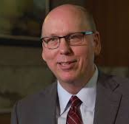

Welcome
The Compassion in Action Approach A Definition
Help you identify your authentic and valuable skills and personal approach to empowering you and your residents.
Provide the latest information on how best to serve residents, partners, and their families.
Build your skills so you feel confident about providing compassion in action.
Daniel J. Lavender President / CEO Moorings Park
Notes:
Say, “The Compassion in Action program will help you identify your authentic and valuable skills and personal approach to empowering you and your residents. It will also provide the latest information on how best to serve residents, partners, and their families. And finally, we will build your skills, so you feel confident about providing compassion in action.”

Slide 4
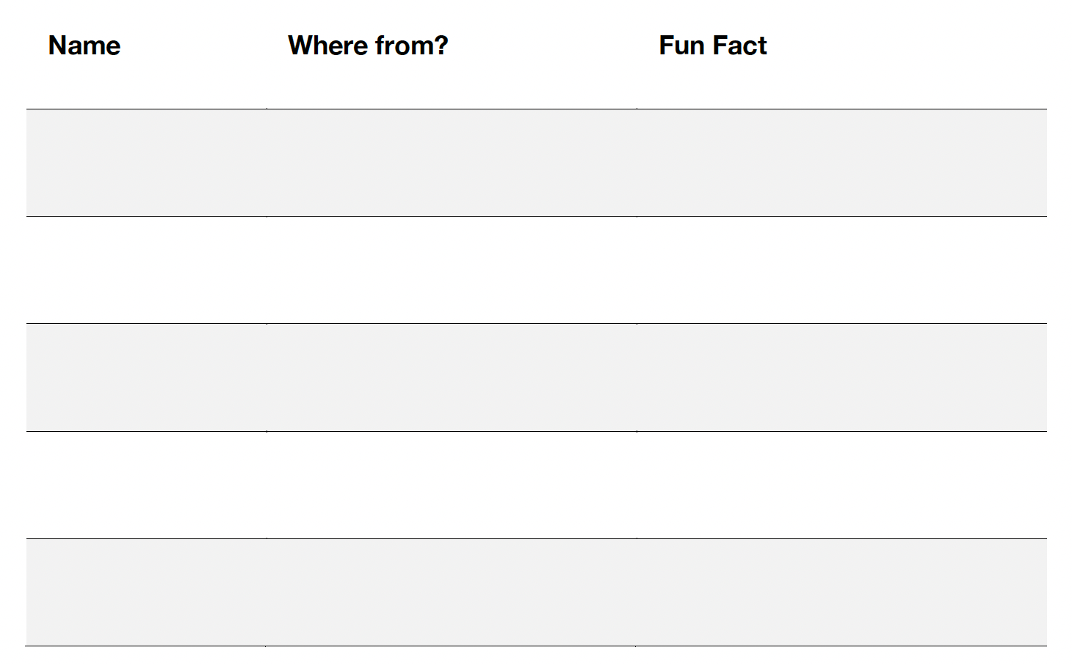
Pull up a Chair, We’re Glad You’re Here!
Get to know your instructor Where from & one fun fact
Get to know your table Where from & one fun fact
Notes:
Say, “Get to know your instructor and table members with this fun activity. My name is XXX and I am from XXX. My one fun fact is XXX. Take a few minutes at your table and introduce yourselves, share where you are from and one fun fact.”

Slide 5
As a Friendly Reminder…
Housekeeping Guidelines
Please silence your phones: we will have breaks so you can check messages.
This is an active session, be prepared to be up moving about, working with your table partners, and working in pairs.
What are the pipe cleaners for? Consider our learning theme, “Compassion in Action,” and make some art!
Notes:
Say, “As a friendly reminder, please silence your phones: we will have breaks so you can check messages. This is an active session, be prepared to be up moving about, working with your table partners, and working in pairs. What are the pipe cleaners for? Consider our learning theme, “Compassion in Action,” and make some art!”

Slide 6
Five Ways to Say Hello
Please stand and get ready to mingle around the room with others.
In a moment but not yet, find a person from another table to stand with.
Say hello with a fist bump and introduce yourself and what you do.
Get ready to answer a question on the screen.
When I call break, find a new person to stand with.
Go!
Notes:
Read the slide.

Slide 7
Round 1
On a scale of 1-10 how are you feeling about this program? What do you need from your colleagues to get closer to 10 so you are ready to learn in this program?
1
2
3
4
5
6
7
8
9
10
Notes:
Read the slide.

Slide 8
Say Goodbye!
Say goodbye to your fist bump partner with a fist bump, but remember, they are your fist bump partner for life!
Break! Find a new partner!
This time, greet your new partner with a high-5 in the air!
Notes:
Read the slide.

Slide 9
Round 2
Think of someone who really admire and respect. It can be someone famous, a friend, a family member, or a work colleague, anyone!
What is it about them you admire?
What do you think their guiding values are?
Notes:
Read the slide.

Slide 10
Say Goodbye!
Say goodbye to your air high-5 partner with an air high-5, but remember, they are your air high-5 partner for life!
Break! Find a new partner!
This time, greet your new partner with a bow or head nod!
Notes:
Read the slide.

Slide 11
Round 3
Think of a time when you saw some outstanding service, or Compassion in Action, here at Moorings Park.
What happened that really impressed you and why?
Notes:
Read the slide.

Slide 12
Say Goodbye!
Say goodbye to your bow or head nod partner with a bow or head nod, but remember, they are your bow or head nod partner for life!
Break! Find a new partner!
This time, greet your new partner with an elbow bump!
Notes:
Read the slide. Say “This is your elbow bump partner for life!”

Slide 13
Round 4
Being Compassionate while you are in action will require that you use your personal strengths.
What are your strengths? What are you good at and how does this show up at Moorings Park?
Notes:
Read the slide.

Slide 14
Say Goodbye
Say goodbye to your elbow bump partner with an elbow bump, but remember, they are your elbow bump partner for life!
Break! Find a new partner!
This time, greet your new partner with a Jelly Fish(fist bump followed by your hand acting like a jelly fish!)
Notes:
Read the slide.

Slide 15
Round 5 (Final Round)
You have a bit of information on what this program, Compassion in Action, is about.
What are you hoping to walk away with today?
What will be helpful for you to ensure that you practice Compassion in Action?
Notes:
Read the slide.

Slide 16
Greeting Frenzy!
We want to make sure that everyone has remembered their 5 partners and the way in which you greet ed each other.
Quickly go find your -
Fist bump partner and give them a fist bump!
Air high five partner and give then an air high five!
Elbow bump partner and give them an elbow bump!
Bow or head nod partner and give them a bow or head nod!
Jelly fish partner and give them a jelly fish greeting!
Notes:
At the conclusion of round 5, the trainer explains that we need to make sure that
everyone has remembered their 5 partners and the way in which they greet
each other. The trainer then starts calling out the partnership names in random fashion e.g.,
“Fist Bump” “Elbow” “Bow” etc. This is done in rapid succession so partners will
have to move fast!!! This typically lasts around 1 minute. If time allows; What did you take away from this experience that you can apply at Moorings Park?
What would the benefit of greeting people differently based on their individual needs?
You have just expanded your support network by meeting five partners. What would
be the benefit to you in expanding your support network at Moorings Park?

Slide 17
Table Discussion: Five Ways to Say Hello Debrief
1. What did you learn about others?
What are you hoping to walk away with today?
Take-away thought: Greetings have the power to transform relationships.
Notes:
Read the slide, This is a table discussion.

Slide 18
Module 1 Our Shared Mission and Vision
LEARNING GOALS:
Learn About the Moorings Park Mission
Discover the Moorings Park Values in Action
Learn About the Values you Share with Moorings Park
Discover your Compassion in Action Super Skills
Take the Table Quiz
“It’s not hard to make decisions when you know what your values are.” Roy Disney (Walt’s older brother)

Slide 19

We are on a mission.
It’s important.
It’s powerful.
And it involves you.
Notes:
Read the slide.

Slide 20
The Moorings Park Mission
Our mission is to provide Simply the Best® facilities and services for successful aging with professional and compassionate care to each person we serve.
Our mission asks us as professionals to always look for opportunities to use compassion in our work. Here is a true story about a partner who found a way to do just that:
Notes:
Read the slide.

Slide 21
Compassion in Action: A Story
A Chateau resident’s funeral was being held
…in the Bower Chapel. After the service ended family and friends were invited to come up to the pulpit if they wanted to share anything or remember the individual in front of the congregation. One of the Chateau CNAs stood up and approached the pulpit.
Notes:
Read the slide or ask for a volunteer to read the story aloud. If you read the story, walk to the back of the classroom so you can read the story with participants not seeing your back.

Slide 22

…You could hear a pin drop in the Bower Chapel. The CNA stepped up to the microphone and began to sing the hymn, “Amazing Grace.” She had a beautiful voice and there wasn’t a dry eye in the Chapel.
Notes:
Read the slide.

Slide 23

…Afterwards she shared that the hymn was special because she and the resident would sing it together each day. This was so meaningful to the resident’s family and exemplified the compassion and strong bond that often occurs between residents and partners.
Group Discussion
Who played a critical role in the story and how?
Notes:
Read the slide and as the entire group the discussion question.

Slide 24
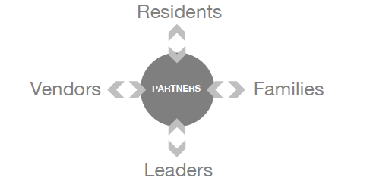
Our Compassionate Service Model
Residents
You are at the Center of the Compassionate Service Model
PARTNERS
Vendors
Families
What will you do with that opportunity?
Leaders
Notes:
Read the slide.

Slide 25

Table Discussion Our Shared Mission and Vision
If our mission is to provide Simply the Best® facilities and services for successful aging with professional and compassionate care to each person we serve,” what is your mission?
What are some ways that you have “changed the world” for others here?
“You’re going to change the world.” – Superman
Notes:
Read the slide: As tables to talk about some of the ways each person has changed the world for others here. At Moorings Park. Allow 1-2 minutes before you move on. It’s OK to ask people to share a story they heard if they get permission from the storyteller.

Slide 26
Our Shared Values
What are the Moorings Park Values in Action?
Values are fundamental principles which guide our decisions and actions.
Like…
What causes us to decide which occupation to choose?
How to treat others?
What we value most in life?
Notes:
Read the slide.

Slide 27
Here are the Moorings Park Values, Listed in Your Own Perspective:
I respect each person across the organization.
I practice ethical behavior – I do the right thing.
I am committed to acting with integrity, accountability, and excellence.
I see our diversity as a strength and build strong relationships with partners,
the residents I serve and their families.
I am committed to our non-profit model - which prioritizes each person we serve.
I am open to innovation that improves the resident and partner experience.
Notes:
Read the slide or ask a volunteer to read each one.

Slide 28
GROUP Discussion
Review the Moorings Park values in your workbook, on page 9.
Which values are easy for you to remember and practice every day?
Which values do you need to work harder at to practice every day?
Notes:
Read the slide. Hold a group discission on the two questions.

Slide 29
Discover your Personal Values: Sorting Exercise: Page 10
Our personal values are beliefs that govern our decisions about what is most important to us.
Values are the principles we live by.
Values are about what we consider important in life.
We make life decisions based on our personal values.
Values are unique to each of us.
You can use your personal values here at Moorings Park to make good decisions.
Notes:
Discover your Personal Values Exercise:
Our personal values are beliefs that govern our decisions about what is
most important to us.
Values are the principles we live by.
Values are about what we consider important in life.
We make life decisions based on our personal values.
Values are unique to each of us.
You can use your personal values here at Moorings Park to make good decisions.

Slide 30
Exercise Instructions
Using the cards provided, sort through them and choose your top 5 personal values.
Arrange them into a column, with your “most important” value at the top, and less important values at the bottom.
Notes:
Ask the participants to locate their values cards and read the exercise instructions.

Slide 31
Then…
Select the 3 values of top importance to you, removing the other 2.
Arrange these into a column, with your most important value on top.
TABLE DISCUSSION
Share your top 3 personal values.
Walk around your table to look at each partner’s 3 top personal values.
What do you notice about the variety of values?
Notes:
Read the slide. Ask participants to walk around and compare values.

Slide 32
Match your Values to a Moorings Park Value
How do your top 3 personal values match the Moorings Park Values?
Your top 3 personal values are your Super Strengths: a unique set of skills and abilities that you practice effortlessly and skillfully that bring you and those you impact joy, satisfaction, and happiness.
Notes:
Read the slide.

Slide 33
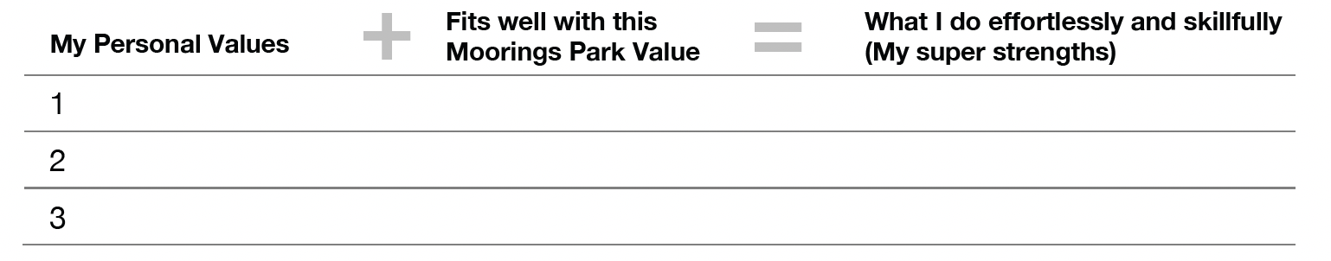
Match Your Personal Values to a Moorings Park Value
Moorings Park Values
Respect for each person Ethical behavior Integrity, accountability, excellence Diversity as strength Commitment to non-profit model Open to Innovation
Shared Values =
+
My Personal Values
=
Your Compassion in Action Super Strengths
Notes:
Read the slide.

Slide 34
Table Discussion
What new discovery have you made about yourself?
What are your super strengths – and how can you use them more here?
What Moorings Park values fell outside your 3 top personal values, and What can you do to ensure that you practice them?
Notes:
Read the slide.

Slide 35
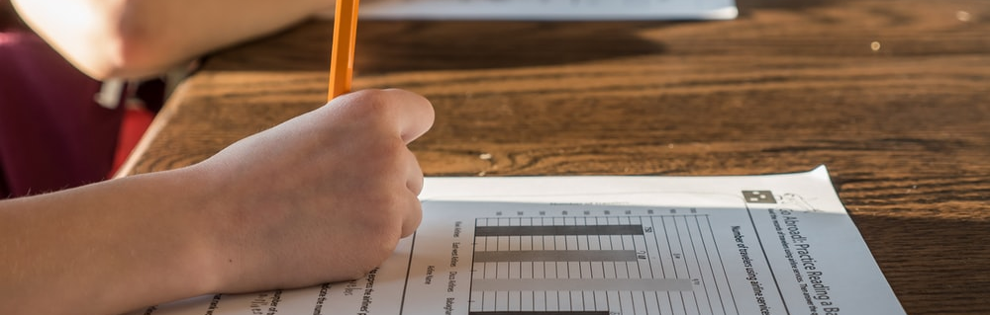
Module 1 Table Quiz
What do you remember? Work with your table to complete the quiz.
Notes:
Read the slide an allow 1-2 minutes for the tables to complete. Then say:: “We are going to have a competition. Notice that we have placed buzzers on your tables. In a minute you will be using those to compete against other tables for the correct answer to each quiz question.”

Slide 36

Module 1 Table Quiz
Hands on Buzzers
Get Ready to shout your answers!
Notes:
Read the slide with heightened emotion!

Slide 37
1. The Moorings Park Mission says that:
Module 1 Table Quiz
To provide Simply the Best ® activities for successful aging with professional and compassionate care to each person we serve.
To provide Simply the Best ® facilities and services for successful aging with professional and compassionate care to each person we serve.
To provide Simply the Best ® facilities and services for successful living and professional and compassionate care to each person we serve.
To provide Simply the Best ® facilities and services for successful aging with professional and compassionate care to everyone.
Notes:
Read the slide and allow the first table to buzz in to answer. If they are wrong, allow the next table who buzzed in to answer. The correct answer is b.

Slide 38
The Correct Answer
b. To provide Simply the Best ® facilities and services for successful aging with professional and compassionate care to each person we serve.

Slide 39
2. You should use the Moorings Park Values as a guide to make good decisions.
Module 1 Table Quiz
a. True
b. False
Notes:
Read the slide and allow the tables to buzz in to answer. The correct answer is a.

Slide 40
The Correct Answer
a. True

Slide 41
3. The Moorings Park Value “I am open to innovation that improves the resident and partner experience” means that you should be open to changing your actions or approach to improve the resident and partner experience.
Module 1 Table Quiz
a. True
b. False
Notes:
Read the slide and allow the tables to buzz in to answer. The correct answer is a.

Slide 42
The Correct Answer
a. True

Slide 43
4. A Super Strength is a set of skills and abilities that you practice effortlessly and skillfully that bring you and those you impact joy, satisfaction, and happiness.
Module 1 Table Quiz
a. True
b. False
Notes:
Read the slide and allow the tables to buzz in to answer. The correct answer is a.

Slide 44
The Correct Answer
a. True

Slide 45
Quick Stretch!
Stand up and close your eyes.
Now with your eyes closed, point to the north, and keep pointing.
Open your eyes.
It’s hard to get everyone to point in the same direction!
This module is about creating a common culture, so we are all heading in the same direction.
Notes:
Read the slide and facilitate this short energizer.

Slide 46
Module 2 Our Best Friends Culture
LEARNING GOALS:
Consider your Own Relationship with your Best Friend
Learn about the Components and Expectations of Our Best Friends Culture
Discover the Importance of Empathy, and How to Develop It
Empathize with a Resident
Watch a Video About the Difference Between Sympathy and Empathy
Take the Table Quiz

Slide 47

Icebreaker: Think About Your Own Best Friend
Talk with others at your table about the traits you admire in your best friend.
Then discuss the qualities of the relationship that you value most.
Notes:
Read the slide and facilitate the table activity.

Slide 48
Our Best Friends Culture
Culture is “the way we do things around here.” Our Best Friends Culture is the idea that all partners should treat everyone in the Moorings Park family as they would a best friend.
Think about the essential building blocks of a friendship:
Respect
Empathy
Support
Trust
Humor
Notes:
Read the slide

Slide 49
We Support Everyone in Following this Philosophy
Strive to communicate (as you would with a friend).
Be patient and understanding on the bad days (as you would with a friend).
Laugh and smile (as you would with a friend).
Provide encouragement (as you would with a friend).
Listen and talk about meaningful things (as you would with a friend).
Notes:
Read the slide.

Slide 50
TABLE DISCUSSION
At 211 degrees, water is hot.
At 212 degrees, it boils.
And with boiling water, comes steam.
And with steam, you can power a train.
One extra degree makes all the difference.
How can a little extra effort from you and each partner create a Best Friends Culture here?
Notes:
Read the slide and facilitate the table discussion.

Slide 51
The Importance of Empathy
Empathy is important because it helps us understand how others are feeling so we can respond appropriately to the situation.
Empathy is your ability to “feel with people.” Here is an opportunity to develop your empathy skills with residents.
Notes:
Read the slide.

Slide 52
Empathy Exercise: Minnie Remembers
Ask a table partner to read “Minnie Remembers” aloud.
TABLE DISCUSSION
What did you learn from Minnie?
What would happen if you became very aware of a resident’s unexpressed or unspoken needs, like Minnie?
Notes:
Read the slide and ask each table to appoint one person to read ”Minnie Remembers.”

Slide 53

How to Develop your Empathy Video
Watch Brene Brown’s creative video on the difference between sympathy and empathy.
https://www.google.com/search?q=brene+brown+sympathy+vs.+empathy&oq=brene+brown+sympathy+vs.+empathy&aqs=chrome..69i57j0i22i30l5j0i390l3.10853j0j15&sourceid=chrome&ie=UTF-8

Slide 54
How to Develop your Empathy
TABLE DISCUSSION
Empathy is a way to connect to the emotion another person is experiencing. It doesn’t require that we have experienced the same situation they are going through.
If empathy is connecting with people, so they know they are not alone when they’re in a struggle, how can you do more of that?
In your role, what types of situations (that others experience) do you want to increase your empathy for?
Notes:
Read the slide.

Slide 55
Tips for Becoming More Empathetic
Be kind.
Be curious.
You don’t always need to fix it or make people feel better.
Connecting and listening is powerful.
Try to understand how the person is feeling (not how you might feel in the same situation).
Help people know that they are not alone in their feelings.
Even if you’ve never had that experience, you might know the feeling.
Let people know that you are grateful they shared with you.
When you miss the opportunity to show empathy or when you would like the opportunity to do it better, you can say, “I’d like to circle back.” In this context, circling back means practicing empathy by trying again.
Remember, you are on the road to being a Compassion in Action Pro!
Notes:
Read the slide.

Slide 56
TABLE DISCUSSION
What does it look like when partners use empathy across Moorings Park?
What does it look like when partners use it in your department?
How can we use role modeling (positive peer pressure) to ensure that partners feel comfortable using empathy every day and with everyone?
Notes:
Read the slide and facilitate a table discussion.

Slide 57
Module 2 Table Quiz
What do you remember? Work with your table to complete the quiz.
Notes:
Read the slide, and allow the tables to work through the quiz.

Slide 58
Module 2 Table Quiz
Hands on Buzzers
Get Ready to shout your answers!
Notes:
Read the slide with heightened emotion.

Slide 59
1. Minnie Remembers is about a resident experiencing dementia.
Module 2 Table Quiz
a. True
b. False
Notes:
Read the slide. The correct answer is b.

Slide 60
2. Empathy is connecting with people, so they know they are not alone.
Module 2 Table Quiz
a. True
b. False
Notes:
Read the slide. The correct answer is a.

Slide 61
3. When you miss the opportunity to show empathy or when you would like the opportunity to do it better, you can say, “I’d like to circle back.” In this context, circling back means practicing empathy by trying again.
Module 2 Table Quiz
a. True
b. False
Notes:
Read the slide. The correct answer is a.

Slide 62
Module 2 Table Quiz
4. Our Best Friends Culture is based upon the building blocks of friendship, which include:
a. Respect, empathy, love, trust, and humor
b. Respect, honesty, support, trust, and humor
c. Respect, honesty, fun, trust, and humor
d. Respect, empathy, support, trust, and humor
Notes:
Read the slide. The correct answer is d.

Slide 63
Ageing is About Adapting to Change: How Well do You Manage Change?
On a 1-10 scale (10 high) how well do you manage change?
When change happens here, how do you respond?
Change is happening! Say goodbye to your table team and create a new table team with new team members.
Introduce yourselves, where you are from and one fun fact.
Notes:
Read the slide. Debrief: Say: “Using your Compassion in Action and Best Friends skills, how can you support yourself and other partners during change? How can you support residents experiencing change? What helped you feel welcome at your table? This is that our Best Friends Culture and Compassion in Action is all about. .

Slide 64
Module 3 An Insider’s Guide to Understanding the Aging Process
LEARNING GOALS:
Clarify that Each Resident is on Their Own Unique Aging Path
Understand Ageism and Biases Toward Aging Populations
Learn About and Experience Aging Challenges, and How to Support Them
Take the Table Quiz

Slide 65
Our Diverse Resident Population
We have a diverse range of residents experiencing their own unique aging journey.
It is important for you to be able to provide the right support and care to meet the wants and needs of each resident.
Notes:
Read the slide.

Slide 66
Our Diverse Resident Population
Others may have vision, hearing, or balance challenges, suffer from depression or live with dementia.
Our positive approach to aging means that we focus on what residents can do and empower them to live their best lives.
Notes:
Read the slide

Slide 67
Video: What is Old?
Watch: https://videos.aarp.org/detail/video/4834178739001/mill%20ennials-show-us-what-&#39;old&#39;-looks-like---aarp

Slide 68
What is Ageism?
Ageism refers to the stereotypes (how we think), prejudice (how we feel) and discrimination (how we act) towards others on their ageing journey.
Check in with your table team: How old are you on the inside?
Now consider our residents. Like us, they have a number.
This module is about supporting the needs of our residents and empowering them at any age.
Notes:
Read the slide, allow a minute to share responses to

Slide 69
Try this Challenge! Workbook Page 20
Turn your table into a team of scientists by exploring different types of aging challenges. You will be able to experience the aging process first-hand to get a sense of how our residents experience a variety of aging challenges.
Notes:
Read the slide.

Slide 70
Get Ready for Minute Presentations!
Find your table number and the corresponding aging challenge.
Use the discovery tables in your workbook to describe the aging challenge your table is assigned and provide 1-2 Compassion in Action tips to best support a resident. You have up to 10 minutes to prepare a 1-minute report to share.
Notes:
Read the slide.

Slide 71
Table Assignments
Table 1 | The Challenge of Glaucoma;
Table 2 | The Challenge of Macular Degeneration
Table 3 | The Challenge of Stroke
Table 4 | The Challenge of Cataracts
Table 5 | The Challenge of Dexterity
Table 6 | The Challenge of Fall Prevention
Table 7 | The Challenge of Hearing Impairment
Table 8 | The Challenge of Dementia
Table 9 | The Challenge of Depression
Table 10 | The Challenge of Supporting Successful Aging
Notes:
Read the slide. Some tables will need to locate supplies, help them by showing them where they are.

Slide 72
Learning from Minute Presentations: Discover the 10 Ageing Challenges
What did you learn?
Write it out in your discovery table.
After the last presentation, discuss with your table team what surprised you.
Notes:
Read the slide.

Slide 73
Module 3 Table Quiz
What do you remember? Work with your table to complete the quiz.
Notes:
Read the slide.

Slide 74
Module 3 Table Quiz
Hands on Buzzers
Get Ready to shout your answers!
Notes:
Read the slide with heightened emotion.

Slide 75
1. A resident with glaucoma will not typically be startled if you're out of their central point of view.
Module 3 Table Quiz
a. True
b. False
Notes:
Read the slide. The correct answer is b.

Slide 76
The Correct Answer
b. False

Slide 77
2. One of the best ways to communicate with a resident having hearing impairment is to make sure that you are continually making eye contact.
Module 3 Table Quiz
a. True
b. False
Notes:
Read the slide. The correct answer is a.

Slide 78
The Correct Answer
a. True

Slide 79
3. Moorings Park Communities offer a variety of services and resources that support healthy aging.
Module 3 Table Quiz
a. True
b. False
Notes:
Read the slide. The correct answer is a.

Slide 80
The Correct Answer
a. True

Slide 81


Break!
Enjoy a 10-minute break.

Slide 82
Module 4 You are Empowered to Deliver WOW
LEARNING GOALS:
What is a Wow Experience?
Share your Best Wow’s!
Start with a Growth Mindset
The Wow Service Motto and Steps of Service
You are empowered to Deliver WOW
Take the Table Quiz
“Legendary service is about surprise and delight. It’s about providing unexpected,
unique, and memorable moments.”
Diane Oreck, VP of Ritz-Carlton’s Leadership Training Center

Slide 83
Icebreaker: Greatest Fan You are Empowered to Deliver WOW!
Get ready to play the champion edition of rock-paper-scissors!
Notes:
Read the slide and ask everyone to join you in the play area and make a large circle. Make sure you know how to facilitate the activity using the GREATEST FAN directions.

Slide 84
Icebreaker: Greatest Fan You are Empowered to Deliver WOW!
This activity is called Greatest Fan. Why?
What does this activity have to do with delivering a WOW experience for members of your team?
This activity highlighted creating win-win situations. How can you ensure win-win situations and WOW everyone at Moorings Park?
Notes:
Read the slide and ask everyone to join you in the play area and make a large circle. Make sure you know how to facilitate the activity using the GREATEST FAN directions.

Slide 85
A WOW EXPERIENCE at Moorings Park
LEARNING GOALS:
What is a WOW Experience?
Share your Best Wow’s!
Start with a Growth Mindset
The WOW Service Motto and Steps of Service
You are Empowered to Deliver WOW
Take the Table Quiz
A resident was sitting in the hallway and a partner had some extra roses from an event. The partner stopped and gave her a rose. Later that week she gave the partner a handwritten note on how much that rose meant to her, how she was having such a hard time and a hard day, and that one small rose gesture completely changed her day around. Those tiny, tiny moments, which we may not even think twice about, are so impactful.
Notes:
Read the slide starting with the title and quote. Then proceed to the questions about the story on the next slide.

Slide 86
What is a WOW Experience?
Think about what makes the rose story a WOW experience.
Think of a time when you experienced WOW here and be ready to share the best story from your table.
In the next exercise, Open Mic, you can tell your best story to the group.
Use this WOW Story Template to construct your story:
Notes:
Read the slide-no group or table discussion needed.

Slide 87
WOW Story Template Page 33
Make your story 1-Minute or Under
Before WOW: Why was WOW needed? Where did this take place?
After WOW: What happened? What was the impact of the WOW on the partner and the resident?
Notes:
Read the slide. Say, “Use the Wow template to deliver a WOW story.” We will have time for a few WOW’s,

Slide 88

Exercise: WOW Open Mic: 1-minute WOW Stories
Share your best WOW Story!
GROUP DISCUSSION
What did you learn from others about how to deliver WOW? Write down your ideas in your workbook so you can remember them and use them for future WOWS!
Notes:
Read the slide.

Slide 89
Are you Ready to Deliver WOW?
Sensing and delivering a WOW requires you to think differently. It requires that you think about possibilities rather than limitations on what you can do to go above and beyond to WOW another partner or resident.
What have I learned? Page 34
Notes:
Read the slide, direct participant to age 34 to write down key learnings.

Slide 90
Prepare for WOW with a Growth Mindset
A mindset is a way of seeing opportunities and possibilities. Review the fixed and growth mindsets:
Notes:
Read the slide.

Slide 91
Table Discussion: Prepare for WOW with a Growth Mindset
Do you spend more time in your fixed or growth mindset?
Why is a growth mindset so important to delivering WOW?
Notes:
Read the slide. Allow 2 minutes for a table discussion/

Slide 92
The WOW Service Motto
Discovering opportunities every day to go above and beyond to enable others to live their best lives. THE WOW STEPS OF SERVICE
Use the WOW Preparation Tips.
Practice the WOW Service Guidelines.
Create a WOW Great First Impression with the 20-10-5 Rule.
Follow the WOW Roadmap.
Notes:
Read the slide.

Slide 93
The WOW Preparation Tips
1
Looking great and feeling great are important for you and everyone you work with. Research supports the idea that preparing for work with an organized calendar and a clean, neat appearance adds to your ability to perform at your best and gives you an extra emotional boost.
Manage your time wisely – give yourself the gift of extra time with this motto: “being early is on time!”
A neat, clean professional appearance creates a great first impression.
Leave personal problems behind in the parking lot. Be prepared to use your energy to offer your service strengths to practice Compassion in Action.
Notes:
Read the slide.

Slide 94
WOW Great First Impressions: The 20-10-5 Rule
2
Start with a great first impression! Use the 20-10-5 steps with partners, vendors, residents, and their families (in short, your entire Moorings Park Family).
TABLE DISCUSSION
What is the difference between walking by someone and intentionally using the 20-10-5 rule?
At 5 feet give a warm "hello"
At 10 feet smile!
At 20 feet make eye contact
Notes:
Read the slide.

Slide 95
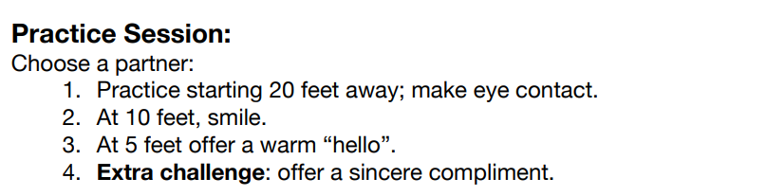
20-10-5 Rule Practice Session
Practice Session: Choose a partner:
Practice starting 20 feet away; make eye contact.
At 10 feet, smile.
At 5 feet offer a warm “hello”.
Extra Challenge: offer a sincere compliment.
Notes:
Read the slide and allow a few minutes for pairs to practice.

Slide 96
Exercise
Rapid Compliment Competition Throwdown Learn to give effective compliments to partners and residents!
Notes:
Read the slide. Be sure you are familiar with the Rapid Compliment Competition Throwdown.

Slide 97
TABLE DISCUSSION
A partner tells you that they find it hard to compliment others. What advice would you give them so they can develop this skill?
What can you do to improve your ability to give partners and residents genuine and relevant compliments?
Notes:
Read the slide, facilitate a short table discussion.

Slide 98
GROUP DISCUSSION:
Which WOW service guidelines do you practice now, and which do you need to work on?
3
WOW Service Guidelines
Your challenge is to practice the following guidelines to deliver WOW every day:
I use the Moorings Park values as a guide to make good decisions.
I contribute to a team atmosphere of respect and support for all those at Moorings Park.
I anticipate needs and respond with excellent quality and service.
I am empowered to create unique, memorable, and personal experiences that we call WOW experiences.
I embrace change, and continuously seek opportunities to innovate and improve the lives of everyone at Moorings Park.
I own every problem I see and resolve problems quickly using the LASSIE approach.
I am a professional through my appearance, behavior and communication.
I seek opportunities to learn and develop new skills.
Notes:
Read the slide.

Slide 99
3
WOW Service Guidelines
GROUP DISCUSSION
A partner tells you that they find it hard to compliment others. What advice would you give them so they can develop this skill?
What can you do to improve your ability to give partners and residents genuine and relevant compliments?
Notes:
Read the slide, facilitate a short conversation.

Slide 100
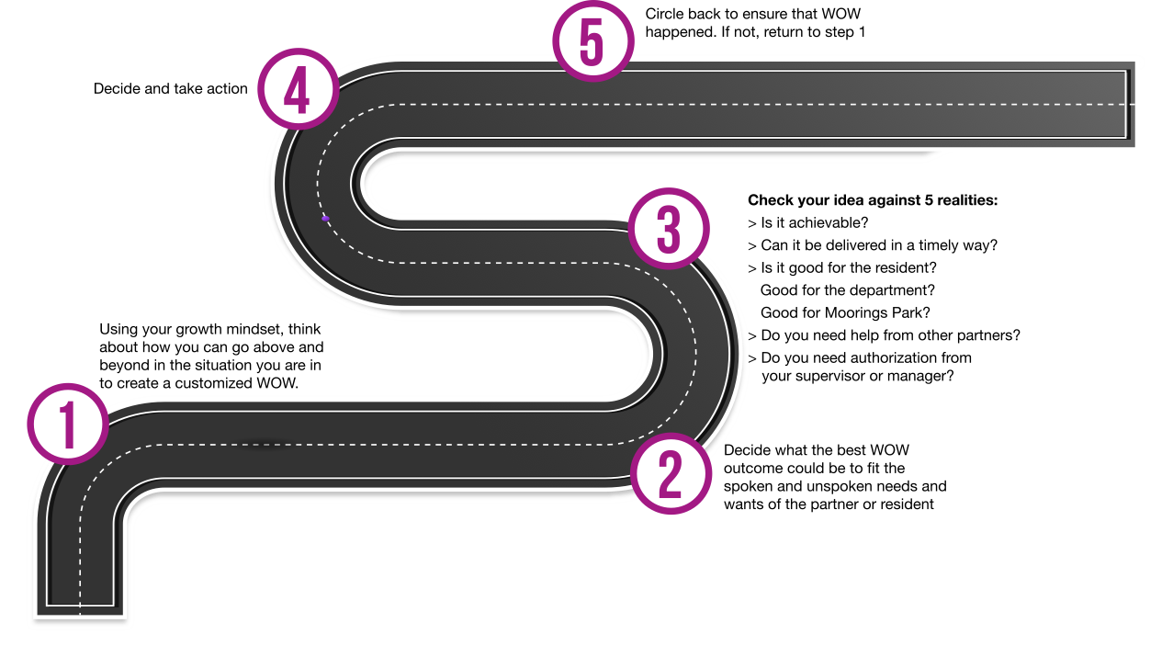
4
Follow the WOW Roadmap
Notes:
Rad the slide. Explore the roadmap.

Slide 101
Use the WOW Meter to Determine How to Offer a WOW
WOW METER A tiny WOW: A quick smile or kind word.
A small WOW: Stopping to help open a door, carry a heavy box, etc.
A medium-sized WOW: Arranging an activity, providing an unanticipated item.
A large WOW: Resolving a major problem that takes more time and effort by you, such as working with other partners to deliver a WOW
Notes:
Read the slide.

Slide 102
You are Empowered and Supported
Two Steps to Empowerment
1. Talk with your supervisor or manager about how much latitude and resources you have to deliver WOW.
2. Own a WOW from start to finish, whether it’s a small or large WOW. Take accountability from beginning to end of the WOW to create and execute the WOW.
You are Empowered to Deliver WOW! You are empowered to tackle problems and find solutions with and for partners, residents, and their families. That means that you have the authority to act.
What Does it Mean to be Empowered? Empowerment is the power you are given in your role to decide the best options possible to deliver WOW! A WOW Experience is the result of a partner who correctly anticipates or predicts a resident’s need and delivers customized solutions in a surprising and satisfying way.

Slide 103
Role Play Compassion in Action: A Story
As a Compassion in Action Pro, you are empowered to serve our residents’ needs—even when you are unsure if you should. Being a Compassion in Action Pro means going above and beyond the normal services we offer to fully meet the spoken and unspoken needs and wishes of each resident.
Objectives: This activity is designed to give you a chance to practice the skills needed to go “above and beyond.”
Directions: Pair up with a neighbor and review one of the case studies on the presentation. Work through the case study using the WOW Meter and Roadmap.

Slide 104
Choose an Empowerment Case Study: Page 39
Case Study 1: It’s a busy day. You arrive at work and discover that many of your teammates are absent. Because of this, another department is directly impacted. Your manager cannot leave. She worries out load that the team most impacted needs an update about the situation. Use the WOW Roadmap and Meter to decide how to proceed. Role play the situation.
Case Study 2: You see a resident needing assistance with a service your department does not provide. The resident seems concerned and anxious. Select a service you often see needed, and role play. Use the WOW Roadmap and Meter to decide how to proceed.
Notes:
Read the slide.

Slide 105
TABLE DISCUSSION
What did you learn from your role play?
How did you go above and beyond?
What did you find to be the most challenging?
Notes:
Read the slide.

Slide 106
Module 4 Table Quiz
What do you remember? Work with your table to complete the quiz.
Notes:
Read the slide.

Slide 107
Module 4 Table Quiz
Hands on Buzzers
Get Ready to shout your answers!
Notes:
Read the slide with heightened emotion.

Slide 108
The WOW Service Motto reads: Discovering opportunities every day to go above and beyond to enable others to live their best lives.
Module 4 Table Quiz
a. True
b. False
Notes:
Read the slide. The correct answer is a.

Slide 109
The Correct Answer
a. True

Slide 110
2. The WOW Steps of Service are: 1. Use the WOW Preparation Tips 2. Create a WOW Great First Impression with the 20-10-5 Rule 3. Practice the WOW Service Guidelines 4. Follow the WOW Roadmap
Module 4 Table Quiz
a. True
b. False
Notes:
Read the slide. The correct answer is a.

Slide 111
The Correct Answer
a. True

Slide 112
3. The WOW Great First Impressions say to: “Start with a great first impression! Use the 20-15-5 rule with partners, vendors, residents, and their families (in short, with your entire Moorings Park family).”
Module 4 Table Quiz
a. True
b. False
Notes:
Read the slide. The correct answer is b.

Slide 113
The Correct Answer
b. False

Slide 114
4. The WOW Service Guidelines say that: “I embrace change, and continuously seek opportunities to innovate and improve the lives of everyone at Moorings Park.”
Module 4 Table Quiz
a. True
b. False
Notes:
Read the slide. The correct answer is a.

Slide 115
The Correct Answer
a. True

Slide 116
5. In the Two Steps to Empowerment, it says “Own the WOW need personally, whether it’s a small or large WOW. Take accountability from start to finish to create and execute the WOW.”
Module 4 Table Quiz
a. True
b. False
Notes:
Read the slide. The correct answer is a.

Slide 117
The Correct Answer
a. True

Slide 118
Module 5 Turning Problems into Solutions
LEARNING GOALS:
Understand the LASSIE Service Recovery Model
Resolving Difficult Conversations with Residents
How to Resolve Conflicts with your Partners
Take the Table Quiz
I’ve learned that people will forget what you said, people will forget what you did,
but people will never forget how you made them feel.
-Maya Angelou, Author

Slide 119
Icebreaker: Stay in the Game!
Join us in the play area for this fast-paced activity.
Notes:
Read the slide and be familiar with the activity.

Slide 120
Icebreaker: Stay in the Game!
What do you want to remember from this exercise, so you persist developing your Compassion in Action capabilities?
TABLE DISCUSSION
Becoming a Compassion in Action Pro is not easy. You will have setbacks and successes as you learn and apply the content we have covered. What do you need to remember from this exercise to make sure you “stay in the game” to develop your skills as a Compassion in Action Pro?
Notes:
Read the slide. Be certain to be familiar with the game before facilitating it.

Slide 121
The LASSIE Steps of Service Recovery Page 44
L
A
S
S
I
E
Listen
Apologize
Solutions Offered
Solutions Determines
Initiate
Ensure
Notes:
Read the slide and refer to the workbook page for additional details. Say, “let’s go deeper with the LASSIE Steps on page 44. Then read the following: Listen – and restate what you heard
Actively Listen to what is being said.
Use positive body language.
Don’t take it personally!
Apologize
Research shows that when customers tell a company about a problem with a
product or service, they receive an apology less than half the time. The solution
to every problem should start with a sincere apology. This isn’t necessarily an
acknowledgment of fault, but rather a show of empathy for the difficulties
customers have experienced, regardless of the cause.
Does not mean it is your fault.
Empathize with their situation. Say, “I’m so sorry that happened to you, I am here to help.”
Solutions Offered
Offer several options.
Be realistic.
You are empowered to replace/repair. If in doubt contact your supervisor.
Solutions Determined
If possible, allow the partner, vendor, resident, or family member to select the solution they prefer. Those who are asked to participate in a problem-solving effort are more satisfied with the resolution than those who aren’t asked. It is critical to invite them into the problem-solving process.
Let the other choose.
Restate the solution for moving forward.
Initiate Action
Take the necessary measures to follow through with the solution that was determined, right now.
Don’t be afraid to ask for help from your supervisor or other partners.
Ensure Satisfaction
Offer a thank you. Say, “Thank you for bringing this to my attention.”
After the action has been initiated follow up to see if the issue has been rectified.
If it has not, offer different solutions and follow through.

Slide 122
TABLE DISCUSSION
Work in groups of three: One person plays the resident, one plays the housekeeper, and one plays the laundry attendant.
Decide what the laundry attendant should do and what the housekeeper should do. What can they do to work together? Develop a plan.
Use the LASSIE Steps of Service Recovery to resolve the problem.
Be ready to share your plan.
GROUP DISCUSSION
Will you need to use Lassie in your role?
Notes:
Read the slide. Facilitate a brief group discussion.

Slide 123
Read the LASSIE Role Plays on Page 45
Lassie Role Play #1
Pair up so that one of you plays the resident, and one plays the partner.
Scenario: A resident booked a Mother’s Day brunch for her family of four. Her family surprised her and brought six additional family members and friends an hour before …
LASSIE Role Play #2
This is a challenging exercise. Apply Lassie across three Moorings Park departments to resolve this issue…
Notes:
Read the slide.

Slide 124
Resolving Difficult Conversations with Residents
Sometimes residents will ask uncomfortable questions. Here are some examples of the most common questions residents ask of partners.
Notes:
Read the slide.

Slide 125
Resolving Difficult Conversations with Residents Page 46
Are they paying you enough money?
Can you tell me why they took a resident away in an ambulance?
Do you like the management?
Do you have anything to do with the schedule?
Can you accept tips? I won’t tell if you take it!
Can you watch my house/animals while I’m gone? I’ll pay you.
Notes:
Read the slide. Say “these are some examples of difficult conversations, Let’s review them.”

Slide 126
Resolving Difficult Conversations with Residents Residents
If you are asked questions like this, how do you think you should respond? The best way to avoid these types of questions is to pivot and focus back to the resident and the resident’s needs. You can politely decline to answer their question and redirect the conversation to how you can help them.

Slide 127
Difficult Resident Conversations: Effective Responses
I am happy here because I get to work with people like you!
I am not able to tell you any information about anyone’s health condition.
This is a HIPPA violation.
I enjoy working here.
I do not manage the schedule but can help you find the right person to help with that.
I don’t accept tips--it’s our Moorings Park policy. But I am glad you are happy with me.
I can’t watch your animals or house, but I can find out who can help with some ideas for you.
Did you know that you cannot share anyone’s health information with anyone else?
Notes:
Read the slide.

Slide 128
Resolving Difficult Conversations with Residents
Using professional ethics and a friendly but professional and firm response can help you answer questions.
TABLE DISCUSSION
Have you experienced a difficult conversation with a resident? Do you have any additional tips to share?
Notes:
Read the slide.

Slide 129
How to Resolve Conflicts with your Partners
The AGREE Model How to Hold a Difficult Conversation with a Partner
A
G
R
E
E
Ask to Meet
Get ready to share what happened
Review
Empathize
End
Notes:
Read the slide. Offer details here: A
Ask to meet: Name the issue, express your willingness to resolve the problem.
G
Get ready to share what happened: Each person can voice their feelings and experience of the conflict using “I” statements. The other person listens without interrupting before they share their experience.
R
Review: Each person takes ownership of their piece in the conflict: “Here’s my contribution to the mess.”
E
Empathize: Each person “walks a mile” in the person’s shoes and tries to see the conflict from the other person’s perspective. “This is what I feel it must be like in your shoes.”
E
End: Both partners work together to make a plan for moving forward. “What can we do so this doesn’t happen again?” and “What will we do differently next time?”

Slide 130
The AGREE Model Roleplay
Work through each step of the AGREE Model to help these two work this out.
Ask to meet
Get ready to share what happened
Review: Each person takes ownership of their piece in the conflict
Empathize: Each person “walks a mile” in the person’s shoes
End: Both partners work together to make a plan for moving ahead

Slide 131
AGREE Model Role Play Page 48
Directions: Pair up - one of you will be “Vinnie” and the other “Jose.”
Vinnie was asked to move a multitude of chairs to the chapel. His dolly broke and he went to get a new one. On his way back with the new dolly, he ran into Jose, who seemed angry. “Hey, what are you doing with my cart?” he asked. “You always do this!”
“This is labeled for my department!” he added, grabbing the cart away from Vinnie.
Vinnie was shocked. He had never used a cart from Jose’s department before and had gotten the cart from his own department.
Notes:
Read the slide.

Slide 132
TABLE DISCUSSION
How many of you feel that you need to hold an AGREE conversation as soon as possible with a partner to clean up a mess?
Without naming anyone out loud, write down who you need to have an AGREE discussion with:

Slide 133
Module 5 Table Quiz
What do you remember? Work with your table to complete the quiz.
Notes:
Read the slide.

Slide 134
Module 5 Table Quiz
Hands on Buzzers
Get Ready to shout your answers!
Notes:
Read the slide with heightened emotion.

Slide 135
LASSIE stands for Listen, Apologize, Satisfy, Solutions, Initiate, and End.
Module 5 Table Quiz
a. True
b. False
Notes:
Read the slide. The correct answer is b.

Slide 136
The Correct Answer
b. False

Slide 137
2. The Agree conversation is useful for “cleaning up messes” between partners.
Module 5 Table Quiz
a. True
b. False
Notes:
Read the slide. The Correct answer is a.

Slide 138
The Correct Answer
a. True

Slide 139
3. It is OK to share anyone’s health information with anyone else.
Module 5 Table Quiz
a. True
b. False
Notes:
Read the slide. The correct answer is b.

Slide 140
The Correct Answer
b. False

Slide 141
How Did You Do on the Quizzes?
Think about your scores on the table quizzes and consider reviewing the material as often as needed.
Keep this workbook handy to refer to as you move forward in your journey as a Compassion in Action Pro!

Slide 142

Art Show!
Share your artwork - hold up your pipe cleaner art!
Notes:
Read the slide.

Slide 143
My Compassion in Action Plan Page 50
Complete the following to continue your journey as a Compassion in Action Pro!
My 3 service strengths that I can use daily and that others can tap into are:
What I can start to do to be an effective Compassion in Action Pro:
What I can stop doing to be an effective Compassion in Action Pro:
One Bold Step: What action I can take today to be a Compassion in Action Pro:
Notes:
Read the slide. Allow a few minutes for participants to complete their action plan.

Slide 144

Congratulations!
ON COMPLETING COMPASSION IN ACTION TRAINING
Fill out the short survey, pick up your certificate, then join us to share what you learned and appreciated from this training!
Notes:
Read the slide, then ask the participants to join you in the play area and make a large circle. If time allows, ask each person to use 1-2 words about what they are taking out of the session that they did not bring in. Then, say, ”In a moment but not yet, we you will step into the circle to connect with as many people as possible to share your Compassion in Action and tell them something you appreciate about them or to pay them a genuine compliment.” Say, “GO!” after the frenzy, the session is concluded.

