Slide 1


DISC Professional Styles
Facilitator Training Session

Slide 2
Welcome!
About the session
Minute Introductions:
Within 60 seconds, Introduce yourself and tell us about an unusual skill, a hobby or superpower you have!

Slide 3
Today’s Learning Outcomes
    Learn about the history of the DISC Model
    Learn about DISC theory
    Understand your role as a DISC facilitator
    Tips for improving tour facilitation impact
    Read through the DISC facilitator script
    Take the quiz

Slide 4

The DISC is a behavioral assessment tool was created by Psychologist William Moulton Marston.
Marston’s theory was developed into the four-quadrant model we are now familiar with, which includes: Dominant, Influential, Steady, and Conscientious behaviors. Most of us area combination of styles.
The DISC is a learning tool that helps identify your preferences, not your abilities, and your style strengths and challenges.
History
of the
DISC Model

Slide 5
True or False
1. The DISC measure abilities
2. The four styles are Dominant, Influential, Steady and Compatible

Slide 6
About DISC Professional Styles Assessment and Workbook
In 2015, DISC Professional Styles creator Dr. Susan Cain brought a cost-effective and easy-to-use DISC assessment to market.
Dr. Cain utilized a team of Elmhurst University Industrial and Organizational interns along with assessment developer Martin Gross and graphic designer Debi Giese.
There are many different versions of DISC on the market, from Wiley’s Everything DISC to other brands.

Slide 7
Validity refers to an assessments ability to measure what it intends to measure.
In 2015, Dr. Cain conducted a correlational study to examine the four dimensions measured in the DISC Professional Styles assessment. *
The study determined that there is a strong correlation between the DISC Professional Styles assessment and a commercially available version of DISC, it can be concluded that the DISC Professional Styles Assessment produces results that accurately measure each of its four dimensions.
How Valid is DISC Professional Styles?
*The values are; Dominance .89, Influence .90, Steadiness .83, Conscientious .83.

Slide 8
The Four
DISC Styles

Slide 9

Imagine that you and your 4 DISC friends are holding a yard sale together: How would each style contribute?

Slide 10
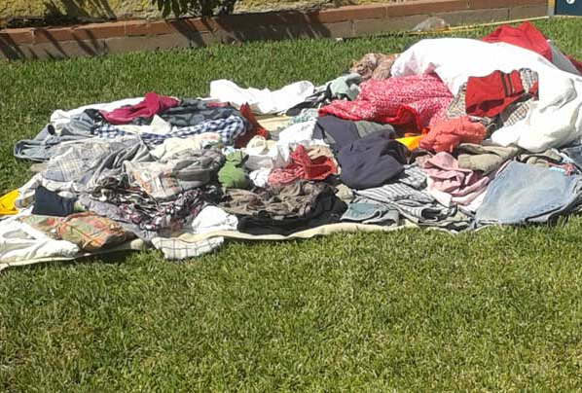
How the D Style approaches a yard sale
Great at starts but struggles with follow-through!

Slide 11

How the I Style approaches a yard sale
Great at taking care of others with free lemonade but may forget about the profits!

Slide 12
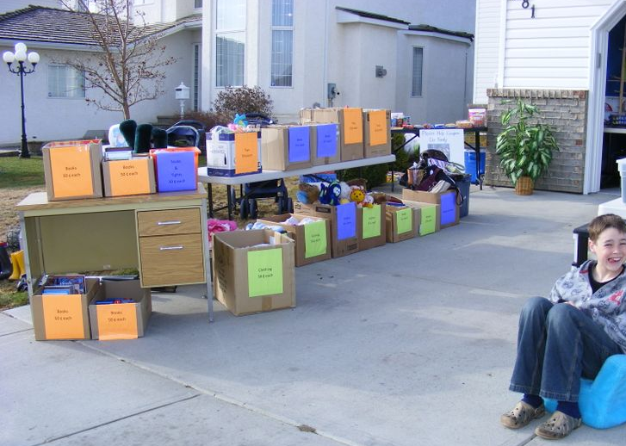
How the S Style approaches a yard sale
Great at detail like sorting and labeling but may be less inclined to offer spontaneous deals!

Slide 13

How the C Style manages a yard sale
Great at offering only the best items at a yard sale, and may forget that others may be looking for a bargain!

Slide 14
The D Dominant Style is energized at the start of the sale
The I Influential Style is energized by helping others
The S Steady Style is energized to join the sale once clear
information and expectations are established
The C Conscientious Style is energized by opportunities
to assess and improve the sale

Slide 15
True or False
1. The I, Influential Style is great at details
2. The C, Conscientious Style loves to collaborate

Slide 16

Cornerstone Principles of DISC Theory
All styles are equally valuable and can be equally effective.
Understanding yourself better is the first step to managing your intentions and making the impact you want.
DISC is a learning assessment, measuring preferences, not abilities.
You can and have learned to flex your style to accommodate changes in your environment.

Slide 17
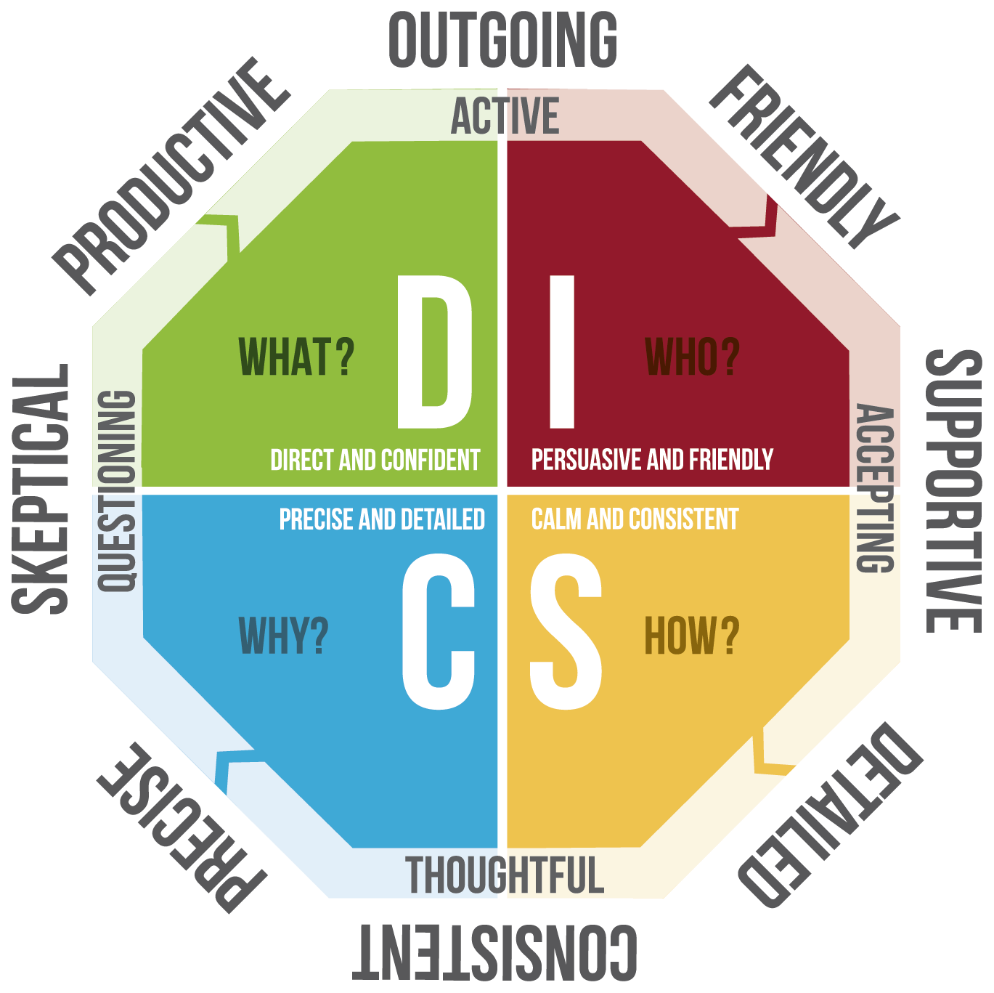
Let’s Take a Closer Look at the Styles

Slide 18
The D, Direct and Confident Style focuses on what needs to be done.
This style is characterized by being:
Productive
Outgoing
The D style takes risks and initiate's action.

Slide 19
The I, influential, Persuasive and Friendly Style focuses on who needs support.
This style is characterized by being:
Outgoing
Friendly
Supportive
The I style is enthusiastic and collaborative.

Slide 20
The Steady, Calm and Consistent Style focuses on how things needs to be done. The style characterized by being:
Supportive
Detailed
The Steady Style likes to
focus on understanding how to proceed to ensure
stability and reduce risk.

Slide 21
The C, Conscientious, Precise and Detailed Style and Confident Style focuses on why things need doing.
This style is characterized by being:
Precise
Skeptical
The C style works to ensure accuracy and ensures that
they know why to proceed before acting.

Slide 22
Let’s take a deep dive into each stye
As we explore, ask yourself, “is this my style, or do I know someone who has this style?”

Slide 23
Explore the D/Dominant Style
High Self-Confidence
Courageous
Result-Oriented
Commanding
Competitive
Change-Agent
Direct
Straightforward

Slide 24
Reading & Understanding D/Dominant Style
Motivated by
Challenge, power and taking charge
Opportunities for individual accomplishments
Freedom from direct control
New and varied activities
Fears
Having a loss of control
Being taken advantage of
Challenges
Lack of concern for others
Impatience
Moving forward without considering outcomes

Slide 25
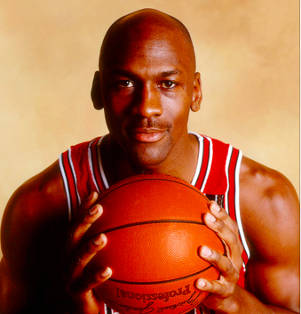


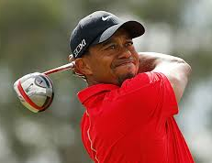
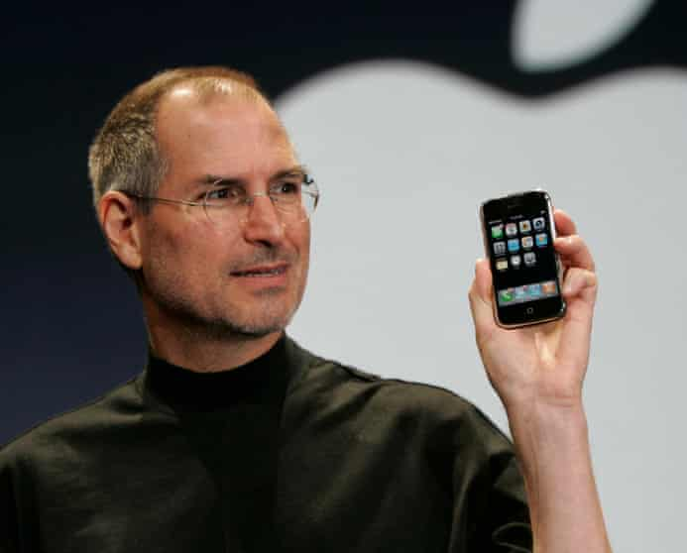
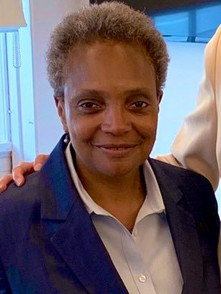
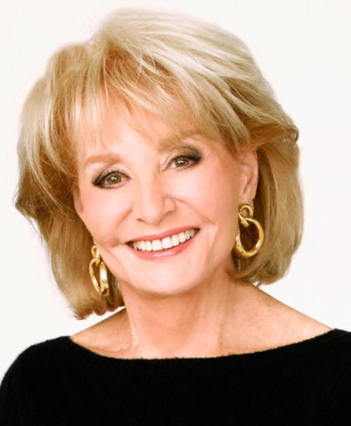

D

Slide 26
Discussion
How is the D style useful?
How can the D style create challenges?

Slide 27
Supporting the
D/Dominant Style
Use an assertive approach –
you are supporting a speeding bullet
Slow them down and focus on detail
Keeping them active during
the whole project –
not just the beginning
Push back on bluntness
and insensitivity
Help them value people’s needs

Slide 28
True or False
1. The D, Dominant Style prefers a fast-paced environment
2. The D, Dominant Style considers options and details before moving forward

Slide 29
Explore the
I/Influential Style
People-Oriented
Emotional
Talkative
Fun Loving
Optimistic
Spontaneous
Seek Social Acceptance and Applause

Slide 30
Reading & Understanding
I/Influential Style
Motivated by
Social recognition
Group activities
Relationships
Freedom of expression
Fears
Social rejection, disapproval,
loss of influence
Challenges
Impulsiveness, disorganization, lack of follow through

Slide 31
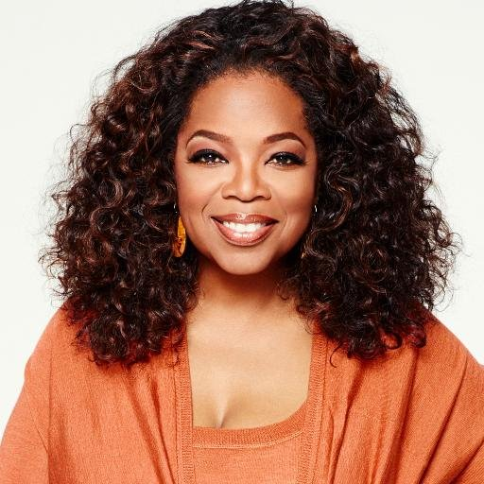

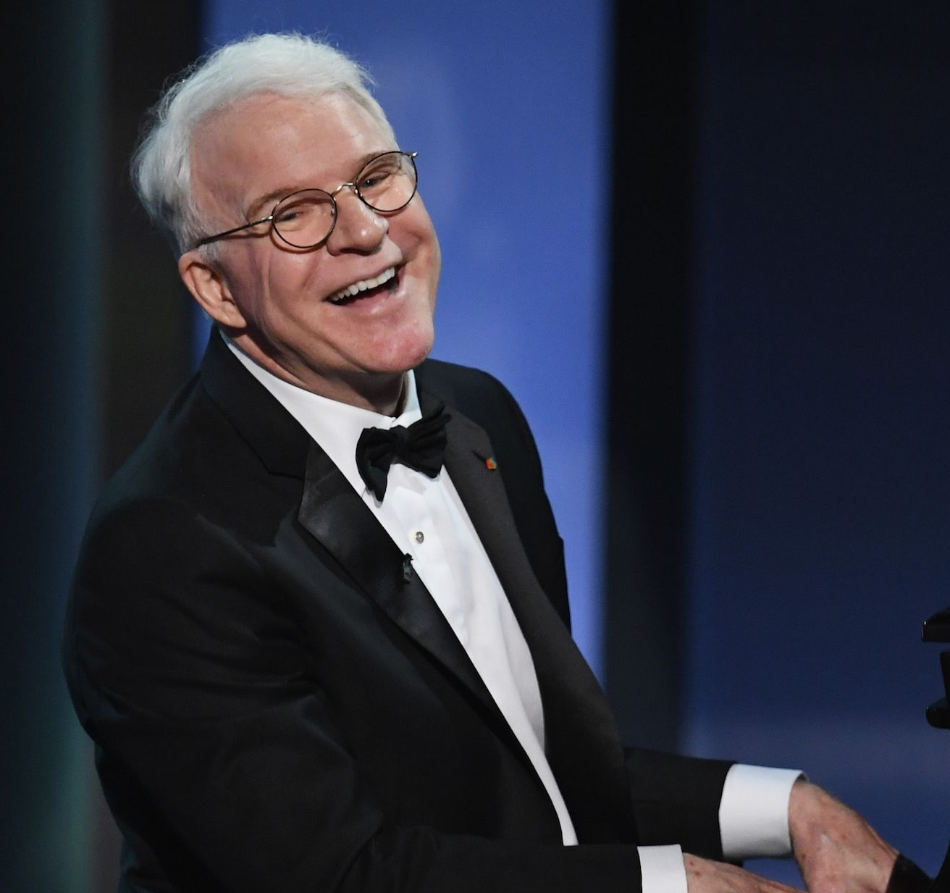
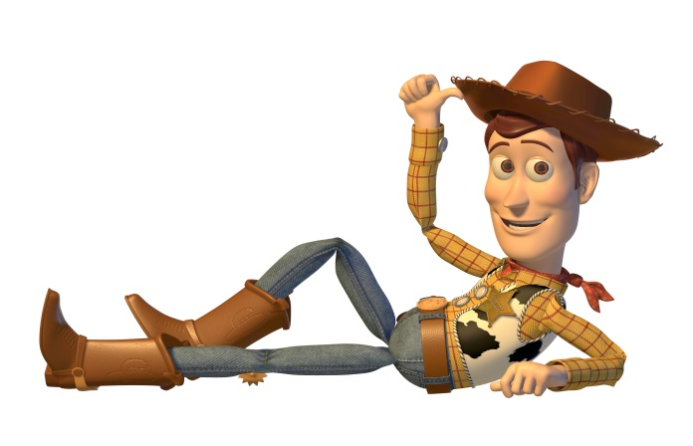
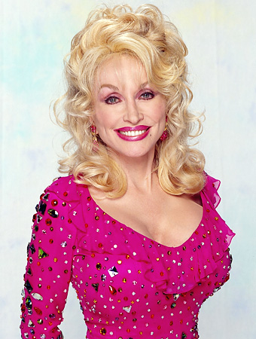




Slide 32
Discussion
How is the I style useful?
How can the I style create challenges?

Slide 33
Supporting
I/Influential Style
Build your relationship before approaching tasks
Focus them on task details
Ensure they have opportunities to collaborate
Help them focus on their own needs

Slide 34
True or False
1. The I, Influential Style likes to help others
2. The I, Influential Style may look erratic as they rush about, trying to please everyone

Slide 35
Explore the
S/Steady Style
Loyal
Team Player
Prefer Familiarity
Render Service
Humble
Committed To People
Pragmatic

Slide 36
Reading & Understanding
S/Steady Style
Motivated by
Stability
Sincere appreciation
Cooperation
Using traditional methods
Fears
Loss of stability
Sudden change
Unpredictability
Challenges
Resistance to positive change
Responding to urgent timelines
Setting bottom lines

Slide 37
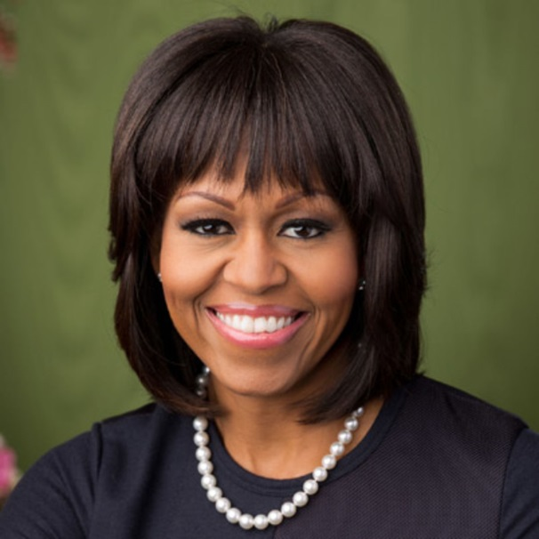
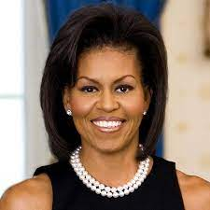
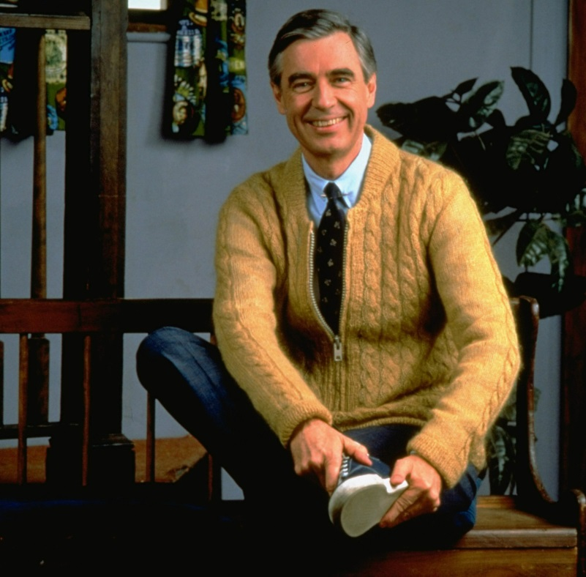
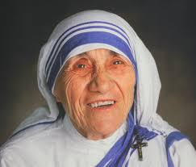

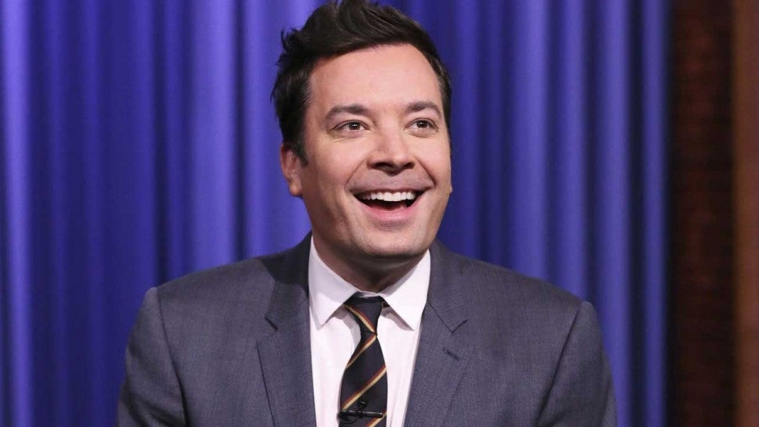
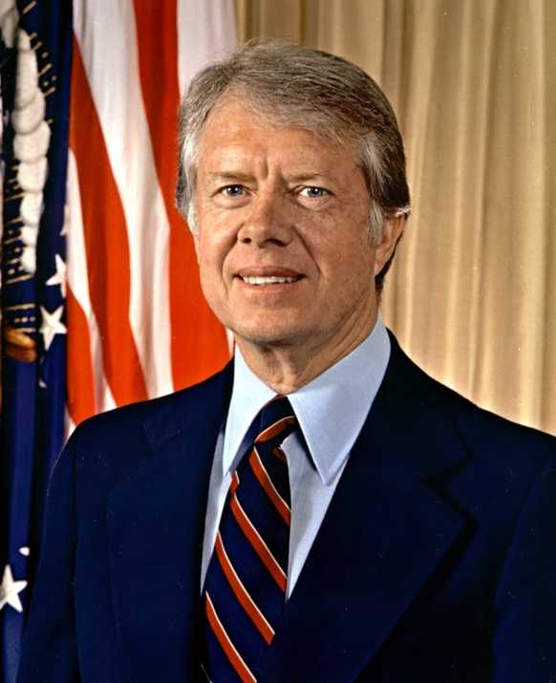
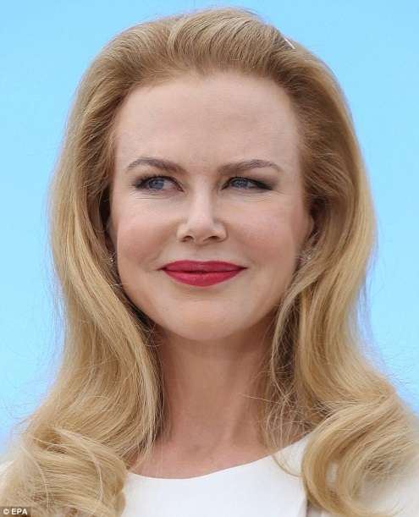
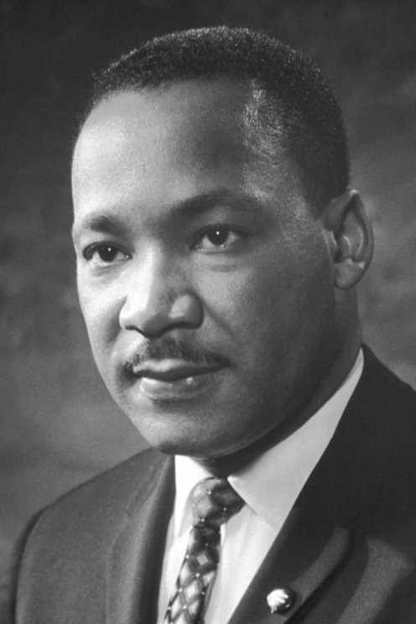


Slide 38
Discussion
How is the S style useful?
How can the S style create challenges?

Slide 39
Supporting
S/Steady Style
Help them face conflicts without giving in
Help them take a stand
Encourage speaking up
Allow them time to think

Slide 40
True or False
1. The S, Steady Style likes to collaborate
2. The S, Steady Style like to take in as much information as possible to avoid unnecessary risks

Slide 41
Explore the
C/Conscientious
Style
Maintains High Standards
Attentive to Key Details
Self-Disciplined
Cautious
Analytical
Highly Intuitive
Does Things the “Right Way”

Slide 42
Reading the
C/Conscientious
Style
Motivated by
Clearly defined performance expectations
Quality and accuracy
Reserved atmosphere
High standards
Fears
Criticism of their work
Slipshod methods
Situations emotionally out of control
Challenges
Overly critical of themselves and others
Indecision due to analyzing too much data
Creativity hampered by following the rules

Slide 43



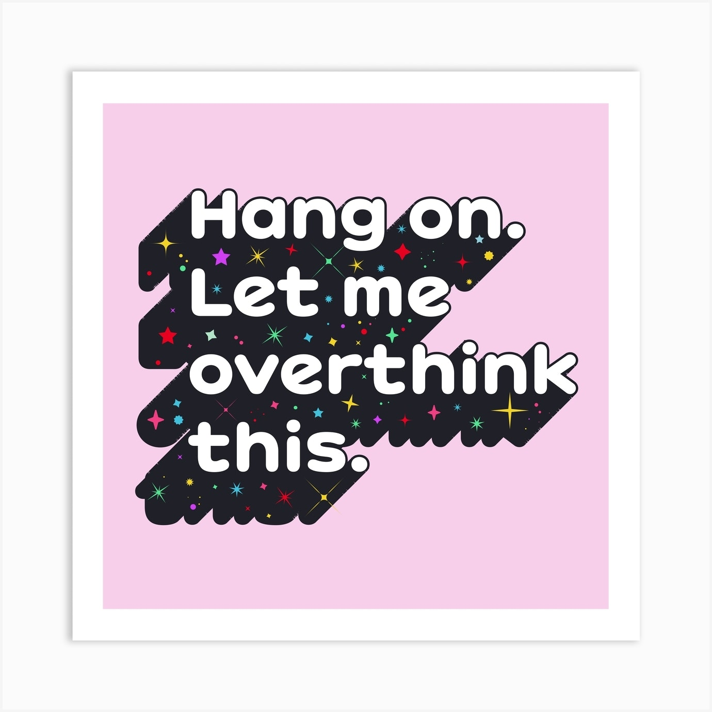
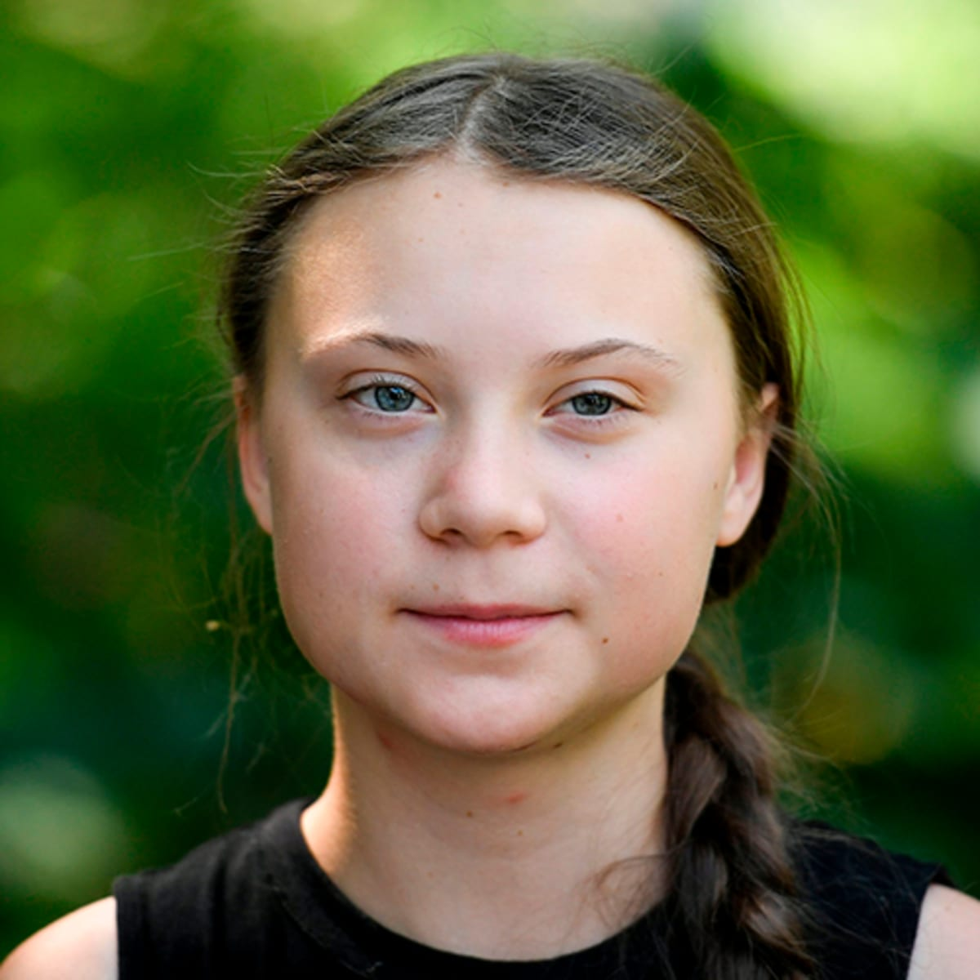
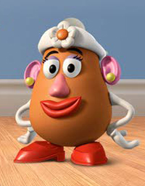
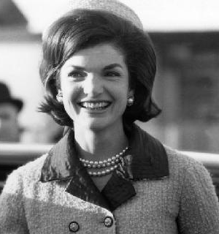

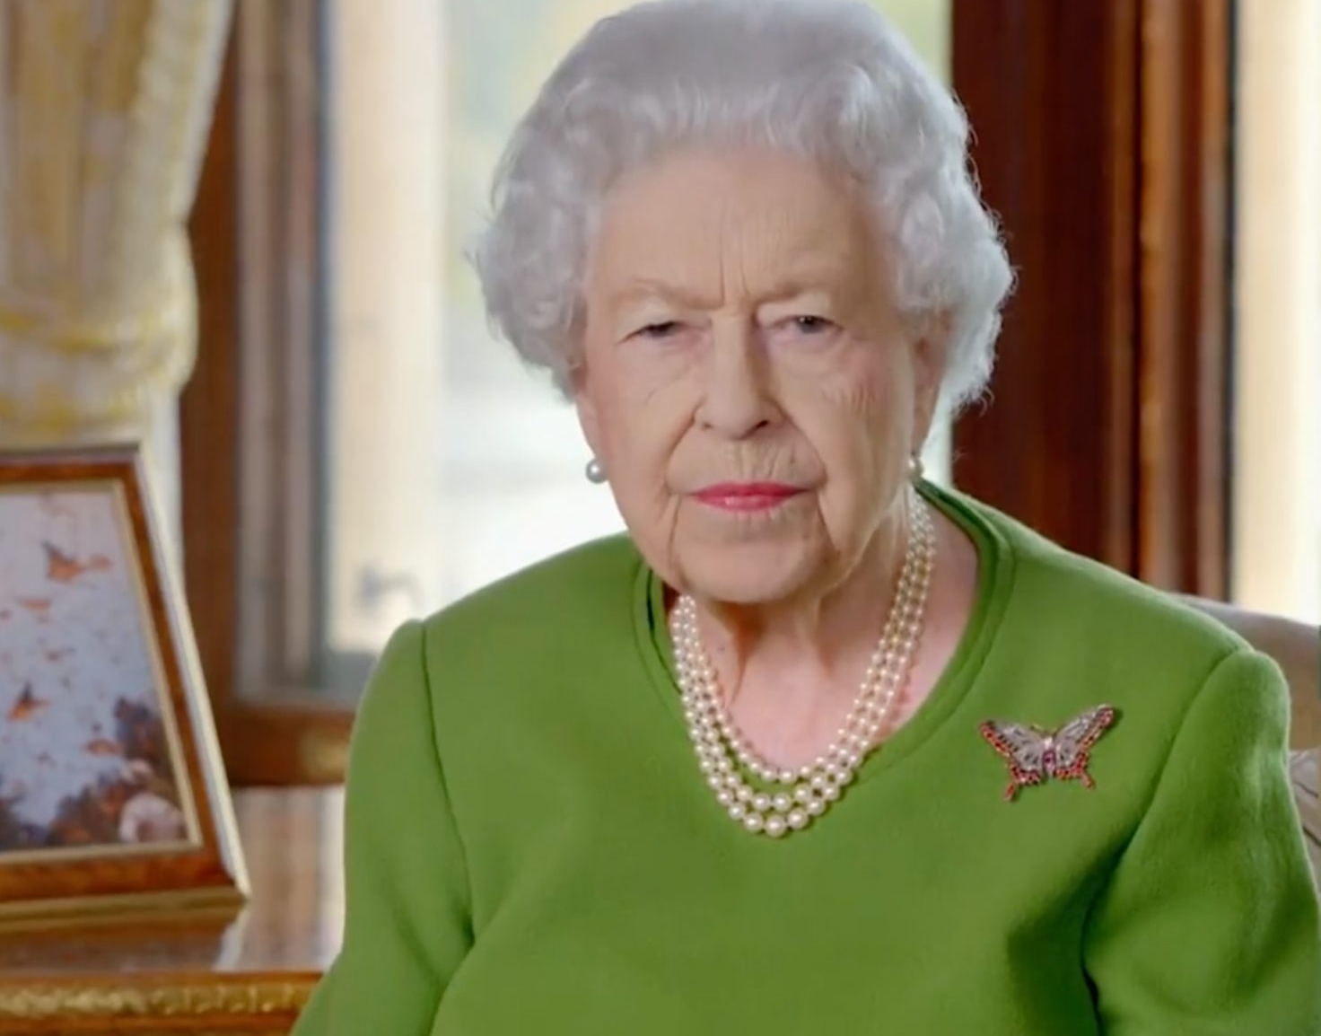


Slide 44
Discussion
How is the C style useful?
How can the C style create challenges?

Slide 45
Supporting
C/Conscientious
Style
Pushing them to join the
group early in the decision-making process
Exposing their thoughts and ideas
Supporting them to stay involved instead of withdrawing

Slide 46
True or False
1. The C, Conscientious Style is outgoing and friendly
2. The C, Conscientious Style is great at assessing and refining

Slide 47
Benefits
C: Precise
C: Overly critical
S: Overly cautious
I: Too giving
Challenges
S: Dependable
I: Supportive
D: Productive
D: Too urgent
DISC Style
Benefits &
Challenges

Slide 48
True or False
1. The S, Steady Style can be overly critical
2. The D, Dominant Style can be too urgent

Slide 49
Learn to Flex your Style
If you are a: | Reduce your overemphasis on: | And be more:
High “D” | Controlling people and conditions in your environment | Patient; accepting; open to others; listening in your approach.
High “I” | Approval from others your primary source of direction | Task-focused; open to facts and data; prepared; organized.
High “S” | Resistance to new ideas and opportunities and “risk-free” choices | Direct with your opinion; negotiable; open to change; quicker to adapt.
High “C” | Perfectionism; the weaknesses of others and yourself. | Flexible in problem-solving; open to views of others; empathic.

Slide 50
True or False
1. The I, Influential Style can benefit by reducing their focus on controlling people in their environment
2. The C, Conscientious Style can benefit from being more flexible in problem-solving, open to the views of others and empathic

Slide 51
The Role of the Facilitator
The role of a DISC Professional Styles facilitator is to guide participants in interpreting their style and provide coaching specific to their style. The facilitator should be knowledgeable in DISC styles, how those styles are most successful and how different styles come together in a team.
Facilitation involves three best practices:
Accurately interpret and convey DISC Professional Styles materials
Guide learners within an engaging, experiential learning approach
Help learners apply their new knowledge and skills

Slide 52
Your Facilitation Style
DISC Style | Facilitation Style Strengths | Facilitation Style Challenges
D: Dominance | Is direct and confident Provides concise information Is fast paced Directive | May appear cold and distant May provide superficial information May deliver content too quickly May be abrupt or blunt
I: Influence | Warm and friendly Connects with each learner Cares about feelings and emotions over facts Is enthusiastic and energetic | Can be seen as insincere May avoid resolving conflicts that arise through appeasement Enthusiasm can mask a lack of deeper knowledge Some need more detail and direction as learners
S: Steadiness | Ultimate team player Listeners rather than talks Wants to help and support Likes detail and certainty and follows a clear plan or agenda | Can be seen as a peer instead of leader Some may need firmer direction as learners May get lost in detail instead of providing the “big picture” Can avoid conflicts that arise instead of resolving
C: Conscientious | Is accurate and factual Uses objectivity, rational thinking, and facts over emotion. Looks for the correct way of doing things Gives learners time to process and think | Can be seen as cold and distant May be too rational: not able to connect the emotional dots Can avoid conflicts that arise instead of resolving May be too rigid in following a plan or agenda

Slide 53
What Learners Want
D/Dominant Learners: Challenging, fast-paced compelling learning opportunities delivered with a professional approach
I/Influential Learners: Meaningful learning opportunities to connect and align with others
S/Steady Learners: Clear, detailed, agenda-driven training information delivered with a personal approach
C/Conscientious Learners: Clear, detailed, agenda-driven training information delivered with a matter of fact, professional approach
Review
What styles do you naturally connect with as a facilitator?
What styles will you need to work harder to connect with as a facilitator?

Slide 54
Tips for Improving
Your Facilitation Impact
For all facilitators, focus on your group: What DISC styles are evident?
Facilitate to the learner’s style needs and flex your own style to meet the learner.
For D/Dominant Facilitators:
Warm up your learners! Provide small talk, ask them about their interests, Get more personal
Focus on details as well as the big picture
Slow down: Pace learning

Slide 55
Tips for Improving
Your Facilitation Impact
For I/Influential Facilitators:
Follow an agenda: Stay on topic and on time
Allow the learner to be responsible for learning or not
Don’t get too familiar too fast with learners who prefer formality

Slide 56
Tips for Improving
Your Facilitation Impact
For S/Steady Facilitators:
Speak up and quicken your pace
Follow an agenda and stay out of the weeds
Take risks and try new approaches

Slide 57
Tips for Improving
Your Facilitation Impact
C/Conscientious Facilitators
Warm up your learners! Bring more emotion into your expression and delivery
Use your agenda as a guide but steer clear of rigidly following it
Be sensitive to the different learning styles and flex your style as needed

Slide 58

Review
What steps can you take to optimize your facilitation style?

