Slide 1
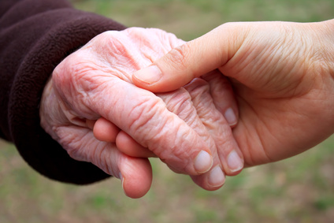
Compassionate Care Training
Living our Values

Slide 2

Notes:
Welcome! Why Compassionate Care Training at Moorings Park? Is it because we think that Moorings Park partners need help in learning how to be compassionate!?? Absolutely not. Surveys revealed that nearly every manager at MP believes staff are compassionate, and given the chance to rate our compassion, managers gave the highest score in almost every category. The reason we are here talking about Compassionate Care today is because compassion is a value that is very important at Moorings Park. In the same way that a each of makes our own personal values a priority in their life, Moorings Park is focused on making the values of the organization a priority for us all. In the end, this makes us a better organization. We will get started now, in learning about our own personal values, the values of Moorings Park and how understanding them can make our organization and our lives better.

Slide 3

Notes:
As Risa said, today we are going to talk about values. My guess is that there is something about working at Moorings Park that connects with you – something about your own values makes you want to continue to work here and feel good about being a part of the Moorings Park mission. We are going to spend the next couple of hours talking about your values and the values of Moorings Park, and how Moorings Park lives up to it’s values and how we can all strive to live up to not only the values of Moorings Park, but also our own values. So, let’s start by having someone tell me what you think values are…

Slide 4
What are Values? – Angella (20 min)
Beliefs that govern our decisions and what is most important to us.
Values are the principles we live by.
Values are about what we consider important in life

Slide 5
Values
Beliefs
Attitudes
Words, thoughts and actions influenced by values & beliefs
What is
thought to
be true
What is important
Notes:
It should be understood that there is a difference between values, beliefs and attitudes. They are not all the same thing…

Slide 6
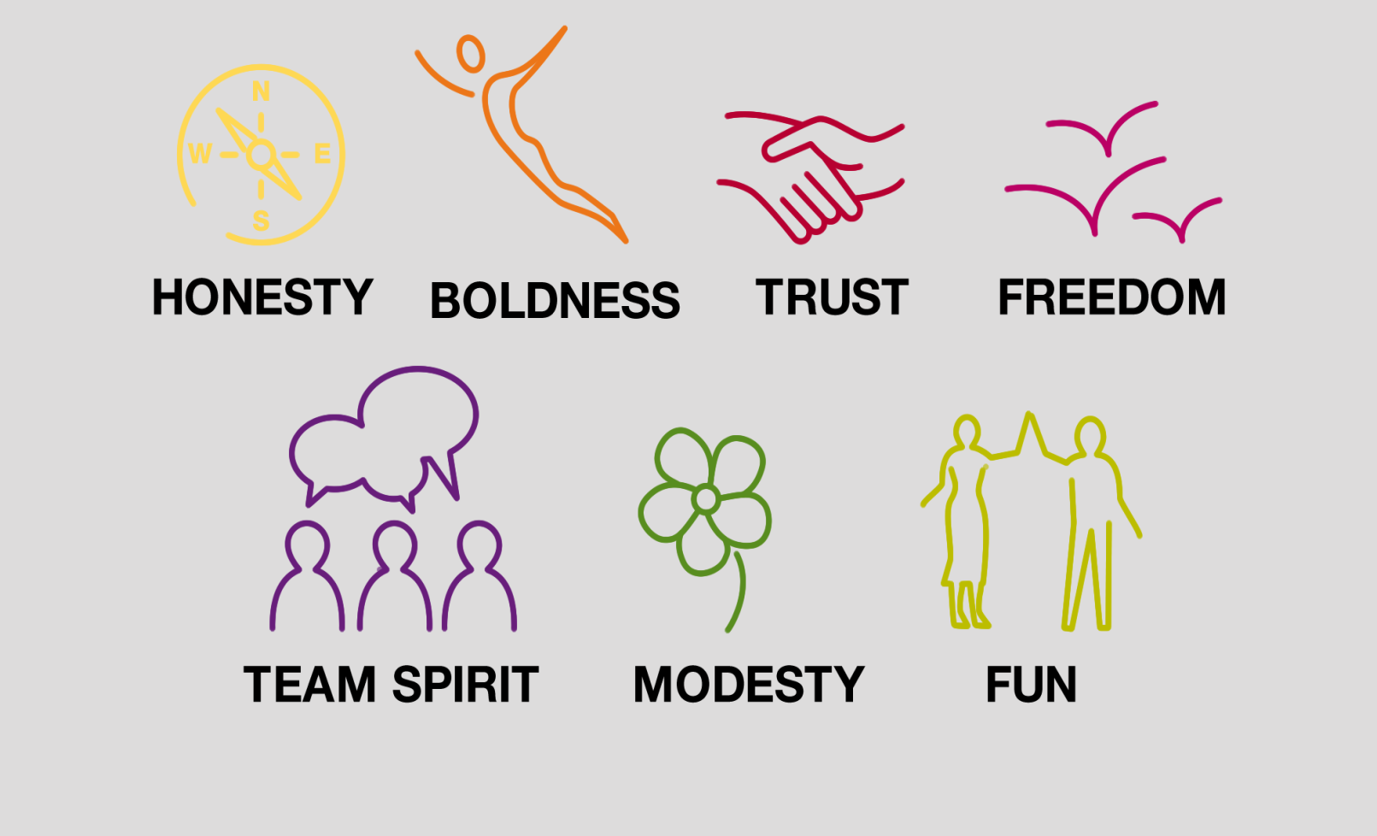
Examples of values
Notes:
Here are examples of values.

Slide 7
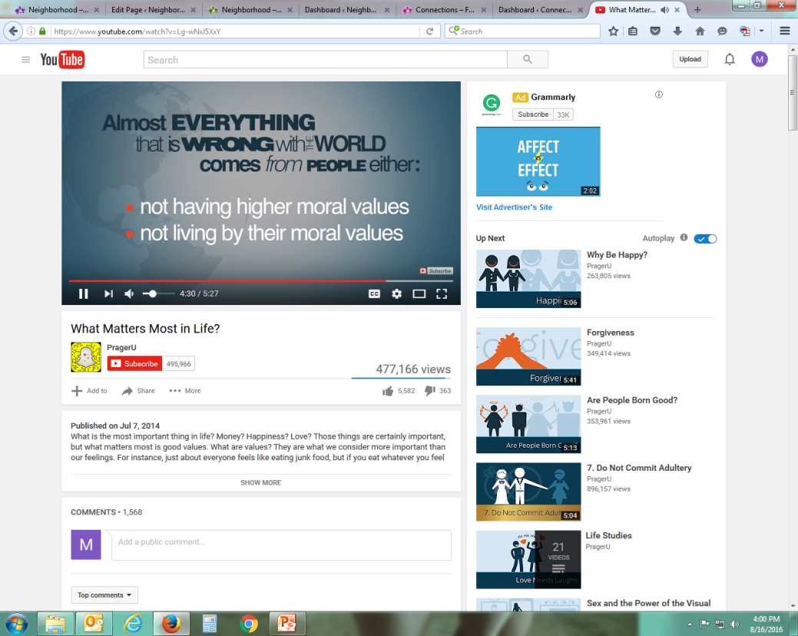

Slide 8
Why Are Values Important?
Influence our behavior and guide us in all situations
Values are about what’s most important to each individual
By becoming aware of our values, we can use them to guide us in life
Values are not only part of who we are and who we want to be

Slide 9
Do values change?
Values build character and can be learned at any age so if you don’t like a particular value you can unlearn it and learn something else which will impact who you are or want to be.
As you get older your values may change. What was important to you as a teenager might not be what is important as an adult. Some values can be taught to you as a child and some you develop on your own as you get older.
Notes:
Can you think of values that you may have held when you were younger that are no longer important to you? Which values do you feel you have held all of your life? Why do you think it is important to understand your own values?

Slide 10
Understanding Your Values
It is important that we understand what our values are. When we do, will be able to consider two very important questions:
Do my values make me a better person?
Do I make behave according to my values?

Slide 11
By understanding our values, we can learn to stay focused on living by our values in BIG ways (such as important life-decisions) as well as small ways (such as our every day behavior and how we choose to interact with others.)

Slide 12

Icebreaker Activity (erica 30 minutes)
Values Activity
List of values on board/paper
Choose 10 values
Then narrow to top 3
Answer questions
Share

Slide 13
Personal Values
Accountability
Achievement
Adaptability
Ambition
Attitude
Awareness
Balance (home/work)
Being the best
Caring
Coaching/mentoring
Commitment
Community involvement
Compassion
Competence
Conflict resolution
Continuous learning
Cooperation
Courage
Creativity
Dialogue
Ease with uncertainty
Enthusiasm
Entrepreneurial
Environmental
Efficiency
Ethics
Excellence
Fairness
Family
Financial stability
Forgiveness
Friendships
Future generations
Generosity
Health
Honesty
Humility
Humor/fun
Independence
Integrity
Initiative
Intuition
Job security
Leadership
Listening
Making a difference
Open communication
Openness
Patience
Perseverance
Professional growth
Personal fulfillment
Personal growth
Power
Recognition
Reliability
Respect
Responsibility
Risk-taking
Safety
Self-discipline
Success
Teamwork
Trust
Vision
Wealth
Well-being
Wisdom

Slide 14
Personal Values
From the 10 values chosen, think about the 3 that are the most important to you?
Why do you believe that this value is important to you?
Recall a moment in your life when you really lived this value. What behaviors did you exhibit that support this value?
How might you react if this value was not being honored by others? Describe your feelings thoughts and actions.

Slide 15
Reaffirm Your Values
Do these values make you feel good about yourself
Would you be proud share your values with others
Would these values represent the things you support, even if it makes you unpopular and in the minority

Slide 16
Believing , embracing and living out your values
When you understand your values then you can believe in them and embrace them and practice them as you travel the path of life. Values can define not just who you are, but also how you behave.

Slide 17
Organizational Values
Do organizations have values? Examples

Slide 18
Moorings Park’s Values
Respect for each person
Ethical behavior
Integrity, accountability, excellence
Diversity as strength
Commitment to Non-profit model
Open to innovation
***** What about another value of MP that is not listed here?!?!??!?! COMPASSION!!!

Slide 19
Personal Values – MP Values
Write MP Values on the board and have the partners get up and write their personal values under the corresponding MP Value.

Slide 20
Sticky Note Activity
11 Sticky notes
Write down, 3 loved ones, 3 privileges, and 5 possessions
You’re moving into Orchid Terrace tomorrow, what are the three things that you can take? (what values do they represent?)

Slide 21
LASSIE –Erica (15 min)
Listen
Apologize
Solutions Offered
Solutions Determined’
Initiate Action
Ensure Satisfaction

Slide 22

LISTEN
Listen to what is being said
No interruptions
Body language
Don’t get defensive

Slide 23

APOLOGIZE
Does not mean it is your fault
Empathize with their situation
“I’m so sorry that you have to deal with that.”

Slide 24
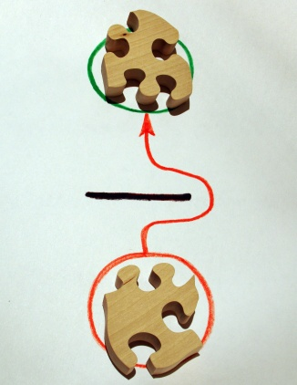
SOLUTIONS
DETERMINED
Let the resident choose
Reiterate

Slide 25

SOLUTIONS
OFFERED
Offer different options
Be realistic

Slide 26

INITIATE ACTION
Take the necessary measures to follow through with the solution that was determined
In a timely manner
Don’t be afraid to ask for help

Slide 27
Lassie
Share personal scenarios in which LASSIE was used successfully.
Did using Lassie allow you to live by your values?

Slide 28
Best Friends – Celeste (30 min)

Slide 29

ENSURE SATISFACTION
After action has been initiated follow up to see if the issue has been rectified.
If it has not, offer different solutions and follow through with those.
Continue until resident satisfaction is reached.

Slide 30

Best Friends™
In January, 2013 when we set a goal to enhance dementia care campus wide and open a new memory neighborhood in assisted living.
The Best Friends™ Approach was identified as a Best Practice
Key staff campus wide attended Master Training.
Engaged David Troxel as our consultant
Created a Best Friends Care Team
Established campus wide training
Moorings Park
To always be “simply the best”.
This is true when it comes to meeting the growing challenges of Alzheimer’s disease and other dementia.

Slide 31
Best Friends™ Project at Moorings Park
Raising awareness of dementia campus wide.
Embracing communication, empathy, activities, engagement, Life Story work and relationships.
Innovating in the area of care partner training.
Opening up a new memory care neighborhood utilizing Best Friends as its philosophy.
Best Friends™: A method of care for people with Alzheimer's disease. A comprehensive approach grounded in the understanding that relationships are supremely important in dementia care and require the essential elements of friendship: respect, empathy, support, trust, and humor.

Slide 32
The Best Friends™ Approach
What a person with dementia needs most of all is a friend – a “Best Friend.”
Philosophy developed in the 1980s and 1990s by Virginia Bell & David Troxel.
A person-centered approach that helps the person feel safe, secure, & valued.
Teaches staff and families the “knack” of providing great care.
When a Care Partner embraces Best Friends he or she:
Strives to communicate (as you would with a friend)
Is patient and understanding on the bad days (as you would with a friend)
Laughs and smiles (as you would with a friend)
Provides encouragement (as you would with a friend)
Exercises, listens, talks about meaningful things (as you would with a friend)

Slide 33
When you create a Best Friends™ culture everything goes better!
Dressing
Embrace the Life Story
Maintain a Sense of Humor
Recognize the Spiritual
Engage in Life-Affirming Activities
Think Outside the Box
Develop “the Knack”
Showers
Conversation
Participation in activities
Less agitation
Dining
Family satisfaction
Safety/less wandering
Staff morale
Less fights/depression
Notes:
The next slides reinforce some key elements of Best Friends and will help your students understand more about Best Friends

Slide 34
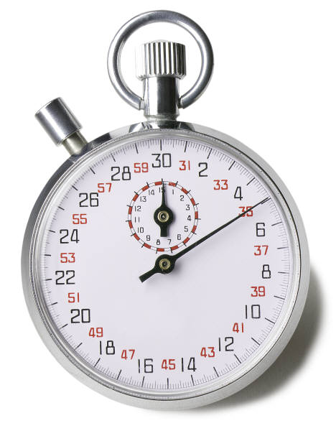
Why friendship?
Persons with dementia can be “lost” and “lonely.”
Being a good friend, involves:
Knowing a person’s history and preferences
Being empathetic, warm, and loving
Communicating
Doing things together
In Alzheimer’s and dementia care, friendship:
Allows us to have empathy and to be more understanding of behaviors that are challenging.
Encourages us to learn and use the Life Story to make a connection, bring up a favorite subject, understand a concern, or redirect.
It only takes 30 seconds to be a little less task-oriented and a little more person-centered.

Slide 35
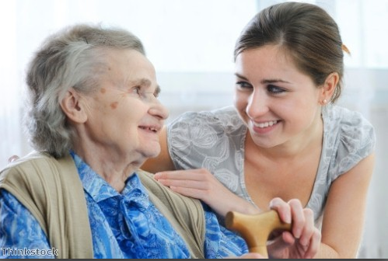
Best Friends and the Art of Friendship
Best Friends™ Know Each Other's History and Personality

Slide 36
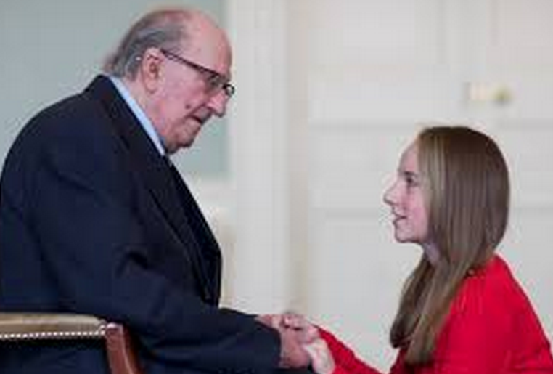
Best Friends™ Do Things Together
A Best Friend:
Communicates.
Listens and speaks skillfully.
Asks questions skillfully.
Speaks using body language.
It is important to:
Greet the person warmly.
Smile broadly.
Give handshakes.
Make eye contact.
Use your hands to gesture.

Slide 37
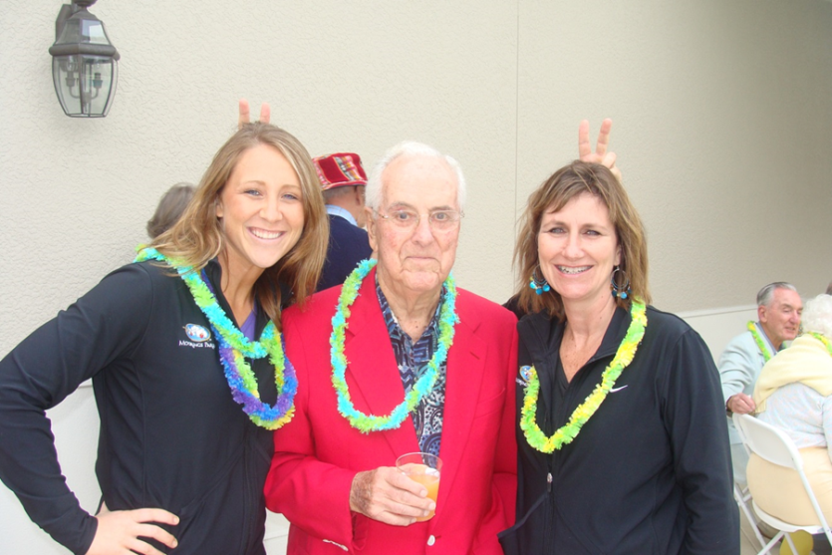
Best Friends™ Build Self-Esteem
A Best Friend:
Gives compliments often.
Carefully asks for advice or opinions.
Offers congratulations.
It is important to:
Laugh often.
Tell jokes and funny stories.
Take advantage of spontaneous fun.
Use self-deprecating humor often.

Slide 38
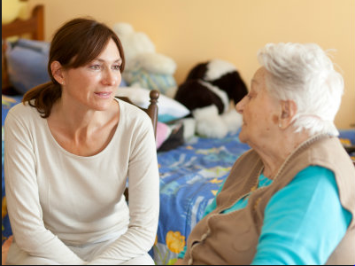
Best Friends™ Are Equals
A Best Friend:
Always works to protect the dignity of the person.
Does not assume a supervisory role.
Recognizes that learning is a two way street.
It is important to:
Not be overly sensitive.
Build a trusting relationship.
Show affection often.

Slide 39
Best Friends™ Communicate as Adults
A Best Friend DOES NOT…
Speak in an exaggerated or slow voice when not necessary
Act insensitive
Use childlike language
Act flippant
Give the person no time to respond to a question
Ask inappropriate and em­barrassing questions
“Talk through" a person as though he or she is not there

Slide 40

The Dementia Umbrella
Irreversible
Alzheimer’s disease
Frontal Temporal dementia
Lewy body dementia
Vascular dementia
Potentially Reversible
Normal-pressure Hydrocephalus
Vitamin B-12 deficiency
Infections/hormone/thyroid
Medication Interactions

Slide 41
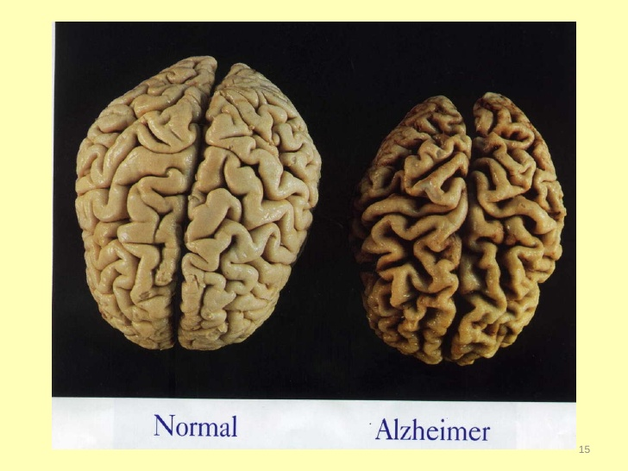
Alzheimer Visualization

Slide 42
Feelings and Behaviors Caused by Dementia
Feelings
Loss
Isolation and Loneliness
Sadness
Confusion
Worry and Anxiety
Frustration
Fear and Paranoia
Anger
Embarrassment
Behaviors
Crying/calling out
Sleeping difficulties
Having delusions or hallucinations
Repetitive behavior
Wandering
Wanting to drive the car
Mistaking identities
Refusing to bathe or eat

Slide 43
Best Friends™ …with the Knack
Knack: The art of doing difficult things with ease or using clever tricks and strategies
Best Friends™ with the Knack…
Smile
Show patience
Are flexible
Communicate
Ask for an opinion
Give a compliment
Give simple choices
Show respect
Use the Life Story
Have a sense of humor
Employ good timing
Prepare creative activities
Enjoy being outside
LOVE!

Slide 44
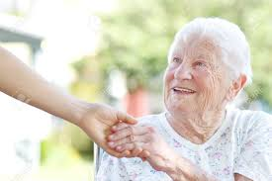
Best Friends™ …with the Knack
Being a Best Friend to persons with dementia
is an act of kindness.
Even caregivers with Knack will fail on occasion. Good & bad days happen. Caregivers with Knack can fine tune approaches.
Using Knack will never make matters worse.
Knack helps you make the best of any situation.

Slide 45
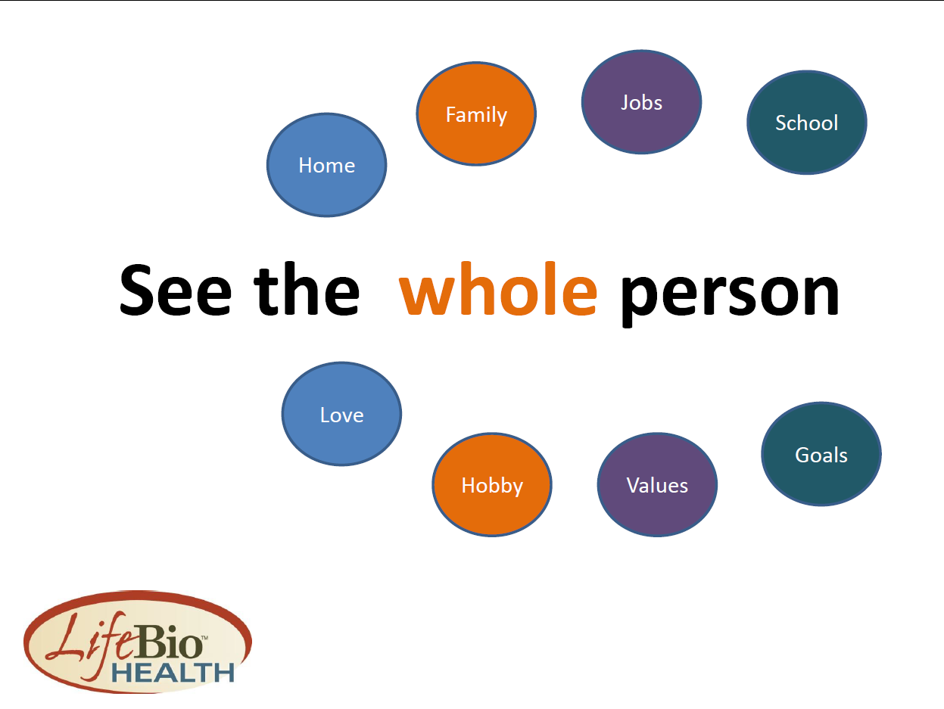
The Importance of Knowing & Honoring
One’s Life Story

Slide 46
Key Elements of the Life Story
Young Adulthood
College and work
Marriage(s)/relationship(s)
Family
Clubs and/or community
involvement
First home
Military service
Middle Age
Grandchildren
Hobbies
Work / family role
Clubs and organizations
Community involvement
Older Adulthood
Life achievements
accomplishments
Hobbies
Travel
Family
Other Major Ingredients
Ethnicity
Religious background
Awards
Special skills
Favorite personal stories
Childhood
-Birth date and birthplace
-Parents and grandparents
-Brothers and sisters
-Early education
-Pets
Adolescence
-High school name
-Favorite classes
-Friends and interests
-Hobbies and sports
-First job

Slide 47
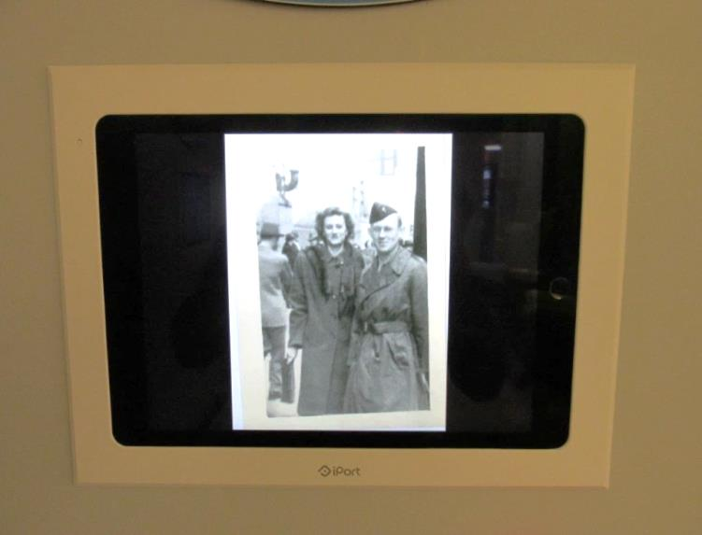
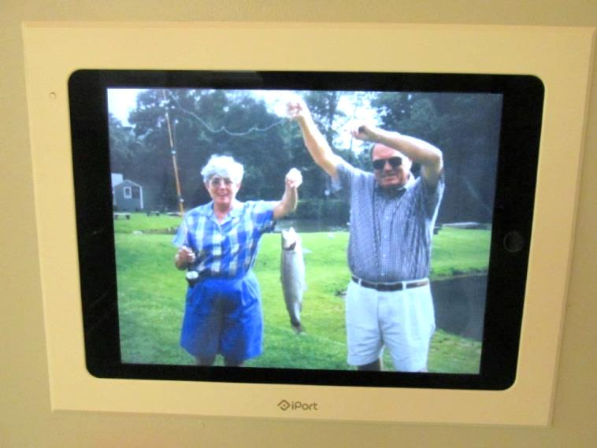
Creating a Life Story at Moorings Park
Moorings Park Ideas:
Leave A Legacy
Story Boards & Things to Know About Me
Personalized Photo Galleries presented on iPads

Slide 48
Capture Life Stories
When you’ve met one person with Alzheimer's Disease, you’ve met one person with Alzheimer's Disease.
Every person’s life is a collection of the many, people, places and adventures experienced.
There is no one else like you!

Slide 49
Why Life Stories?
Person-Centered Care – **Best Friends Approach**
Enhance Health & Wellbeing – Touch ALL Dimensions of Wellness
Streamline Care Transitions (Ex. From Ind. Living to Memory Care)
Reduce Loneliness (a Major Health Risk) & Increase Friendships
Innovate in Memory Care to Provide Effective Engagement
Better Visits Happen Between Staff, Family, and Volunteers
Deliver on Brand Promises – Marketing Individualized Care
Record the Legacy – Share the Life Story at End of Life

Slide 50
Best Friends Approach
Is a testament to how strongly Moorings Park embraces it’s values
Respect for each person
Ethical behavior
Integrity, accountability, excellence
Compassionate Care

Slide 51

Values Recap
MY OWN VALUES
MOORING PARK VALUES
Notes:
Hopefully everything you have heard until now is making you realize that one of the reasons you are working at Moorings Park is because your values and those of Moorings Park are aligned, and you feel good about the part you play for our residents. Our own values make us better people and Moorings Park’s values make us a better organization.

Slide 52
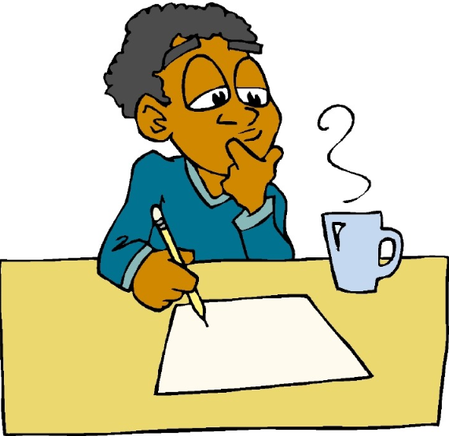
PERSONAL VALUES
Do they make me a better person?
Do I behave according to my values?
Notes:
As we consider values, let’s look back again at the two questions we ask ourselves about our own values. When we think about these questions, something comes to mind that’s very important! First of all, if you acknowledge a value that you aren’t proud of or that you feel doesn’t make you a better person, consider changing it! AND, our values ONLY make us better people IF we behave according to them. Let’s consider Moorings Park, if we say we value respect for every person, but fail to show respect to our residents or our partners, does that value make us any better? And if, as people, we value kindness, but fail to show kindness to others, does that make us better??

Slide 53
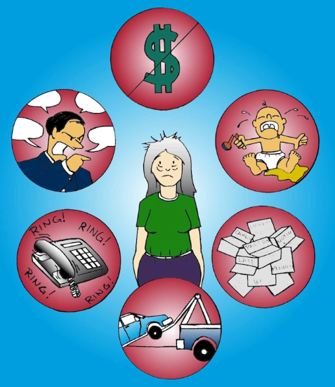
What can cause us to behave differently than our values?
Notes:
Everyone here values kindness and compassion, and we would all wish to be able to show this kindness every day through our actions. But sometimes life is tough – it’s difficult to remember to stay focused on your values when you are worrying about major issues in your life.

Slide 54
What do you do to stay focused on your values when life is tough??

Slide 55

Notes:
Focus on slow, deep breaths. Breathe in through your nose until your lungs are full, and then breathe out your mouth until your lungs are completely empty. Doing this a few times actually creates a physiological response that allows your body to relax and feel more calm, which allows us to re-focus on our values, even during times that are stressful.

Slide 56
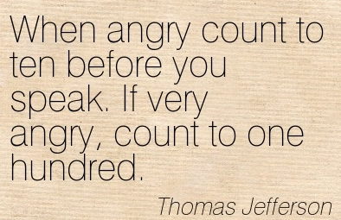
Notes:
The point is – force yourself to stop and think before you react. Breathing at the same time would also help!

Slide 57
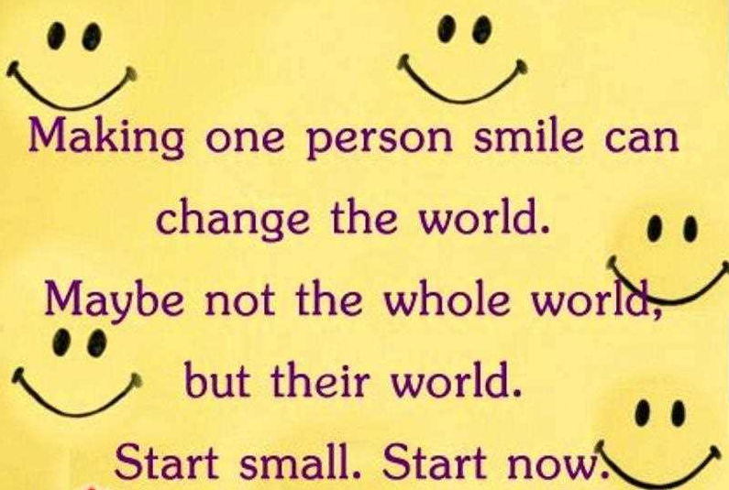
Notes:
Smiling is not only good for the person who gets to see your smile, it also has a physiological impact on your brain as you do it! There is actually scientific research that supports the idea that when in a bad mood, smiling (even if it’s fake) will make you feel better.

Slide 58
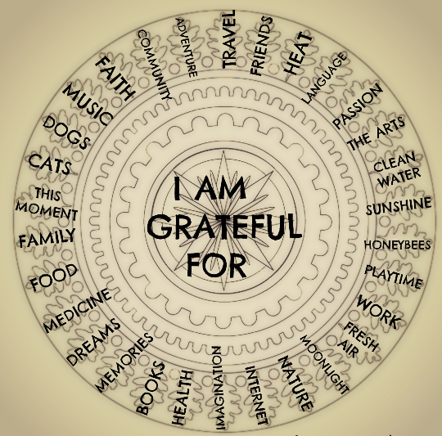
Notes:
Even when things are not going well – we can all think of things to be thankful for. Some of the things I am most thankful for are my family, health, living in the U.S. Sometimes just reminding ourselves of these things is all it takes to re-focus on our values.

Slide 59
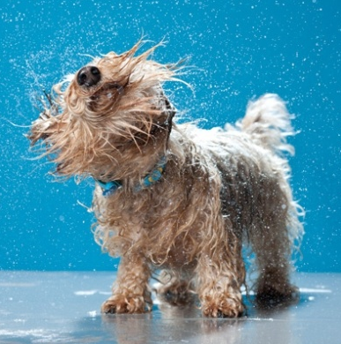
Give yourself time to “shake it off”- but don’t dwell !
Notes:
When something gets us down, it wouldn’t be human to be able to ignore the feelings completely or just pretend the worrisome thought doesn’t‘ exist. So, when there is something weighing on us, sometimes we just need to accept the bad feeling, acknowledge that we are upset, and allow ourselves to feel badly about it for a little while. By giving yourself an actual time limit in your mind to mentally allow yourself to feel frustrated/sad/nervous, and then committing “shaking it off” after you have given yourself some time, you are making a conscious act to work through the emotion and then move on from a better place. And you are also ensuring that you aren’t dwelling on the issue and letting it take up more energy than the issue is worth.

Slide 60

Notes:
This is another fact that we have all heard- Exercise, fresh air, taking a walk are all extremely helpful in allowing us to clear our heads and take a fresh perspective.

Slide 61
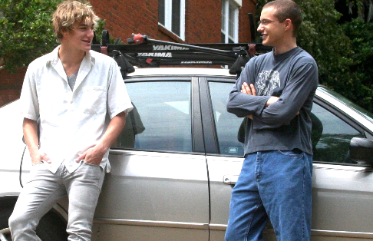
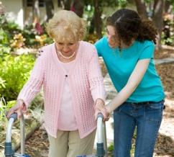
Talk to a friend
Do something kind for someone
Notes:
Most people feel better about almost any issue after talking it over with a friend. Sometimes you are looking for solutions, and other times you just want to vent. It’s especially helpful if you start the conversation by telling the friend if you are looking for input or if you just need a sounding board or sympathetic ear.
Everyone here can likely answer this question…. When you do something kind for another person, who benefits??? Of course the other person does, but don’t you agree that most of the time, you benefit at least as much?!?!?! Remember this when you are feeling blue! It can be a really positive way out of a bad mood for you and for the other person!

Slide 62
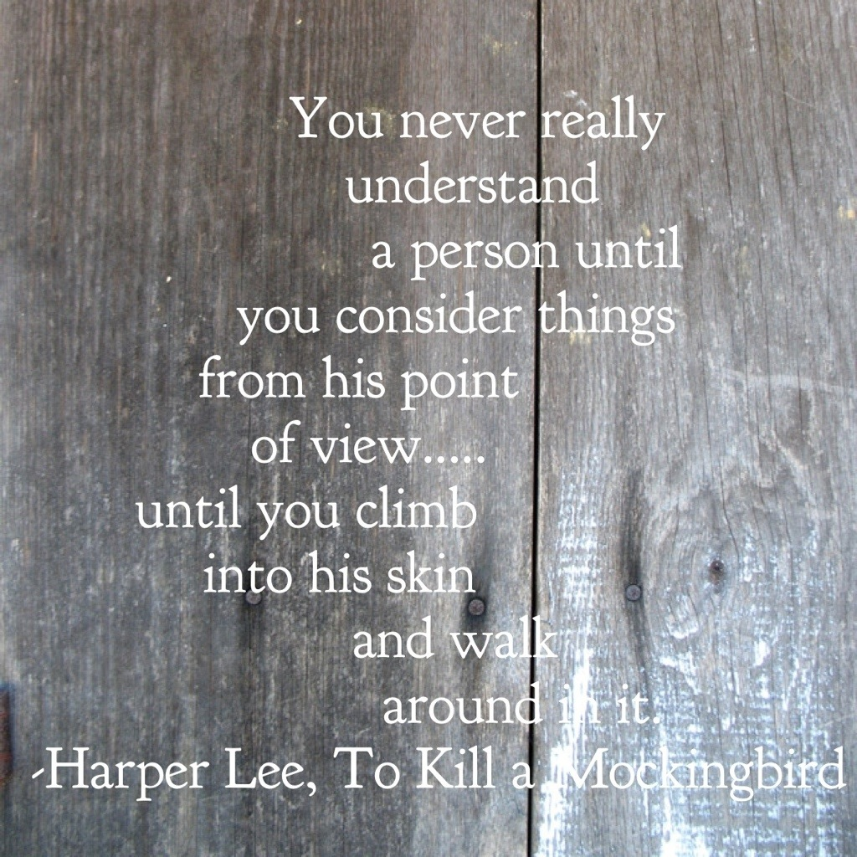
Notes:
Sometimes the thing that has caused us to lose focus on our own positive values is the action or behavior of another person. When this happens, it’s always helpful to step back (and breathe and possibly count to 10!!) and remember that we never know what kind of day, or LIFE, that other person is having. People walk around every day with hardships and worries in their hearts, and most of the time, those of us at work don’t even know it! Before you lash out or feel angry or let a bad interaction with someone else ruin your day, stop and try to remember that you never know the entire story about someone else and if you did, you would most likely see everything differently.

Slide 63
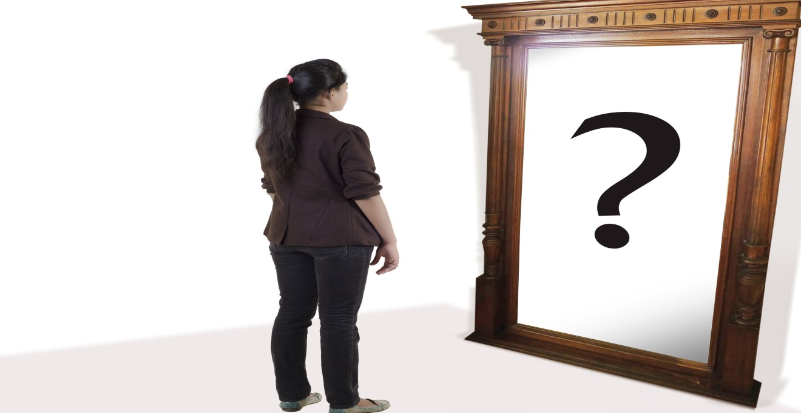
Check yourself! Do you express your values in your demeanor and expressions?
Notes:
Just because you feel like you are living according to your values, every so often, it’s important to stop and consider whether or not you are showing your values outwardly. Give yourself an objective look – Do you smile often? Do you greet others when you see them? What expression does your face share? Do you look bored? Irritated? Do you look people in the eye? Do you walk with your shoulders back and head held high? Do you take time to slow down and show others you care about them?

Slide 64
Re-focus on your values and remember that only you can control whether or not you are embracing your values and living by them each day!

Slide 65
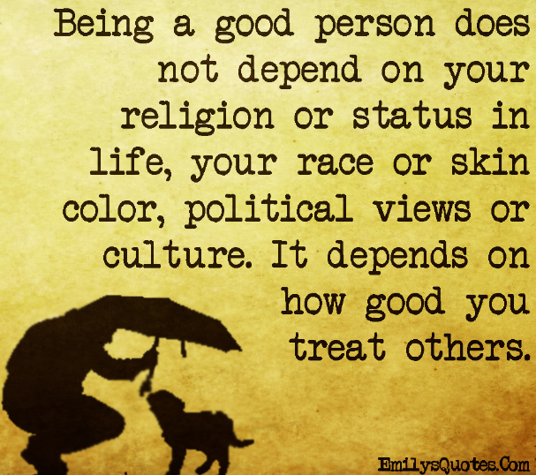

Slide 66
What do we do to maintain our values when life gets us down –Larisa (15 min)
Make a difference: https://www.youtube.com/watch?v=QUGQ-fMgVSQ

Slide 67
Closing Video Testimonial of Residents? (3 min)
Make a difference: https://www.youtube.com/watch?v=QUGQ-fMgVSQ

Slide 68
