Slide 1

©Copyright Lee Health • All rights reserved
Notes:
AgePlay Purpose:
To improve employee understanding of the aging customer and therefore enhance customer service and grow the bottom line;
2) To expand the sensitivity, knowledge and skills of employees to the older adult environment;
3) To better understand the causes of confusion and memory loss in seniors and how to improve communication with them.

Slide 2
AgePlay
Training Objectives
To relate and understand the changes associated with aging through vision, hearing and impaired manual dexterity simulation.
To understand the importance of keeping our seniors active and engaged.
To identify the various causes of confusion in the older adult.
To understand the prevalence of depression and treatments options for the older adult.
To create an elder friendly environment.
To identify the services or groups of services available in your community to assist in providing support for older adults.
Notes:
Introduce yourself include your background, experience and education.
Share your personal interest in the program.
AgePlay Objectives:
• To relate to and understand the changes associated with aging through vision, hearing and impaired manual dexterity simulation.
• To understand the importance of keeping older adults active and engaged.
• To identify the various causes of confusion in the older adult.
• To understand the prevalence of depression in the older adult population, as well as available treatment options.
• To create an elder-friendly environment.
• To identify the services or groups of services available in the community to assist in providing care and support for older adults.
In order to understand the older adult, one needs to gain a “bird’s eye view” of their world. We have designed several simulations to give you this perspective.
My goal today is to put you in the hands, eyes and ears of what some of our older citizens experience, so you better understand their challenges and how best to meet those challenges to enhance the customer experience.

Slide 3
Why are we here today?
Local and national trends in our elder population
Why is this important to our organization
Who is our customer and what percentage are over 65?
How good is your knowledge and understanding of aging challenges?
Notes:
Briefly talk about both your local aging demographics as well as nationally.
In the United States, we have seen our elder population increase dramatically. In 1900 only a small percentage (4.1%) of our population was 65 and older. By 2030, 1 in 5 (20%) Americans will be 65 and older. What does this tell us?
Be able to explain what type of impact the aging population has on your business.
Let the participants know that we are going to do a pre and post test today. They do not need to put their names on the test. This will give you and opportunity to assess the value of the training
Distribute the Pre-test and give them a couple minutes to complete the test individually.

Slide 4
Aging Challenges Pretest
Is significant memory loss a normal part of aging?
Are cataracts a normal part of aging?
Is most hearing loss due to the inability to hear high frequency sounds?
Do people become more grouchy and stubborn as they age?
Does loss of depth perception contribute to senior falls?
Is the sense of touch diminished as one gets older?
Does sunlight has an effect on the aging eye?
Notes:
Here are some of the questions on the pre-test.
These will come in individually, read the question out loud to the group and ask them answer out loud.
Do not give them the correct answers at this time as all of the questions will be answered in your presentation.
As a leader this will give you a good idea of the knowledge base of your students.

Slide 5

Aging: Perception or Biological
Who is an older adult?
How old would you be if you didn’t know how old you were?
What do you see?
Notes:
So let me ask you… Who is an older adult? Allow time for discussion—the answers may surprise you.
Often, people may mention the age 65, which is typically when we are eligible for Medicare. The younger the participants in the training the younger this number is.
How old would you be if you didn’t know how old you were?
You might be inclined to answer this based on how you feel versus your biological age.
You can have very active 90 plus year olds and some very frail 60 years old. Our perception of our age is what is really important. Have you ever heard the saying… you are as old as you feel?
Take a look at this picture of this lady. What do you see?
Do you see a young girl, a mother, a business woman, a grandmother, an active volunteer or world traveler? Or do you just see the wrinkles and aging skin?
Be prepared to think of someone who has been an inspiration to you that is an older adult. Feel free to share this with the group so they can begin to look at our older adults in a new light.

Slide 6

Experiencing Vision Challenges
Notes:
Hand out the mini kits to the participants. If necessary, participants can share the kits.
Remove the glasses from the kit. The glasses are all numbered.
Those of you with glasses #1, #2 and #3 read the company newsletter or correspondence. Trade the glasses with your group members until all of you have read with all three pairs of glasses. Also, take time to look at your group members as they attempt to read the newspaper using the glasses. How have you compensated to be able to read the newspaper.
Have another member put on glasses #4. Using the number game card, begin with number 1 and trace a line to 2 and then 3, and so on. Did you have difficulty?
Have another member put on glasses #5. Put the glasses on before opening the prescription bottle, then spill some of its contents onto a table. Select three white pills, three blue pills, three yellow pills and three green pills. Now remove your glasses. How did you do?
Each member of the group should experience all of the vision loss simulations.

Slide 7
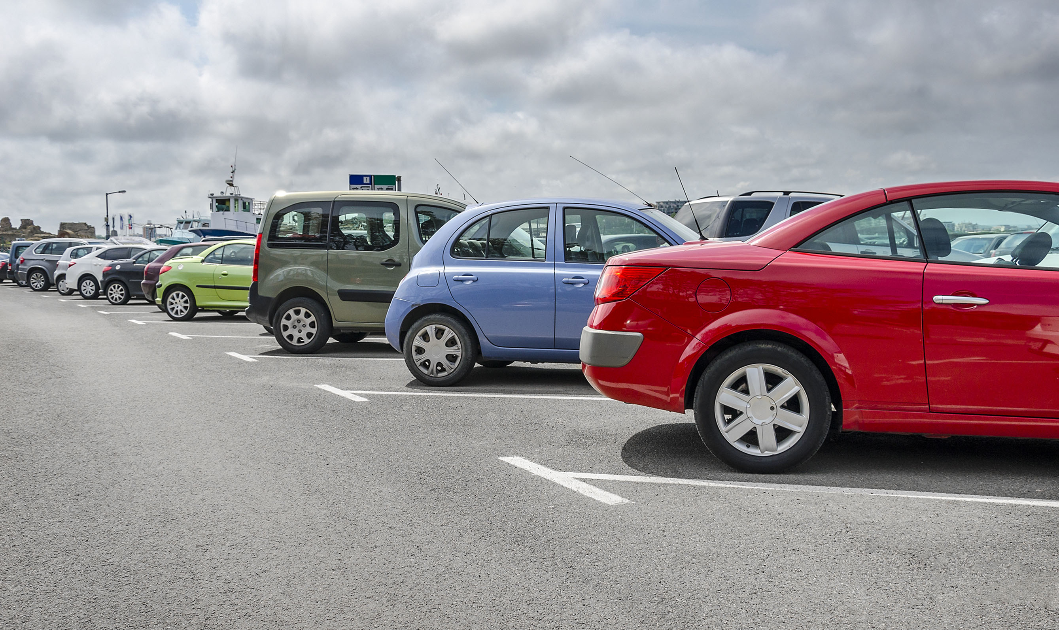

Glasses #1: Glaucoma
Notes:
Ask the participants to hold up glasses labeled #1.
Ask the participants what vision loss this simulates?
Click on the slide and you will see this is a simulation of glaucoma.
What problems did you have? Tunnel vision? Diminished peripheral vision?
There is a constant production of fluid within the eye and drainage off of this fluid. Glaucoma is caused by obstruction of eye drainage which results in increased pressure within the eye, this causes damage to the optic nerve. Can you understand why an older person might cut in front of you in traffic? It is because you are not in their field of vision. The extent of tunnel vision depends on when the diagnosis (of glaucoma) was made and the effectiveness of treatment. It is important to be identified early in the course of the disease to limit damage. Eventually, these individuals may be considered legally blind. Yet they may fool you and observe something you may have overlooked—such as a brown animal cracker on a brown rug. This occurs only if the article is within their central vision.

Slide 8


Glasses # 2: Macular Degeneration
Notes:
Ask the participants to hold up glasses labeled #2.
Ask the participants what vision loss this simulates?
Click on the slide and you will see this is a simulation of macular degeneration.
Glasses #2 simulate macular degeneration. Hardening and obstruction of the retinal arteries cause macular degeneration. This is the opposite of glaucoma: individuals have peripheral vision, but lack central vision.
This may occur in one or both eyes. These individuals may also become legally blind. Magnifying glasses are sometimes helpful to them. Laser surgery techniques also may be helpful. In some circumstances, screening for this condition helps identify individuals who may benefit from laser surgery.

Slide 9

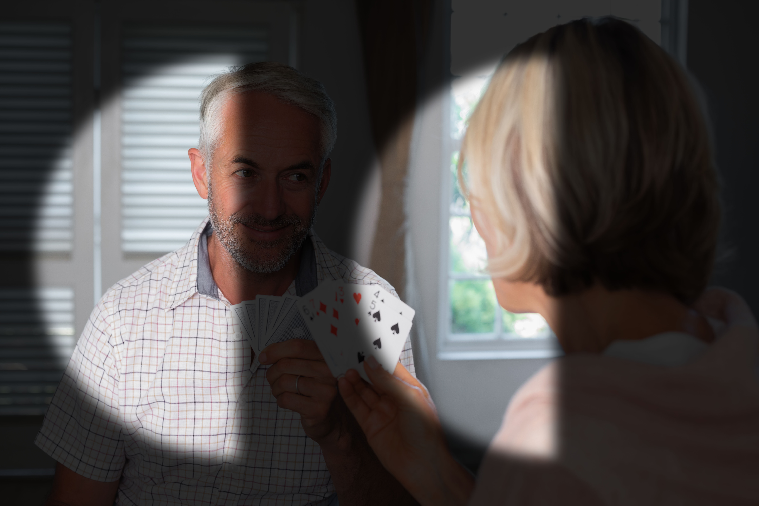
Glasses # 3: Stroke
Notes:
Ask the participants to hold up glasses labeled #3.
Ask the participants what vision loss this simulates?
Click on the slide and you will see this is a simulation of hemianopsia. (hem·i·a·nop·si·a)
With glasses #3, what did you experience?
Glasses #3 simulate hemianopsia. This may be caused by a stroke. What did you experience? You lacked vision on one side—you are blind in part of both eyes.
Usually when you walk into a room and speak to someone who is not looking in your direction, that person will turn your way. However, if this is the side on which the person is blind, you do not exist; therefore, the person will look ahead. If you placed a dish of food in front of people with this problem, they may eat everything but the vegetables. Naturally, you might conclude that they didn’t like the vegetables; when, in fact, they simply may not have been in their field of vision. In the hospital, these individuals are taught to “scan” to the right or the left to compensate for this optical deficit. Some follow through with this technique better than others. If we don’t know the person and this happens, we may perceive that they are ignoring us. In their attempt to scan the blind side, they may turn their head in a fashion that we might interpret as odd behavior.
All vision losses demonstrated thus far were disease processes that occur as we grow older. They may happen or they may not.
The next two vision simulations are a normal process of aging, so they will happen to us as we age.

Slide 10


Glasses # 4: Cataracts
Notes:
Ask the participants to hold up glasses labeled #4.
Ask the participants what vision loss this simulates?
Click on the slide and you will see this is a simulation of cataracts.
What problems did you have? Cloudy or blurred vision? If you held the game card very close to your eyes you could see better?
How did you do tracing the numbers? Those numbers were in bold print, so they were easier to see. Any type of glare creates a blind area for individuals with cataracts.
The clear picture illustrates how you view the scene; while the other picture illustrates how an older person with cataracts sees it.
Cataracts are a normal process of aging.
Research shows that excessive exposure to sun and smoke can cause cataracts. Therefore, one should wear sunglasses to filter the sun’s rays.

Slide 11

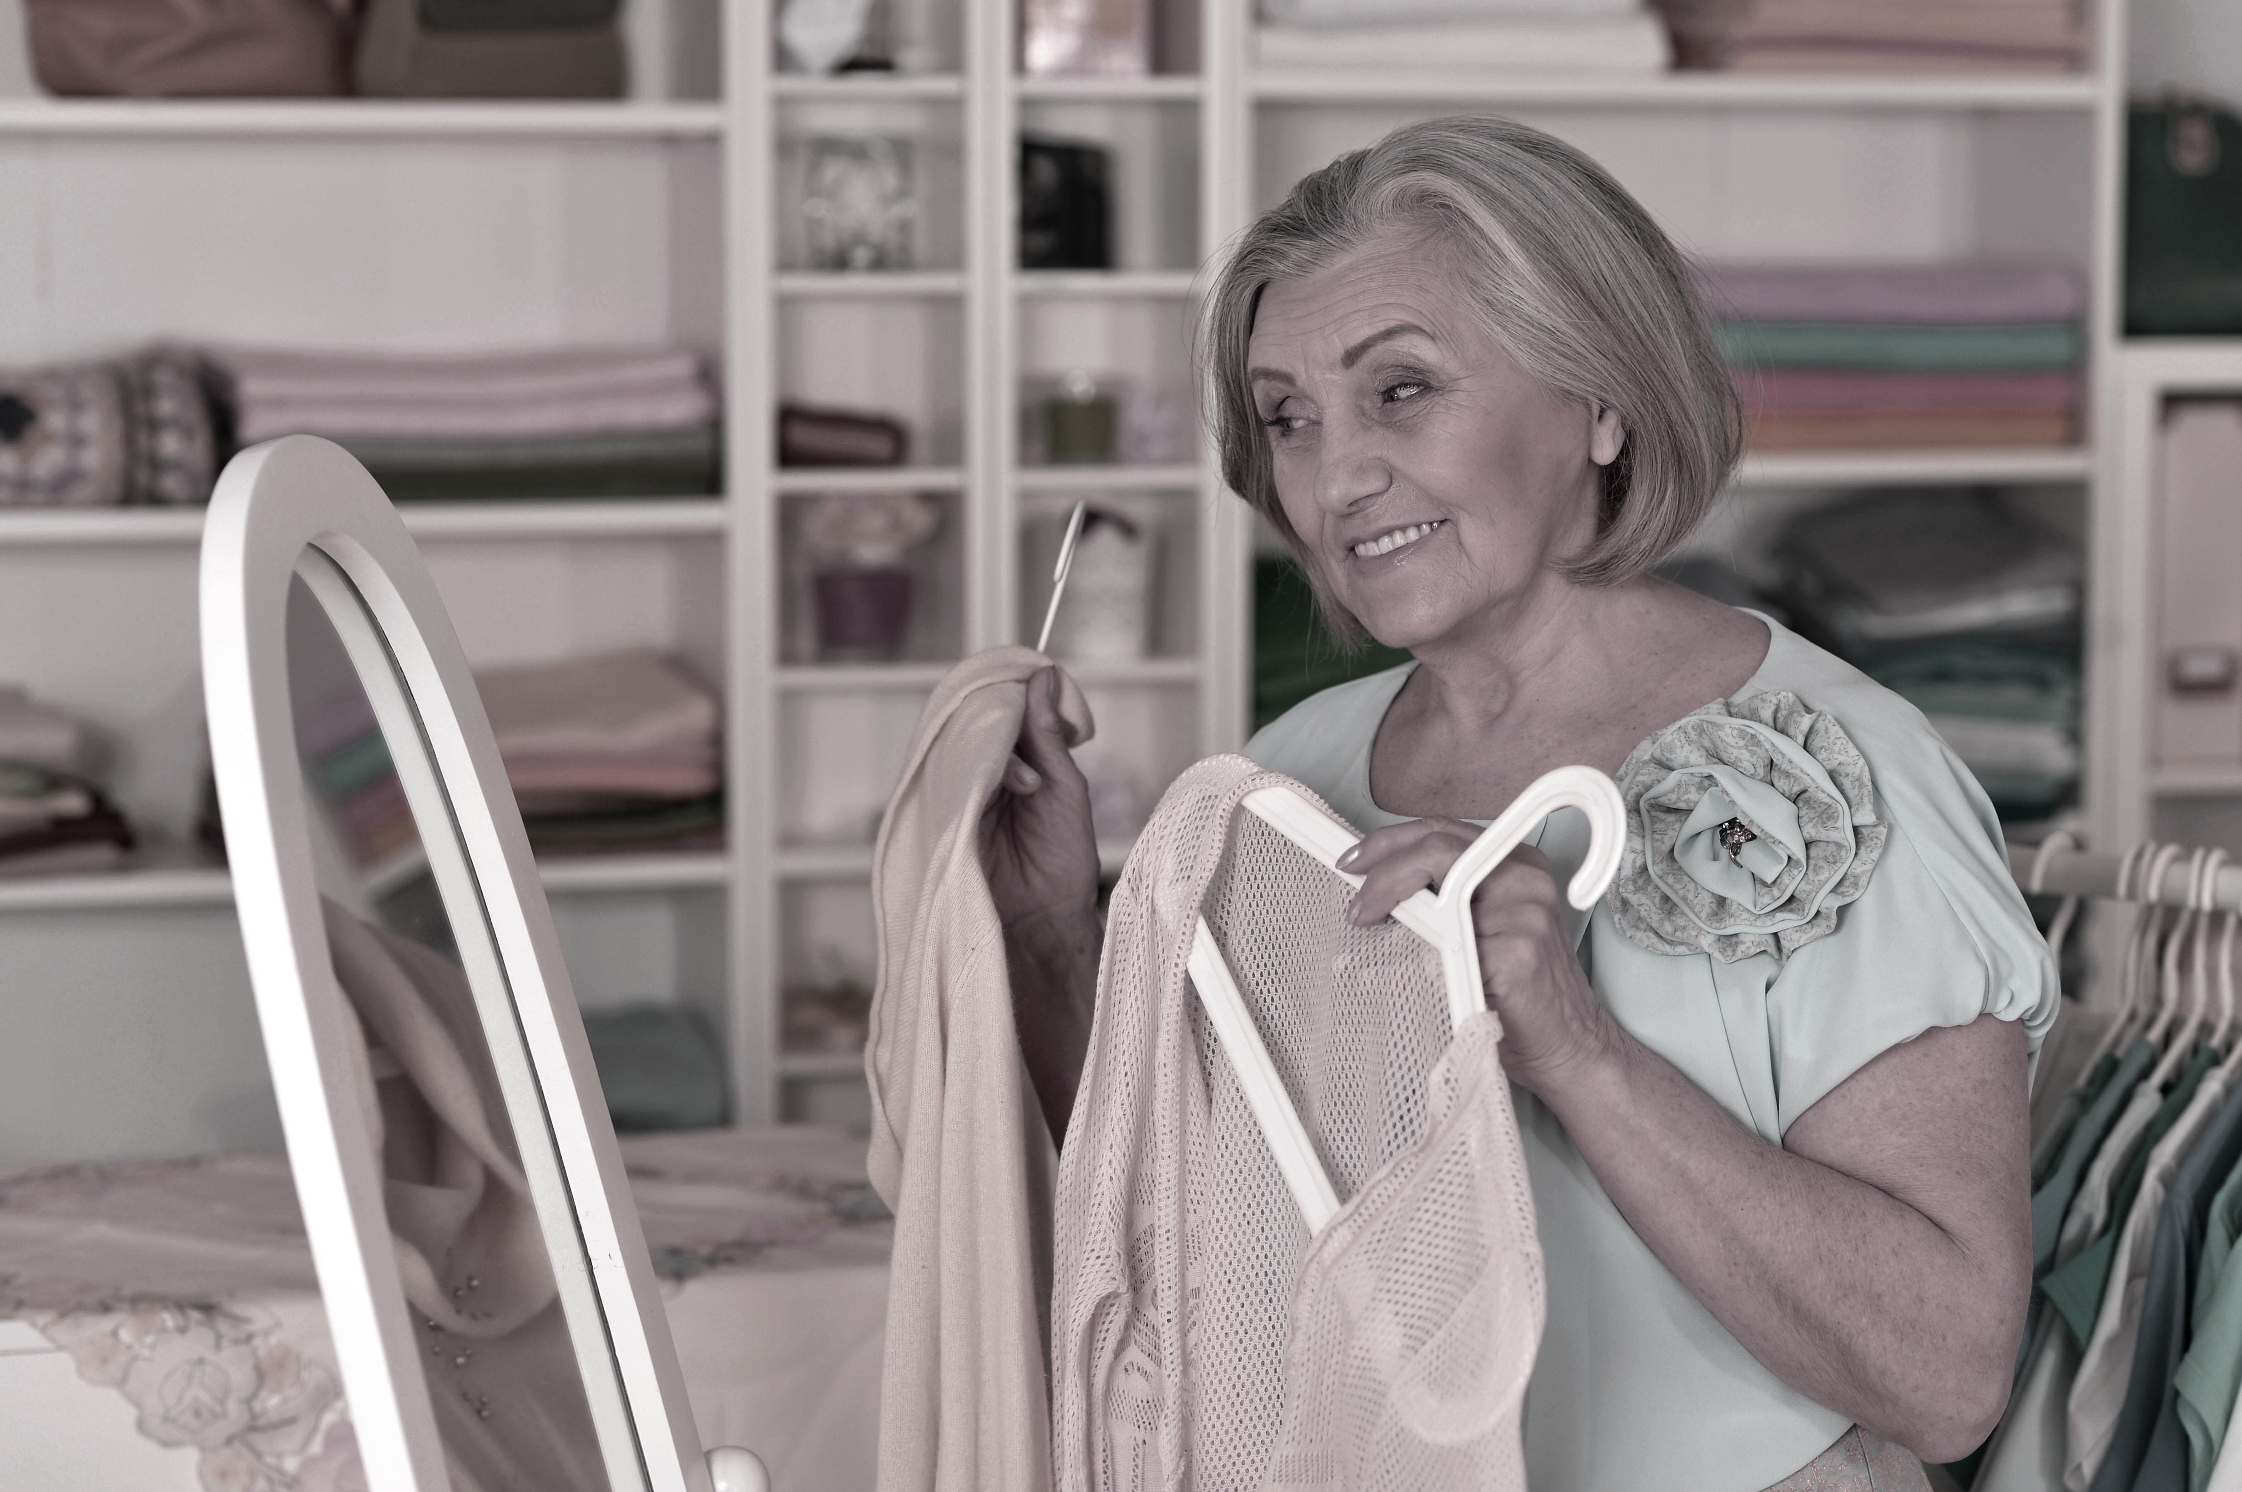
Glasses # 5: Yellowing of the Lens
Notes:
Ask the participants to hold up glasses labeled #5.
Ask the participants what vision loss this simulates?
Click on the slide and you will see this is a simulation of yellowing of the lens.
What problems did you have?
This impairment will affect all of us.
Many times we identify medications by their color. What problems did you encounter in identifying pills by their color? Yellowing of the lens affects our perception of the colors in the blue-violet range. The blues and greens, and whites and yellows were difficult to differentiate. We need to encourage older adults to have a system for identifying their medications besides the color of the pills.
Also keep in mind if you are making any kind of signage or fliers for older adults do not use blue’s and greens together as they are difficult to differentiate. You normally would not use white and yellow as they are not contrasting colors.

Slide 12



Examples of depth perception and how it relates to fall prevention
Notes:
Before we discuss how to meet these challenges, I would like you to view a few slides that illustrate additional vision loss that could not be simulated any other way.
Here are some examples of environmental hazards that may lead to falls.
As a person ages, his perception of depth diminishes. As a result, a person may have problems knowing when—or how far—to step up to avoid stumbling.
What is the picture on the left? Notice the color of the curb stop is nearly identical to the color of the pavement. These are very hazardous to people walking in parking lots as they are difficult to see.
The picture of the stairs is another good example of a fall hazard for people who have diminished depth perception. As a person becomes older, his perception of depth diminishes. As a result, a person may have problems knowing when – or how far – to step down.
The picture on the right is an uneven part of a sidewalk, Notice it is difficult to see that it is uneven.
We recommend using bright red or yellow tape to help people judge height of stairs or steps.
As you approach the age of 40, you will start noticing that your arm is no longer quite long enough to read print clearly. Also, you may begin to find it difficult to change focus quickly from one area to another.
Falls are a leading cause of death in our older adults. Many times it is the complication of the fall that causes death and not the actual fall. Let’s discuss what may happen after a fall occurs: possible fracture, surgery, hospitalization. A slower recovery process and often times depression and inactivity. For a senior the fear of falling is very real and may prevent them from staying active and engaged.

Slide 13

Depth Perception and Driving
Notes:
Another visual change of accommodation is the ability of the eye to focus on objects at varying distances.
This picture depicts depth perception while driving.
Does the person have enough time to safety make the left hand turn?
The following content excerpted from: Centers for Disease Control and Prevention, National Center for Injury Prevention and Control, and Division of Unintentional Injury Prevention.
In 2012, more than 5,560 older adults were killed and more than 214,000 were injured in motor vehicle crashes. This amounts to 15 older adults killed and 586 injured in crashes on average every day.
There were almost 36 million licensed older drivers in 2012, which is a 34% increase from 1999. Per mile traveled, fatal crash rates increase noticeably starting at ages 70–74 and are highest among drivers age 85 and older. This is largely due to increased susceptibility to injury and medical complications among older drivers rather than an increased tendency to get into crashes.
Age-related declines in vision and cognitive functioning (ability to reason and remember), as well as physical changes, may affect some older adults’ driving abilities.
Briefly discuss your community’s public transportation; be sure to include door-to-door transportation for people who are unable to walk to a bus stop.
There are many driver safety courses available that teach seniors how to adapt to some of these age related changes to keep them driving safely.

Slide 14

Glare and Lighting Challenges
Notes:
Light is another problem encountered by the older person. Their pupils are slower to respond to the changes in light. Adjusting from sunlight to darkness, or vice versa, takes longer than for younger people.
At night, the headlights of oncoming traffic can cause temporary blindness. In similar fashion, they experience an exaggerated amount of glare from sunlight shining in a window onto a highly polished floor.
The older person also needs 2-3 times more lighting to read than a teenager does.

Slide 15
Meeting the Vision Challenges
• Avoid glare areas, use blinds
• More light on signs
• Use large print for handouts and signs
• Bold print for publications
• Use night lights to reduce fall-related incidents
• Avoid printed materials in the blue-green-violet color range
• Use yellow background with red print
• Placemats or tablecloth in contrasting color from tableware
• Have curbs, edges of steps, handrails, and door knobs marked in contrasting colors
• Stand close to the older person, use touch
• Utilize high intensity light for reading areas
• Use roadways with more than one lane of traffic at night.
Notes:
Age-Related Vision Changes and Challenges
In summary, as we age, we can expect the following changes:
• Decreased ability to see objects clearly.
• Decreased ability to focus on objects at varying distances.
• The need for more lighting in order to function.
• Decreased ability to perceive depth.
• Slow accommodation to changes in light sensitivity.
• Decreased ability to discriminate colors in the blue-violet range.
Address challenges with vision loss by:
• Avoid glare areas, use blinds
• More light on signs
• Use large print for handouts and signs
• Bold print for publications
• Use night lights to reduce fall-related incidents
• Avoid printed materials in the blue-violet range
• Use yellow background with red print
• Placemats or tablecloth in contrasting color from tableware
• Have curbs, edges of steps, handrails and door knobs marked in contrasting colors
• Stand close to the older person, use touch
• Utilize high intensity light for reading areas
• Use roadways with more than one lane of traffic at night
You may wish to ask the participants to make suggestions for changing their environment to meet the challenge of vision loss.
Regular eye doctor appointments is encouraged to maintain the quality of your vision. Older adults should have their vision tested every year.

Slide 16
Understanding Hearing Challenges
Click here for hearing loss simulator
1. Listen to first segment and share what you hear.
2. List the different menu items that are discussed.
The website provided by
Starkey Hearing Technologies
Notes:
Next, you will experience changes in hearing.
Click on the link provided in the PowerPoint. The following website is provided by Starkey Hearing Technologies.
If you have not done this yet, adjust the volume on your computer so it is at a comfortable level.
Begin by clicking on the leaf and select moderate hearing loss.
Ask the participants to tell you what was being said.
Now, click on the leaf and select normal hearing to hear the difference.
Next, click on the coffee cup and select moderate hearing loss.
Have the participants complete the following exercises and questions:
List the different menu items that are discussed.
What noises could you hear in the background?
Now click on the coffee cup and select normal hearing loss.

Slide 17
Meeting the Hearing Loss Challenges
Challenge
Pride
Is a gradual loss over time
Loses ability to hear high- frequency sounds
Hearing aids
Meeting the Challenge
Recognize there is a loss
Make eye contact
Slow your rate of speech
Enunciate clearly
Get rid of background noise
Lower the tone of your voice
Keep phone receiver close to mouth
Teach back
Hearing aids/devices
Notes:
Hearing Loss challenges:
Understand the feelings of pride involved with hearing loss. Many people do not want to admit they have a hearing loss.
Most hearing loss is gradual. It is usually family members or friends who notice it first.
Most age-related hearing loss is the inability to hear high-frequency sounds.
Hearing aids
Meeting the Challenge:
In order to communicate more effectively with the person who has a hearing loss:
• Recognize there is a loss. This is the key to enhancing the communication process and efficiency. Once you know someone is hearing-impaired, you can adapt to improve the communication process.
Ask your participants what cues may suggest someone is hearing-impaired.
Cupped hand behind the ear.
Huh? Please repeat yourself?
Speaking loudly or softly.
Volume level of TV or radio.
Lack of response to a question or inappropriate response.
• Face the person to whom you are speaking to allow them to read your lips
• Slow your rate of speech
• Enunciate your words clearly
• Get rid of background noises
• Lower the tone of your voice, They hear male voices better than females. So deepen you voice and you will be heard better.
• When talking on the phone to someone make sure you keep the receiver of the phone close to your mouth.
• Use teach-back method: Ask the person to repeat back to you the information you just shared with them.
• Employ hearing aids and devices. Hearing Aids are wonderful technology that improves many people’s quality of life. Discuss various reasons people do not using hearing aids – cost, don’t fit well, vanity, difficult to use in public settings as hearing aids amplify all noises.
• Keep sentences short and simple. If you have questions, keep them brief. Also, give instructions in short phrases, e.g., “turn on your right side.”
Noise
Older adults do not recognize how significant the hearing loss is because hearing loss is often a very slow process, and they have compensated with lip reading. It is typically family members or friends who notice the hearing loss first.
If these individuals do have hearing aids, they may leave them at home or in their purse. Some people are vain and don’t want others to be aware of their hearing loss. Most individuals with hearing loss don’t wear a hearing aid because they become frustrated re-learning how to ignore the background noises that are now very sharp.
Loss of hearing may result in social withdrawal. People with hearing loss may be embarrassed when they answer questions inappropriately, for instance. You may ask someone what they had for breakfast, and they respond by saying their address. Most hearing impaired people will respond to what they thought they heard.
Pitch
The male voice is usually easier to hear, because it is lower in pitch. When hearing begins to diminish, the high-frequency sounds are the first to be lost. So, what do we do when someone has trouble hearing? We speak louder, which usually results in increasing the high frequencies. The person on the receiving end usually responds with, “Why are you shouting? I’m not deaf!” Lowering the pitch of your voice may make it easier for hearing-impaired people to hear you.
Consonants
Since consonants are usually in the higher-frequency range, they are harder to hear. So you may be saying, “I love you.” But the person listening hears, “I oe ou.”

Slide 18
Understanding Dexterity Challenges
Here are some activities of daily living to try:
1. Attempt to take an item out of your pocket, wallet or purse.
2. Try to button/unbutton your blouse or shirt.
3. Take your jewelry on and off.
4. Untie and tie your shoes.
5. Put 4 pills in each of the 4 slots in the daily pill container.
Notes:
Materials:
Special gloves
Daily pill container
Special glasses
You can bring in some large button-up shirts that people can use to practice on.
Impaired manual dexterity: First, put on your gloves, for extra challenge have them also put on a pair of the special glasses.
Here are some other things to try:
• Attempt to take an item out of your pocket, wallet or purse.
• Try to button your blouse or shirt.
• Take your jewelry on and off.
• Untie and tie your shoes.
• Put 4 pills in each of the 4 slots in the daily pill container.
These are examples of activities that we perform daily.
You may also want to add some urgency to what the participants are doing to simulate the pressure that some of our seniors feel.
For instance, if someone is trying to button his or her shirt, in a loud hasty voice tell them: “Hurry up! We do not have all day!”
Ask participants to share their experiences. How did they have to compensate?

Slide 19
Understanding Dexterity Challenges
Impaired Manual Dexterity
Stiff joints
Decrease in range of motion
Arthritis
Decrease in strength
Decrease in circulation in extremities
Lifestyle changes in appearance
Notes:
Stiff Joints
As people get older, their fingers, feet, knees and elbows can begin to feel stiff.
You probably guessed that the gloves simulated arthritis. Remember, there are people who have arthritis of the hands, even if they show no outward sign of deformity.
Now when you see people having problems removing money or credit cards from their wallet, or if they are very slow in the process, you will know how they feel.
Weakness in Joints and Decrease in Strength
Typically, age-related loss of muscle tone is largely related to lack of use and exercise. The term “don’t use it and you will lose it,” speaks directly to this issue. If you stop raising your arms straight up over your head, your shoulder joint will become stiff and you will no longer be able to do it.
No matter what age, we need to encourage seniors to stay active and exercise to their greatest ability.
As muscles get weaker, it becomes more difficult to lift heavy objects or perform other activities that require strength. The less muscles are used, the weaker they become.
An example of how this impacts older adults: They may have trouble getting out of an overstuffed sofa or chair; and they fall and hurt themselves.
Lack of Sensation
As we age, our peripheral circulation diminishes. That is why the nerve endings at our fingertips are not as sensitive to touch as they once were. This affects our sensitivity to temperature. An older person may leave his or her hands on a hot item too long and receive a severe burn (for instance, a heating pad). Other times, a person may bump a limb without knowing it because he or she did not feel the pain. Both of these are consequences of diminished sensations. It may also affect how we grasp things, such as a glass or cup.
Lack of dexterity can also change the way we look and feel. We may not wear the clothes we have always worn because we cannot manipulate the buttons or zippers. The fear is that seniors may stop engaging in activities and become isolated.

Slide 20

Meeting the Dexterity Challenges
Use the right tools
Encourage exercise and activity at any age and ability
Have patience and understanding
Offer to assist
Proper foot care
Notes:
Ask the participants what can be done in their environment to assist individuals with impaired dexterity.
The arthritic person is able to perform life’s daily tasks and activities by using adaptive equipment and allowing extra time for completion. This impacts the level of independence for individuals. To meet the challenge posed by dexterity impairment:
• Use “fatter” pens to aid writing.
• Use arthritic door levers.
• Encourage the use of assistive devices for tasks, such as opening jars or threading needles.
• Buy products and brands that are elder-friendly, such as Velcro and easy-to-open containers.
• When ordering prescriptions, you may ask for the non-childproof lids.
• Recommend daily exercise that includes strength training and flexibility exercises for people at all ages. There is much research available that shows strength training at any age improves quality of life and reduces fall related incidents and increases functional independence.
• Often times we may be in a hurry so we rush in to do something for someone if we feel it is taking too long. In order to help maintain a person’s independence and self esteem it is important to ask if they would like assistance with a certain task. Be ok if they so “no thanks, I can do it, it just takes me longer”
• Avoid extreme temperatures in beverages (too hot or too cold).
• Clear pathways/hallways.
• Avoid rushing people if they want to complete the task themselves.

Slide 21
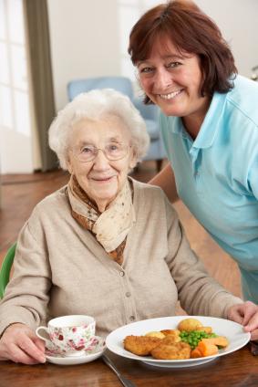
Understanding Loss of Taste
The aging process causes a loss in taste buds.
Diminished taste and smell may cause a decrease in appetite.
Certain medications may also affect our taste and smell.
Notes:
This is an optional activity
Materials:
Unsalted crackers
Unsalted peanut butter
Unsalted potato chips
Unsweetened lemonade
Jars of baby food
Pre-plate food items.
Have participants sample each of the food products being used.
Ask participants to describe the taste of the food and whether it was desirable.
How did it taste? Did it make you want to eat more?
Meeting the Challenge
Loss of taste/smell: Part of the aging process results in the loss of taste buds. That is why older people may feel the need to salt or sweeten food more than others. Sometimes, by this point in life, they may have developed heart problems and are told to decrease their salt intake.
Diminished ability to taste and smell may cause a decrease in appetite. When you smell food cooking doesn’t it make your mouth water? It makes you think about eating.
Certain medications can also affect our sense of taste and smell.
Looking into an older person’s refrigerator, you may discover rotten food. It is very possible that the older person does not realize it is rotten. With loss of vision, they have no visual tip-off, and diminished smell and taste may not tell them, either. When you consider these factors, it is easy to realize that in our dealings with the older adult, our first impression may not be accurate.
One way to stimulate appetite is to hold food closer to the older person’s nose. The smell will promote salivation. Use a variety of herbs and spices to enhance the flavor of food.

Slide 22

Understanding Memory and Confusion Challenges in Aging
What may cause confusion or memory
problems in older adults?
Notes:
The importance of this phase of the program is to increase the participants’ awareness of the reversibility of some mental changes. Many times, mental changes are attributed to “old age,” thus implying they are irreversible.
Many of the factors of growing old that we have discussed may cause one to think of the older individual as confused. But there may be other reasons for a person not to appear normal.”
Ask the participants to list some factors that may cause confusion or memory loss in the older person.

Slide 23
Causes of Confusion or Memory Loss
Poor nutrition
Dehydration
Medications and/or alcohol
Infection – urinary tract infection or high fever
Thyroid problems
Head injury
Hardening of the arteries
Dementia
Alzheimer’s disease
Depression
Notes:
Review some of the most common causes of memory loss and point out the fact that some of these are treatable.
One important factor to mention is the interaction of alcohol and medications. The older generation often enjoys a social happy hour.
The challenge is that many people believe that significant memory loss and confusion are a normal part of aging. As you look at the list of causes, notice that many of these are treatable.
Infections – Urinary Tract Infections or High Fever
When someone has a serious infection, they expect to have a fever. But as one grows older, there is a decrease in white blood cells, as well as in body temperature. These factors prevent fever from occurring as quickly as it did when one was younger.
When a person has pneumonia, the amount of oxygen received by the body (and therefore, the brain) is decreased. Thus, the individual will be confused. Other disease processes, such as stroke, diabetes and hypothyroidism, will also initially exhibit the symptom of confusion. These disease processes interfere with the functioning of brain cells. Once the disease process is treated or controlled, the person is mentally clear, provided the condition has not existed for too long.
Alcohol and Medication Toxicity
Medication interactions can also cause confusion. Alcohol, as well as a change in water/fat ratio, can contribute to medication retention in the system. This can result in drug toxicity.
The intake of alcohol on a daily basis, even though it may be only one glass of wine or two cocktails, may interfere with the amount of medication needed to achieve a therapeutic effect.
Many elderly people do not comply with a doctor or pharmacist when taking medication. Some are known to put all their medications in one bowl and take the prescribed number of pills, which may mean several of the same pills at one time.
Note: Dementia, Alzheimer’s and depression will be discussed in the next couple slides.

Slide 24
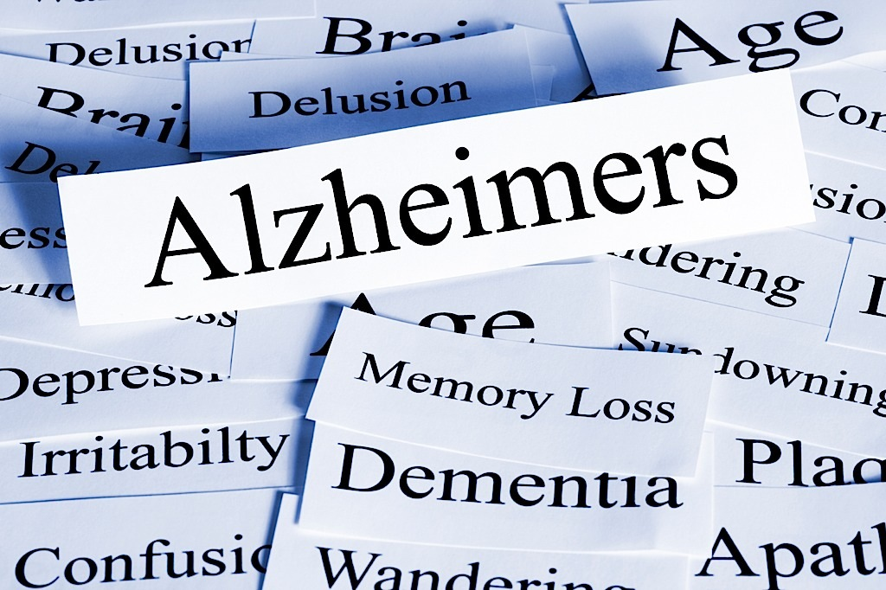
Dementia and Alzheimer’s
Senile dementia is progressive and irreversible.
Most older adults are afraid of the A word.
Importance of early medical assessment and treatment.
Local resources and support are available.
Notes:
Dementia and Alzheimer’s
Senile dementia is another organic mental disorder, but one in which progressive deterioration of brain cells occurs. This process progresses gradually. It is irreversible.
Alzheimer’s disease is caused by the destruction of nerve cells deep in the cerebrum. Think of a nerve cell as a tree with the branches of the tree communicating (touching) with other trees (cells). With Alzheimer’s disease, the branches shrivel up, preventing communication.
One of the first symptoms of dementia is memory loss. All of us have walked into a room and forgotten the purpose of the trip. We blame it on sensory overload—too much on our minds. As we get older and this happens, we may assume it is senility. But the type of memory loss associated with dementia differs from temporary forgetfulness, as it occurs more frequently. Initially, once a month, then once a week to almost daily.
Many times, memory loss is so gradual that only in retrospect will families recall this occurring within the last year.
It is important to note that most people are afraid of the “A” word, Alzheimer’s disease. However, research supports the fact that early detection and treatment may prolong the quality of the individual’s memory. There is no cure yet for this illness.
It is imperative that an appointment with a medical professional is conducted and that resources and support are provided. Please research local resources or reach out to national organizations for additional information and support.
Discuss resources available in your area for confused individuals lacking a support system.
The challenge is that most people believe that significant memory loss and confusion is a normal part of aging. As you look at the list of causes you will notice that many of these are treatable.
Is depression common in older people?
Lets take a closer look at depression

Slide 25

Understanding Depression
1. Cause of depression
Losses of
a) Friends
b) Family
c) Finances
d) Self-esteem
e) Self-image
Diagnoses of
Depression
Notes:
Depression is very common in the older population.
A functional mental disorder cannot be explained by a physical cause because there are no changes in the brain.
A number of factors may contribute to depression. One of them is loss. The older person experiences many losses later in life. These may include the loss of family, friends or even pets, due to death or relocation.
Also, finances may change, forcing the older person to adapt to a fixed or limited income. Loss of work is another precipitator of depression. Having a job gives people a sense of purpose and feelings of self-worth.
Upon retirement, these feelings of self-esteem often are lost. Many former workaholics feel hopeless and useless trying to cope with leisure time because it is something unfamiliar to them. With time on their hands, they are at a loss regarding what to do with themselves.
If they now have Parkinson’s disease, a stroke, cancer or the aging-related changes we discussed previously, they are not the person they used to be. There is a loss of self-image.
Diagnosis of Depression
How does the doctor decide if a person is depressed? Observing the individual’s appearance and taking a thorough history usually reveals many of the losses we have discussed. A thorough physical should also be part of the examination in order to rule out any disease process that could be causing listlessness. Many older people deny being depressed, thinking this implies they may be crazy.
There is a significant difference between the older generation and younger generation when it comes to asking for help with anxiety or depression. The older generation feels as though they can handle it, and do not want to admit they need help. They are not comfortable taking medications for anxiety or depression.
Oftentimes, it is family members who let the physicians know that mom or dad is acting depressed.
Treatment of Depression
Depression is a reversible disorder. Many times, “people therapy” is the answer. Getting the individual out of the house and around other people may be immensely beneficial. Visiting a counselor—someone who can listen objectively—may also be helpful. Medications are used as a last resort, except when the depression stems from a chemical imbalance.
Ask participants to list treatment options for depression.
They should come up with: people therapy, medications, counseling, exercise, engaging activities, etc.

Slide 26
Communicating With a Confused Person
Identify yourself
Call the person by name
Use short, simple words and sentences
Speak slowly and distinctively
Patiently wait for a response
Repeat questions as needed
Turn questions into answers
Avoid confusing or vague statements
Turn negatives into positives
Give visual cues
Avoid saying “Do you remember when?”
Treat the person with dignity and respect
Notes:
How to communicate with confused older adults -
The following techniques may prove helpful in keeping the confused individual calm. This is also available as a handout.
Identify yourself. Approach the person from the front and say who you are. Keep good eye contact. If the person is seated or reclined, go down to that level.
Call the person by name. This helps orient the person and gets his or her attention.
Use short, simple words and sentences. Lengthy requests or stories can be overwhelming. Ask one question at a time.
Speak slowly and distinctively. Be aware of speed and clarity. Use a gentle and relaxed tone—a lower pitch is more calming.
Patiently wait for a response. The person may need extra time to process what you said.
Repeat questions as needed. If the person doesn’t respond, wait a moment and then ask again.
Turn questions into answers. Provide the solution rather than the question. For example, say “The bathroom is right here,” instead of asking, “Do you need to use the bathroom?”
Avoid confusing and vague statements. If you tell the person to “Hop in!” he or she may interpret your instructions literally. Instead, describe the action directly: “Please come here. Your shower is ready.” Instead of using “it” or “that,” name the object or place. For example, rather than “Here it is,” say “Here is your hat.”
Turn negatives into positives. Instead of saying, “Don’t go there,” say, “Let’s go here.”
Give visual cues. Point or touch the item you want the individual to use or begin the task for the person.
Avoid quizzing. Reminiscing may be healthy, but avoid asking, “Do you remember when ... ?”
Write things down. Try using written notes as reminders.
Treat the person with dignity and respect. Avoid talking down to the person or talking as if he or she isn’t there.
This is courtesy of the Alzheimer’s Association website.

Slide 27
Aging Challenges Post-Test
Notes:
Distribute the post-test handout and give the participants a few minutes to complete.
The next two slides will be pre- and post-tests.
Verbally read the questions and ask for the correct response. Participants should answer based on their newly gained knowledge from the training and not how they answered on the pre-test.
Tell your participants not to change their answers on their test papers. This will provide you evidence to show that learning occurred during your presentation.
There is no need for them to put names on the test sheets—just do a percentage improvement from pre- and post-tests.

Slide 28
Aging Challenges Pre-Test
Significant memory loss is a normal part of aging.
At least 12 pt. font size is recommended for all print material for older adults.
Cataracts are a normal process of aging.
Most hearing loss in older adults is due to loss of high frequency sounds.
Loss of depth perception contributes to older adults susceptibility to falls.
Sunlight has no effect on the aging eye.
People become more grouchy and stubborn as they age.
8. The sense of touch is diminished as one grows older.
9. Depression is common in older adults.
10. Alzheimer’s Disease is the only cause of memory loss in older adults.
Notes:
AGING CHALLENGES PRE-TEST ANSWER KEY
1. Significant memory loss is a normal part of aging. False
2. At least 12 pt. Font size is recommended for print material for older adults. True
3. Cataracts are a normal process of aging. True
4. Most hearing loss in adults is due to inability to hear high frequency sounds. True
5. Loss of depth perception contributes to older adults susceptibility to falls. True
6. Sunlight has no effect on the aging eye. False
7. People become more grouchy and stubborn as they age. False
8. The sense of touch is diminished as one grows older. True
9. Depression is common in older adults. True
10. Alzheimer’s Disease is the only cause of memory loss in older adults. False

Slide 29
Aging Challenges Post-Test
1. Aging is a process of life.
2. The blue-violet colors are difficult to differentiate as one grows older.
Facing the older person and lowering the pitch of one’s voice maximizes being heard.
Contrast between objects and their surfaces increases visibility for older adults.
Significant memory loss is a normal part of aging.
6. When talking with someone hearing impaired, raise the tone of your voice.
Medications are the only treatment for depression.
Falls are a leading cause of death in older adults.
Older adults require less light than young people do.
10. Our culture identifies the value of older adults.
Notes:
AGING CHALLENGES POST-TEST ANSWER KEY
1. Aging is a process of life. True
2. The blue-violet colors are difficult to differentiate as one grows older. True
Facing the older person and lowering the pitch of one’s voice maximizes being heard. True
Contrast between objects and their surfaces increases visibility for older adults. True
5. Significant memory loss is a normal part of aging. False
6. When talking with someone hearing impaired, raise the tone of your voice. False
7. Medications are the only treatment for depression. False
8. Falls are a leading cause of death in older adults. True
9. Older adults require less light than young people do. False
Our culture identifies the value of older adults. False
The final question is a good discussion question. Take time to ask the participants why they answered the way they did. Oftentimes this is based on an individuals culture. Many Asian and Hispanic cultures have very different values when it comes to caring for the elderly. Some discussion regarding nursing homes versus at home care may also arise.

Slide 30
©Copyright 2017 Lee Health • All rights reserved
Notes:
Distribute and ask your participants to fill out the Program Evaluation before leaving.
Ask the Participants to put the simulation materials back in their kits.
Remember to clean your kits before your next training session.

