Slide 1
Strategic Action:
Creating and Communicating Vision in a Shifting Landscape
Presenters:
G. Matthew Pike, JD, NCC
Susan Cain, EdD, LCSW
Carolee Jackson, MA, PMP, CCP
Angela Belford, MS
NAHRO 2025 National Conference | Phoenix, AZ

Slide 2
Agenda
Developing the Plan: A 1-Year Case Study
Creating the Plan
Implementing the Plan
Communicating the Plan
Discussion/Q&A

Slide 3
Developing the Plan
G. Matthew Pike,
Cambridge Housing Authority

Slide 4

Strategic Planning at Cambridge Housing Authority
G. Matthew Pike
Director of Strategic Initiatives

Slide 5
Creating the Plan
Susan Cain,
Corporate Learning Institute

Slide 6
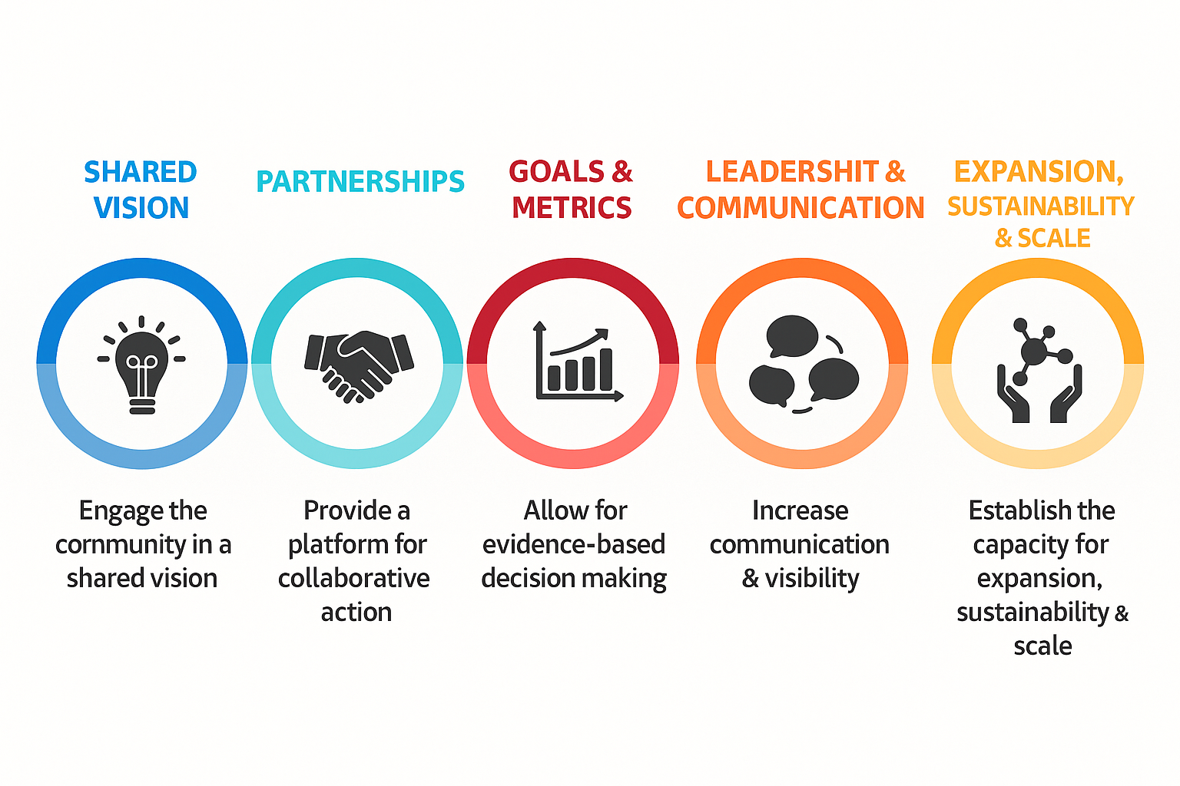
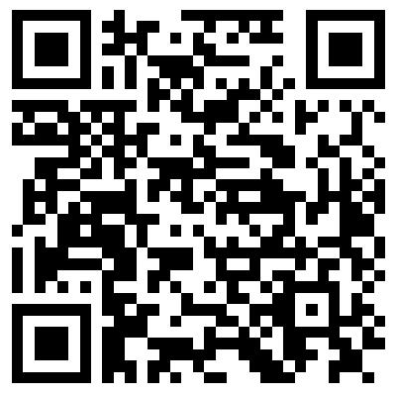
Strategic Planning Does Not Have to be Boring!
Introducing Visual, Experiential Strategic Planning

Slide 7

Traditional Strategic Planning
Needs an Upgrade!
Dense slides & marathon meetings
Low engagement, low follow-through
Fails in this world of turbulent change

Slide 8
The Solution:
Visual Experiential Strategic Planning
3 Core Elements:
Visual Tools
Interactive Facilitation
Experiential Learning

Slide 9
Why Visual?
Because Strategy Needs to Be Seen.
65% of us are visual learners
Our brains process visuals 60,000x faster than text
Visuals improve memory & focus

Slide 10
Why Experiential?
Because Learning by Doing Builds Ownership
Interact with ideas
Tell stories & reflect
Solve problems in real-time

Slide 11
Strategic Thinking Warm-Up
Try this!
Challenge assumptions, make inferences, and
test the value of collaboration
Breakout

Slide 12
Count the number of “F”s in the following sentence…
Don’t share your number.

Slide 13
FEATURE FILMS ARE THE RESULT OF YEARS OF SCIENTIFIC STUDY COMBINED WITH THE EXPERIENCE OF YEARS.

Slide 14
Try again.

Slide 15
FEATURE FILMS ARE THE RESULT OF YEARS OF SCIENTIFIC STUDY COMBINED WITH THE EXPERIENCE OF YEARS.

Slide 16
Did your number change?
Share your best ideas!

Slide 17
FEATURE FILMS ARE THE RESULT OF YEARS OF SCIENTIFIC STUDY COMBINED WITH THE EXPERIENCE OF YEARS.

Slide 18
How does this exercise expand our openness to co-creating strategy?

Slide 19
Visual/Experiential Learning
Three Core Values of Visual Experiential Learning
Clarity – Makes complex ideas visible and easy to understand.
Engagement – Hands-on methods spark creativity and ownership.
Alignment – Shared visuals build discussion and drive action.

Slide 20
Our Design:
Day 1: Reflections & Realities – Learning from Our Journey and Progress
Strategic Thinking Tools for our Uncertain World
Listening to Our Stakeholders: Survey Feedback
Themes From the Listening Sessions with Matt Pike
Auditing CHA’s 2018-2023 Strategic Plan
Tips for Designing the Future

Slide 21



Tools for Strategic Thinking

Slide 22
Tools for Reviewing and Strengthening Our
Last Strategic Plan

Slide 23
Our Design:
Day 2: Designing & Planning Our Shared Future
Activity: Mingle and Debrief
Innovation Strategy Sprint
Reviewing the Draft Strategic Goals for 2025–2029
Strategy Canvas Group Work: Building our 2025–2029 Plan
Presentations and Feedback
Final Wrap-Up & Reflection

Slide 24
Wrap-up & Reflections
Key Takeaways
Tools
Find out more at https://www.corplearning.com/nahro/

Slide 25
Implementing the Plan
Carolee Jackson,
Maiker Housing Partners

Slide 26

Maiker Housing Partners: Our Planning Journey

Slide 27
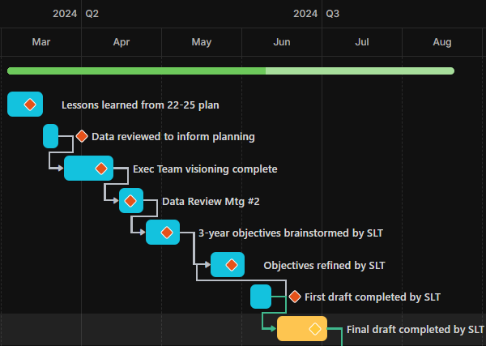
Process:
Reflection
Data
Feedback Loops
Notes:
Examples for organizing people and ideas, PM Software, RACI

Slide 28
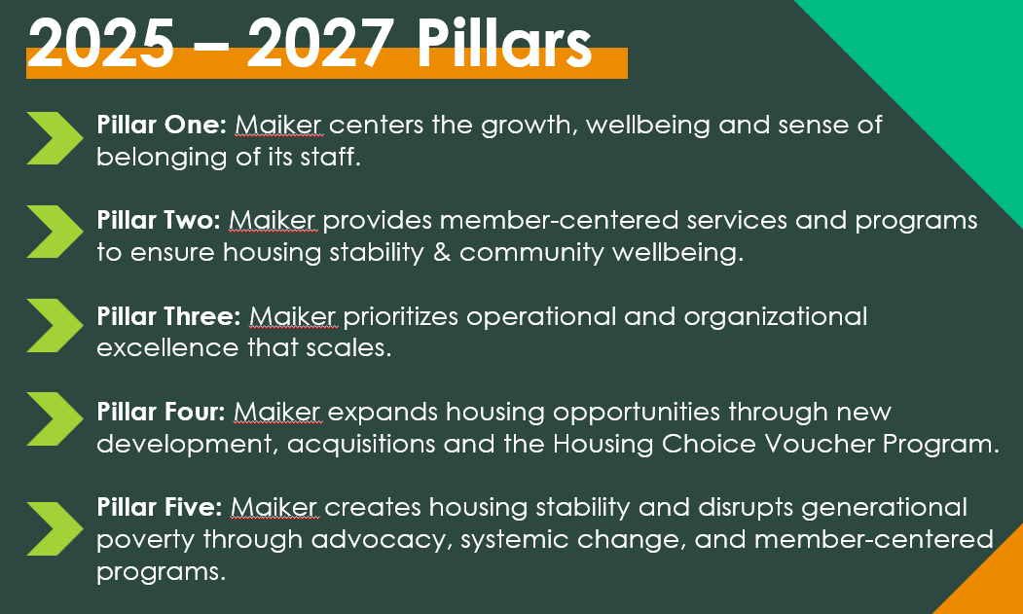
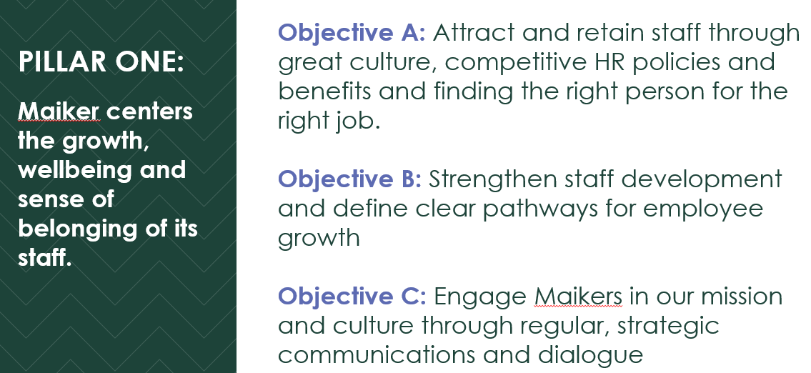
Taxonomy:
Pillars
Objectives
Targets

Slide 29

Keeping the Plan Alive
Prioritization and Resource Allocation
Annual Planning
Monthly Reports
Quarterly Reviews
Newsletters, Celebrations, Storytelling
“Sticky” Language
Notes:
Prioritization: Impact/Effort Mapping, Prioritization Criteria

Slide 30
Communicating the Plan
Angela Belford,
The Belford Group

Slide 31
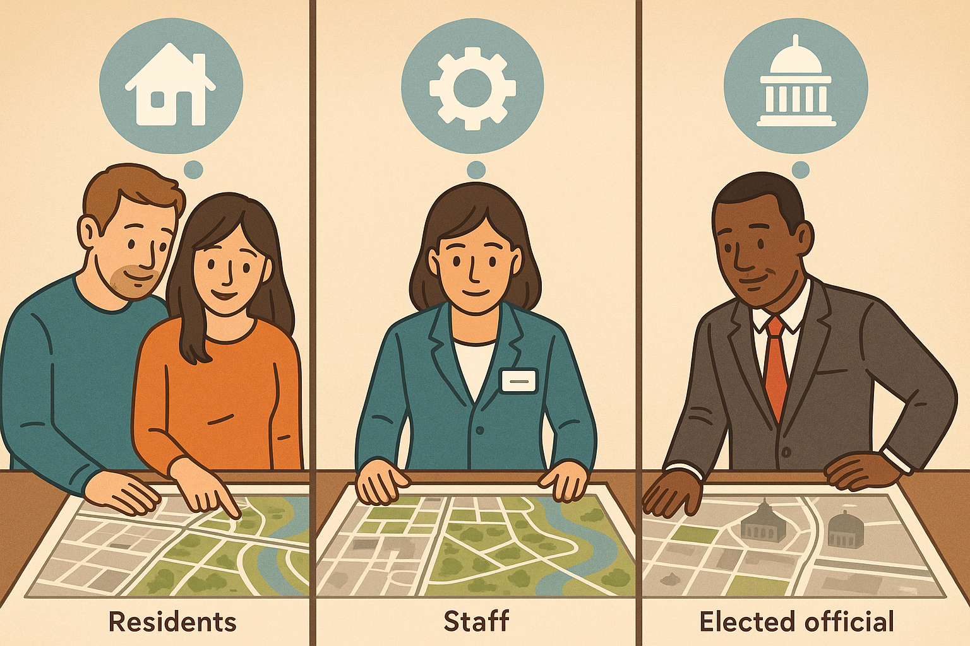
Same Plan. Different Perspectives.
Elected Officials → Outcomes
Partners → Collaboration
Staff → Daily Impact
Notes:
A strategic plan isn’t one-size-fits-all. People approach it through their own lens. Staff worry about what it means for their workload. Elected officials care about outcomes and budgets. Community partners want to know how it aligns with their goals. If you present the same message to all of them, most of it won’t land. Your first job is to recognize the perspectives in the room

Slide 32
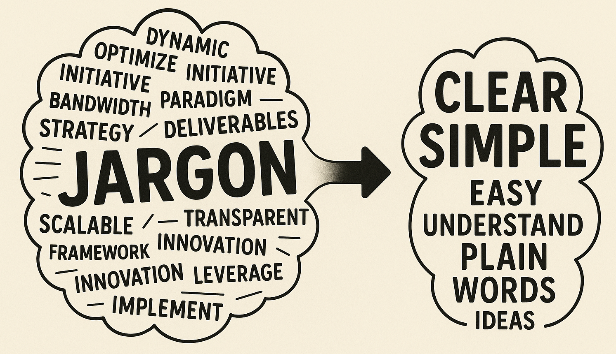
If They Don’t Get It, They Can’t Do It
Strategy language is often abstract and distant
Use plain, relatable words for each group
Example:
“Enhance operational efficiency” → “Make it easier for you to do your work”
“Build capacity” → “Give staff the tools, training, and support to serve residents well”
Notes:
Strategic language can sound impressive but feel meaningless. People can’t act on what they don’t understand. Just like we teach the Declaration of Independence differently to a 5th grader, a high schooler, or someone from another country, we must translate strategic goals into familiar terms for each audience. That’s how you turn buy-in into action.

Slide 33
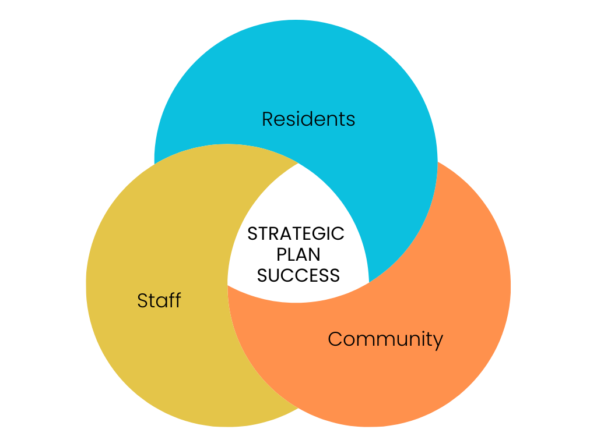
Residents → Community → Staff
Start with residents
Show community benefit
Communicate support for your staff
Notes:
When you’re unsure how to frame a message, follow this sequence. Lead with residents—this is who you ultimately serve. Then connect it to the broader community impact. Finally, emphasize supporting staff—because if you don’t care for your staff, they can’t care for the residents. This simple framework keeps everyone focused on why the plan matters.

Slide 34
Discussion/
Q&A

